Slide 1
Videos for Change
3. Getting Started
Notes:
This presentation and supporting materials are created as teacher resources for Videos for Change by High Resolves
Copyright © High Resolves 2018
Suggested timing: 10 minutes for teacher instruction, additional time needed for teams to research their social issue
Resources: Team Sheet (one per team of students) and/or blank paper (one per team of students)
Teaching and Learning Sequence
Explain that before creating their video the students should find out some more about their chosen social issue so that they can decide what information they want to include in their video.
HRES-VFC-00001-A-AUS

Slide 2
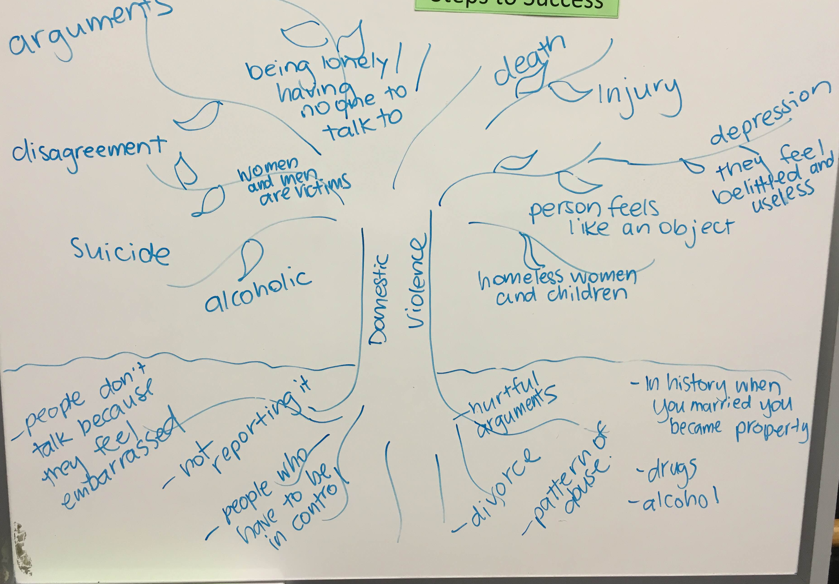
Effects
Social Issue
Causes
Click for fact packs
Notes:
Teaching and Learning Sequence
Suggest that each team, either on the back of their ‘Team Sheet’ or on some blank paper, draw their own ’Issue Tree’ for the social issue: with the trunk of the tree representing the social issue; the branches and leaves representing the effects of the issue; and the roots representing the causes of the issue.
Explain that the example on the screen is one created by a team of students who were researching the social issue of domestic violence and if appropriate point out that some of their research their ideas may be questionable (e.g. divorce is not always a cause of domestic violence, alcoholism is not always an effect of domestic violence).
Remind students that they can access some basic information about a range of social issues by following the link.
Encourage each team to focus only on one or two causes or effects of the social issue as this will help make sure that their video has a clear message and does not overwhelm their audience.

Slide 3


What do you want your audience to
THINK
FEEL
…after watching your video?
Notes:
Teaching and Learning Sequence
Explain that to make sure their video has a clear focus and is more likely to have an impact that each team chooses one or two key facts that they want their audience to know after watching their video and one emotion they want their audience to feel after watching their video.
Introduce the video on the next slide as a finalist in the 2017 Videos for Change challenge and ask the students to make a note of what the video was designed to make them think and how it was designed to make them feel.

Slide 4
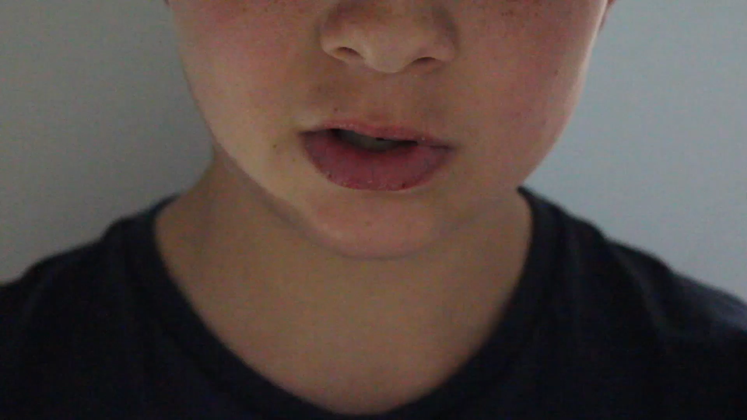
Notes:
Teaching and Learning Sequence
Goulburn Valley High School – Cyber Bullying video will play here automatically (1 minute 3 seconds).
The video can also be viewed at: http://www.highresolves.org/videosforchange

Slide 5
THINK
Notes:
Teaching and Learning Sequence
Ask the students what information the video contained that they are more likely to think about after having watched the video
Summarise the students’ responses

Slide 6
FEEL
Notes:
Teaching and Learning Sequence
Ask the students what emotions the video was designed to provoke
Summarise the students’ responses

Slide 7
Think
Feel
Notes:
Teaching and Learning Sequence
Suggest that each team, using their ‘Issue Tree’, identify the one or two key facts and emotions that they want to audience to know and feel after they have watched the video and write these on their copy of their ‘Team Sheet’.

Slide 8





Call to Action
What do you want people to do after they have watched your video?
Share your video
Show their support
Donate
Change their behaviour
Volunteer
Notes:
Teaching and Learning Sequence
Explain that now the students have more information about the issue, they need to decide what they want their audience to do after watching the video, their call to action. Go through the options displayed on the slide.
Ask each group to decide on one particular call to action that they want to include at the end of the video.

Slide 9


Call to Action
What do you want people to do after they have watched your video?
Change their behaviour
Notes:
Teaching and Learning Sequence
Use the social exclusion and the cyber-bullying videos that they just watched to highlight examples of ’Calls to Action’, which focus on changing behaviours.

Slide 10
Call to Action
After watching our video we want people to…
Share our video with others
Show their support by …
Change their behaviour by …
Donate to …
Volunteer with …
Notes:
Teaching and Learning Sequence
Give each group a couple of minutes to decide on their ’Call to Action’ and to record it on their own ‘Team Sheet’.
For teams that have chosen options other than ‘share our video’ encourage them to add specific details of what they want their audience to act after watching the video.

