Slide 1
Videos for Change
4. Planning your Video
Notes:
This presentation and supporting materials are created as teacher resources for Videos for Change by High Resolves
Copyright © High Resolves 2018
Suggested timing: 20 minutes for teacher instruction, additional time needed for teams to create their storyboard
Resources: Storyboard (one per team of students); Shot Types (one per team of students)
Teaching and Learning Sequence
Introduce this session as being about planning their video including working out the script and/or storyboard.
HRES-VFC-00001-A-AUS

Slide 2

Videos for Change
What does the video make you think?
What does the video make you feel?
What is the ‘Call to Action’?
Notes:
Teaching and Learning Sequence
Introduce the video on the next slide as being a finalist in the 2017 Videos for Change challenge and ask students to consider the three questions on screen whilst watching the video.

Slide 3

Notes:
Teaching and Learning Sequence
Hillcrest Christian College - Mental Health video will play here automatically (1 minute 13 seconds).
The video can also be viewed at: http://www.highresolves.org/videosforchange

Slide 4
Videos for Change
What does the video make you think?
What does the video make you feel?
What is the ‘Call to Action’?
Notes:
Teaching and Learning Sequence
Check for the students understanding of the video, covering the following points:
The video is designed to make viewers think about the effects of mental health on young people
The video is designed to make viewers feel that mental health can have life-changing, negative effects for people just like them
The video is designed to inspire the audience to seek help or learn more about mental health

Slide 5
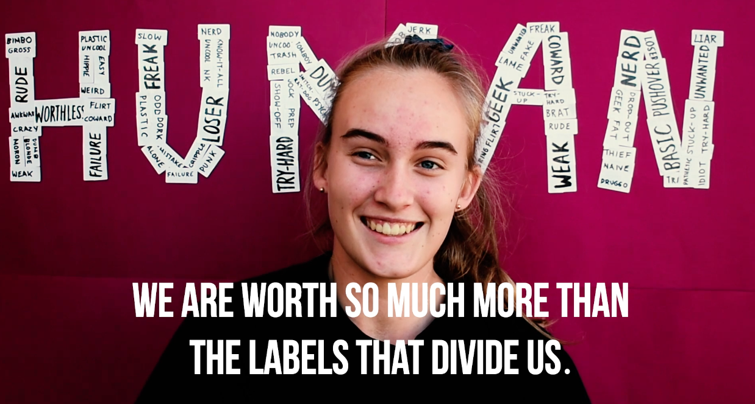
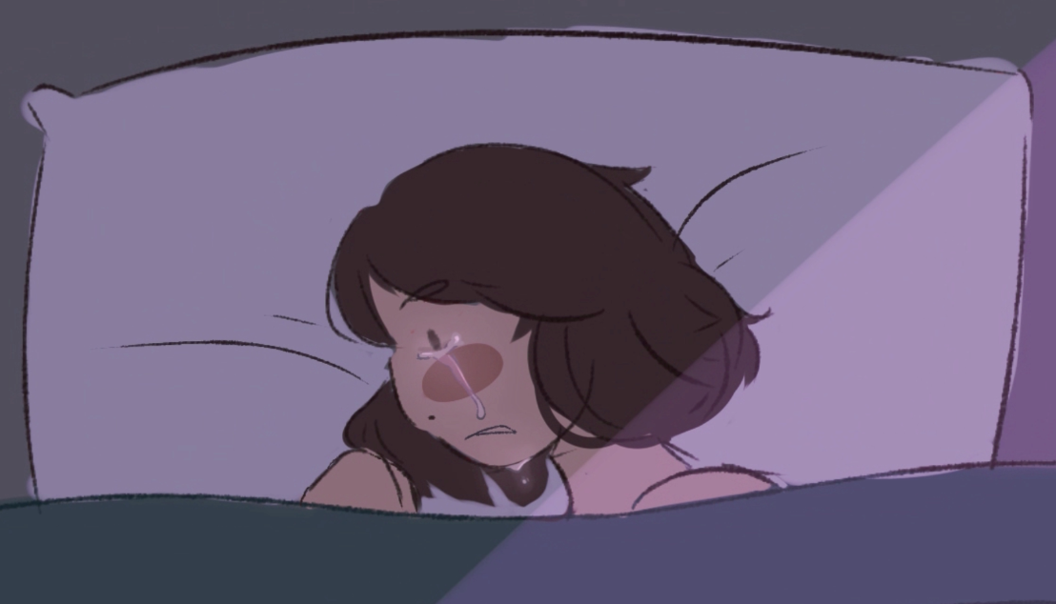

Choose a style of video
Live action
Animation
Still images and text
Notes:
Teaching and Learning Sequence
Introduce three different basic types of video that the students can choose to make: live action, animation, a series of still images and text.
Suggest that each type has its own pros and cons and they should choose one that best fits their needs and the equipment and expertise that they have.
Reassure students that no one style is more likely to win the Videos for Change challenge.

Slide 6
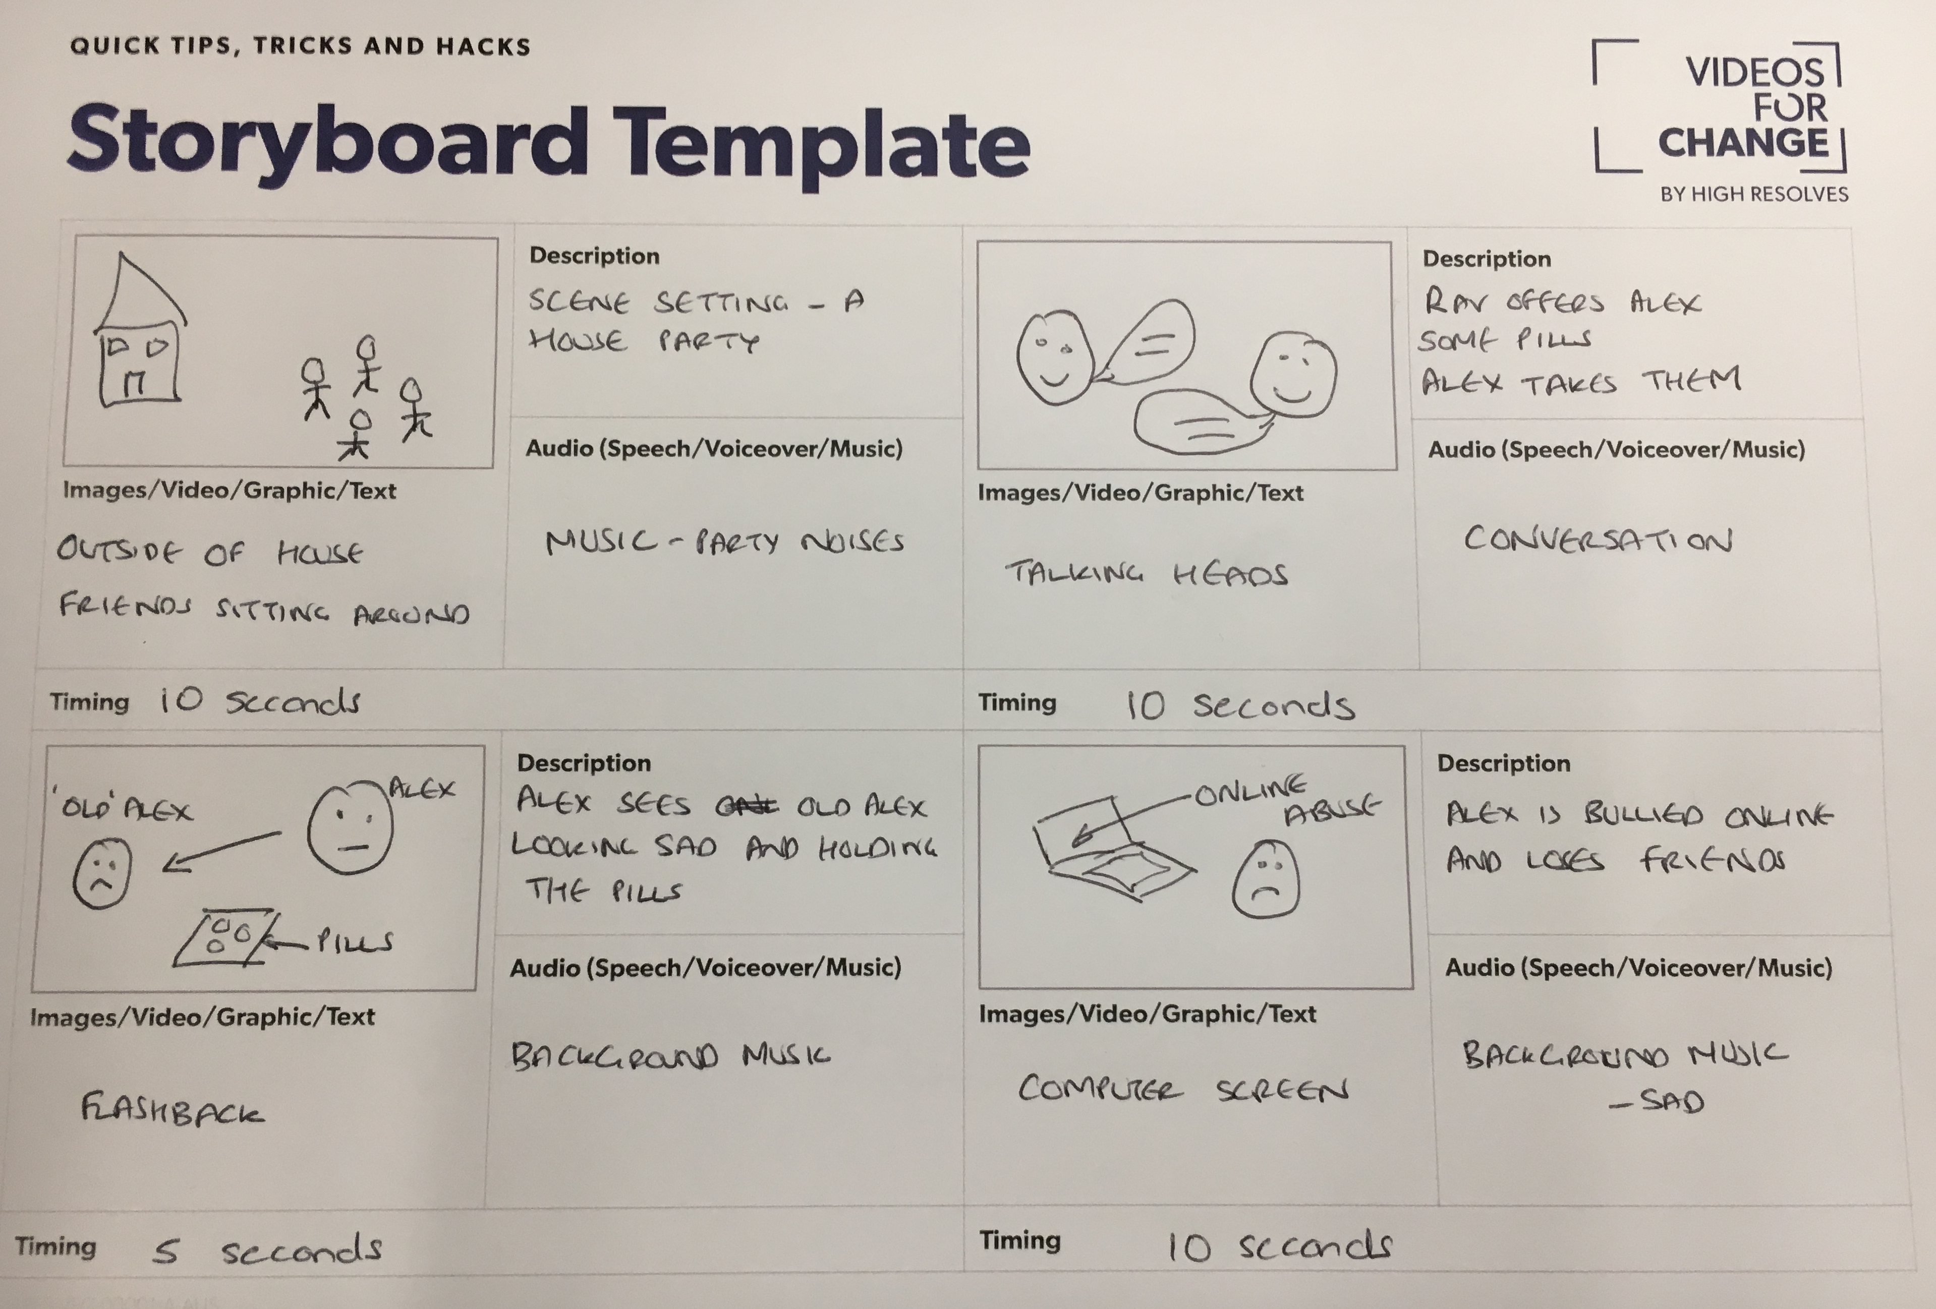
Storyboard
Notes:
Teaching and Learning Sequence
Introduce the storyboard as a basic plan for what the finished video will look like and can be used to plan to the images and scripting that they will need to create their video.

Slide 7
Storyboard
Beginning
Setting the scene, introducing the social issue
Middle
Focussing on what you want your audience to think and feel
End
Promoting your chosen Call to Action
Notes:
Teaching and Learning Sequence
Explain that as with all good storytelling each team should focus on making sure that their video has:
A beginning that sets the scene or introduces the social issue.
(Click to reveal) A middle where they should focus on getting across the key information in a way that promotes the targeted emotional response.
(Click to reveal) An end where there should be a clear ‘Call to Action’ for the audience to take up after watching the video.

Slide 8
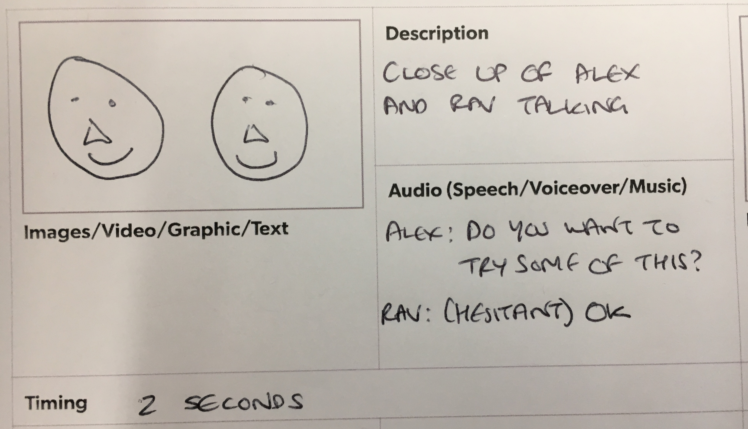
Storyboard
A rough sketch or photo of what will appear on the screen during this point of the film
Notes:
Teaching and Learning Sequence
Go through the different elements of how to complete the storyboard:
Images/Video/Graphic/Text: A rough sketch or still photo of what will appear on screen.

Slide 9
Storyboard
What is happening in the shot e.g. what the characters are doing; anything important about the background; camera movements
Notes:
Teaching and Learning Sequence
Go through the different elements of how to complete the storyboard:
Description: What is happening in this shot, any important details.

Slide 10
Storyboard
The sounds that will go over the shots
If there is a lot of talking have a separate detailed script
Notes:
Teaching and Learning Sequence
Go through the different elements of how to complete the storyboard:
Audio (Speech/Voiceover/Music): What the audience will hear.

Slide 11
Storyboard
How long this image will be on the screen
Notes:
Teaching and Learning Sequence
Go through the different elements of how to complete the storyboard:
Audio (Speech/Voiceover/Music): What the audience will hear.

Slide 12
Different types of shots
Think about including different types of shots in your video to:
Capture your audience’s attention and keep them interested
Influence the emotions that your audience are feeling and maximise the impact
Notes:
Teaching and Learning Sequence
Explain that you are going to introduce the different types of shots that the students might want to use and that they could include in their storyboard.
Use the bullet points to show some of the benefits of using different types of shots in their video.
Explain that the examples they are going to look at focus on live action films but that the suggestions also apply to other types of video.

Slide 13

Different types of shots
Wide Shot
Shows when and where the video is set
Works well for introducing a scene
Notes:
Teaching and Learning Sequence
Introduce the ’Wide Shot’ as being one that provides context for where and when the video is set.

Slide 14
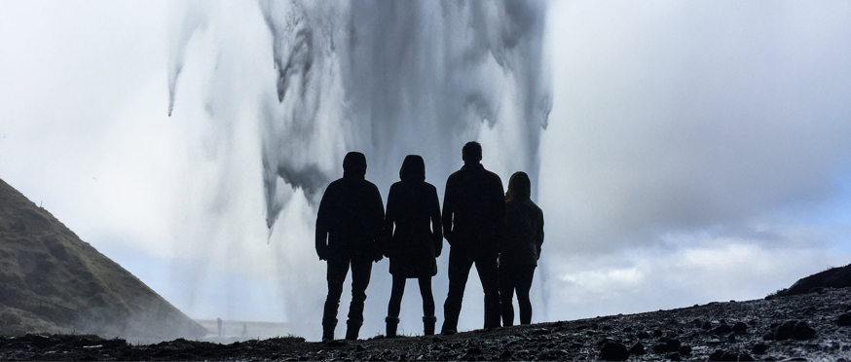
Different types of shots
Long Shot
Shows people from head to toe
Works well for introducing people and action (e.g. playing sport)
Notes:
Teaching and Learning Sequence
Introduce the ‘Long Shot’ as being one that shows people from head to toe and is good as an establishing shot for characters or for showing action.

Slide 15

Different types of shots
Medium Shot
Shows people from the waist up
Works well for highlighting hand gestures and motion
Notes:
Teaching and Learning Sequence
Introduce the ‘Medium Shot’ as being the most common shots, that shows ’half’ of a person, usually the upper half, and is good for basic exposition, gestures and motion.

Slide 16
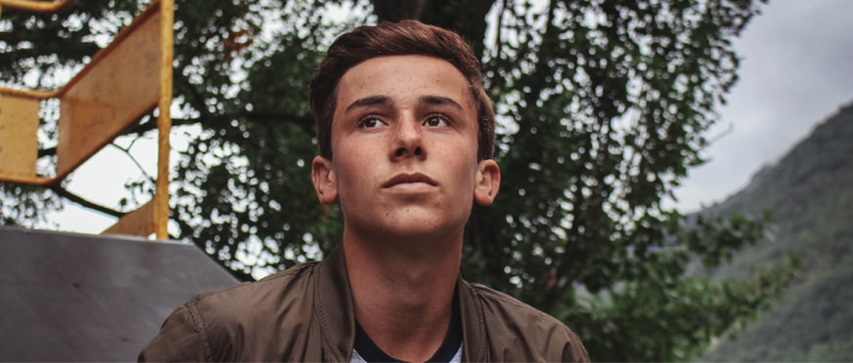
Different types of shots
Medium Close Up
Shows people in more detail, usually the head and shoulders
Works well for basic, ‘neutral’ dialogue
Notes:
Teaching and Learning Sequence
Introduce the ‘Medium Close Up’ as one that shows a person in more detail, usually including their head and shoulders, and is good for basic, emotionally neutral dialogue.

Slide 17

Different types of shots
Close Up
Shows a particular part of the subject, usually a head or a face
Works well for more emotional dialogue
Notes:
Teaching and Learning Sequence
Introduce the ‘Close Up’ as one that shows a a particular part of the subject and is good for more emotional dialogue.
Encourage the students to not be afraid of using close-ups as they help in getting the emotional message of the video across.

Slide 18

Different types of shots
Extreme Close Up
Shows more detail about one part of the subject
Works well for reaction shots and for showing extreme emotions
Notes:
Teaching and Learning Sequence
Introduce the ‘Extreme Close Up’ as one that shows more detail about one part of the subject and is good for reaction shots.

Slide 19

Different types of shots
Over the Shoulder
Shot from behind the person
Works well for showing what people are doing and for interviews
Click for a Shots Sheet
Notes:
Teaching and Learning Sequence
Introduce the ‘Over the Shoulder’ as one that shows the action their subject is taken and is very useful in conversations and interviews.
Point out that students can click on the hyperlink for a sheet that will remind them about different types of shots.

Slide 20

Keep it G-Rated
Videos classified G are not necessarily intended for children but can only have a very mild impact and not contain any matter likely to be unsuitable for children to watch without supervision.
Find out more at www.classification.gov.au
Notes:
Teaching and Learning Sequence
Remind teams that they should keep their video ‘G’ rated, especially if they want to enter it into the ’Videos for Change’ competition.
Explain for more information they can click on the hyperlink.

Slide 21
Click for a Storyboard Template
Notes:
Teaching and Learning Sequence
Get each team a copy of, or link to, a blank storyboard and allow them to start planning what will be included in their video.
Feel free to allow students to use a different type of storyboard, for example, a script with the shots listed next to it, a series of photos with captions added to them.
Explain that they can click on the hyperlink to get their own copy of a blank storyboard.

Slide 22







The RESOLVE Framework
R
elatable – Creates a connection
E
motive – Evokes an emotional response
S
imple – One main focus point
O
riginal – Takes a unique angle
L
asting impression – Sticks in the mind
V
isual – Shows and not just tells
E
mpowering – Give viewers the knowledge to take action
Notes:
Teaching and Learning Sequence
Introduce the ‘RESOLVE’ framework as something that the teams should bear in mind when they have created the first draft of their video:
Click to reveal each of the following elements:
Relatable
It creates a connection – it is real
Emotive
It evokes an emotional response
Simple
It has one main focus point
Original
It takes a unique angle and is unexpected
Lasting Impression
It is memorable
Visual
It shows rather than tells
Empowering
It gives the viewers the knowledge to take action
Introduce the student produced video on the next slide, asking the students to consider what the key message is and how successfully it met the RESOLVE framework.

Slide 23
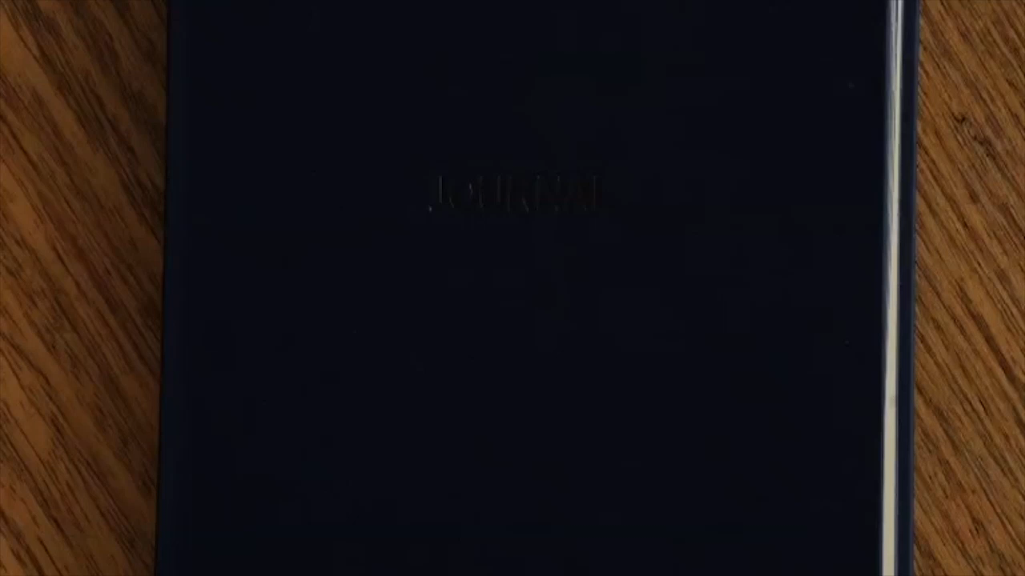
Notes:
Teaching and Learning Sequence
North Sydney Girls - Bullying video 2017 will play automatically (1 minute 4 seconds).
The video can also be viewed at: http://www.highresolves.org/videosforchange

Slide 24
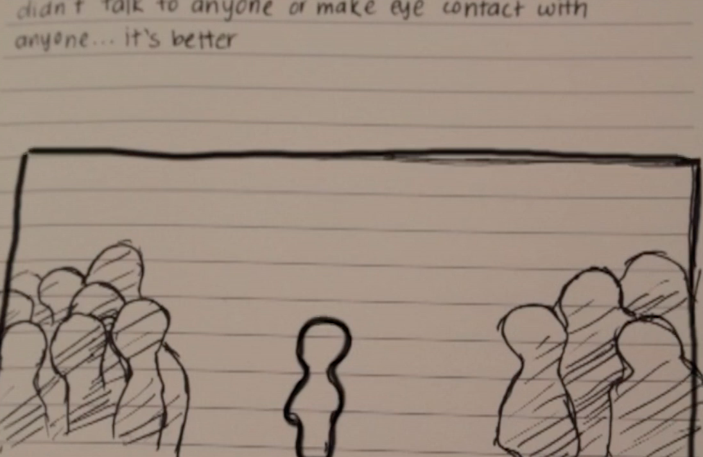
The RESOLVE Framework
R
elatable
E
motive
S
imple
O
riginal
L
asting impression
V
isual
E
mpowering
Notes:
Teaching and Learning Sequence
Ask the students to comment on how well the video met elements of the RESOLVE framework, for example
Simple – it focuses on one main point and one main character
Visual – the effects used to amplify the text on screen show the audience how the character is feeling
Emotive – it personalises the issue and provides powerful insights into the thoughts and feelings of someone struggling with the impact of being bullied

Slide 25
The RESOLVE Framework
R
elatable
E
motive
S
imple
O
riginal
L
asting impression
V
isual
E
mpowering
Notes:
Teaching and Learning Sequence
Encourage each team to apply the ‘RESOLVE’ framework to their completed storyboards before they start to make their videos.

