Slide 1
Videos for Change
7. Sharing your Video
Notes:
This presentation and supporting materials are created as teacher resources for Videos for Change by High Resolves
Copyright © High Resolves 2018
Suggested timing: 15 minutes for teacher instruction, additional time needed for teams to upload their videos and celebrate
Resources: None
Teaching and Learning Sequence
Introduce this session as being about offering advice to the students on how they can share their video so that as many people as possible view it.
HRES-VFC-00001-A-AUS

Slide 2
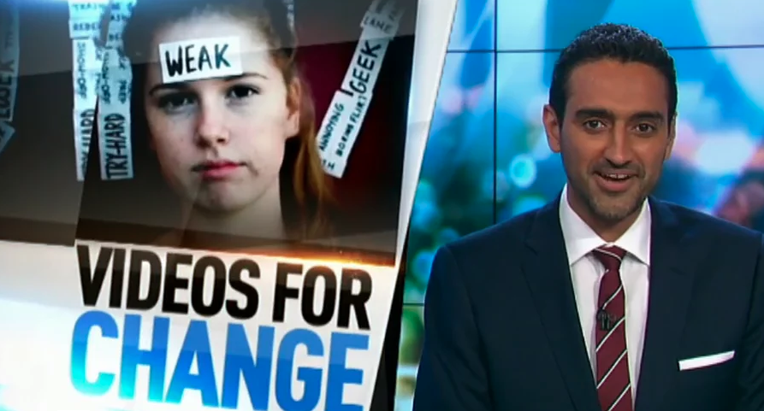
Share your video
Can you change the world in just one minute?
These high schoolers are giving it a pretty good crack! We reveal the High Resolves #videosforchange winners!
Notes:
Teaching and Learning Sequence
Remind teams that the reason behind creating their videos was about making more people aware about a social issue that was important to them and therefore they should aim at getting as many people as possible to view the video.
Explain that before posting the video online, each team should think about the combination of thumbnail image, title, and description that will make it likely for as many people as possible to click on the video. The example on the screen was posted by The Project on to their Facebook page.

Slide 3
Getting more views
Thumbnails that are…
Bright and colourful
Unusual or unique
Feature young people or cute animals
…get more views
Notes:
Teaching and Learning Sequence
Explain that based on a survey of over 1500 students carried out by High Resolves in 2016, thumbnails that were bright and colourful, unusual or unique, and/or featured young people or cute animals get more views.

Slide 4
Getting more views
Titles that…
Ask a question
Are short or catchy
Challenge common viewpoints
…get more views
Can you change the world in just one minute?
These high schoolers are giving it a pretty good crack! We reveal the High Resolves #videosforchange winners!
Notes:
Teaching and Learning Sequence
Explain that based on a survey of over 1500 students carried out by High Resolves in 2016, titles that ask questions to prompt thought, are short or catchy and challenge common viewpoints are morel likely to get higher views.
Ask the students to consider whether they would click on a title like the one shown on the slide.

Slide 5
Getting more views
Descriptions that are…
Short
Get you thinking
Feature topics of interest to young people
…get more views
Can you change the world in just one minute?
These high schoolers are giving it a pretty good crack! We reveal the High Resolves #videosforchange winners!
Notes:
Teaching and Learning Sequence
Explain that based on a survey of over 1500 students carried out by High Resolves in 2016, descriptions that were short, got the audience thinking and featured topics that were of interest to young people got more views

Slide 6



Share your video online
Make sure that you monitor and if appropriate respond to any comments about your video
Notes:
Teaching and Learning Sequence
Explain that wherever they intend to share their video they need to make sure that they monitor and where appropriate respond to any comments about their video.

Slide 7

Share your video at school
At an assembly
At a year meeting
Host a lunchtime film festival
At an assembly
At a year meeting
Host a lunchtime film festival
Notes:
Teaching and Learning Sequence
Encourage the students to come up with a plan for sharing their video(s) with the wider school community, for example, at an assembly, during a year meeting, a lunchtime film festival, or your own video challenge.

Slide 8
Global Leaders
Creating and sharing a video makes a positive difference to your community
It inspires others to act in the long-term, collective interest of humanity
Notes:
Teaching and Learning Sequence
Remind the students by creating their videos they have acted as ‘Global Leaders’, people how have stepped up and inspired others to act in the long-term, collective interest of humanity.

Slide 9

Celebration
Notes:
Teaching and Learning Sequence
Encourage the students to take some time out to celebrate their success at having informed people about the social issues that were important to them.

