Slide 1
Videos for Change
5. Creating your Video
Notes:
This presentation and supporting materials are created as teacher resources for Videos for Change by High Resolves
Copyright © High Resolves 2018
Suggested timing: 20 minutes for teacher instruction, additional time needed for teams to create their videos
Resources: Team Entry Form (one per student); Talent Release Form (on per non-team member who appears in the video); School Entry Form (one per team of students)
Teaching and Learning Sequence
Introduce this session as being about students getting ready to go out and start to create their own videos.
Introduce the video on the next slide as an example of a student-produced video about the issue of coffee cup waste and ask them to think about how well this video connects with the RESOLVE framework.
HRES-VFC-00001-A-AUS

Slide 2

Notes:
Teaching and Learning Sequence
Auburn High School - Coffee Cup Waste video will play here automatically (1 minute 8 seconds).
The video can also be viewed at: http://www.highresolves.org/videosforchange

Slide 3


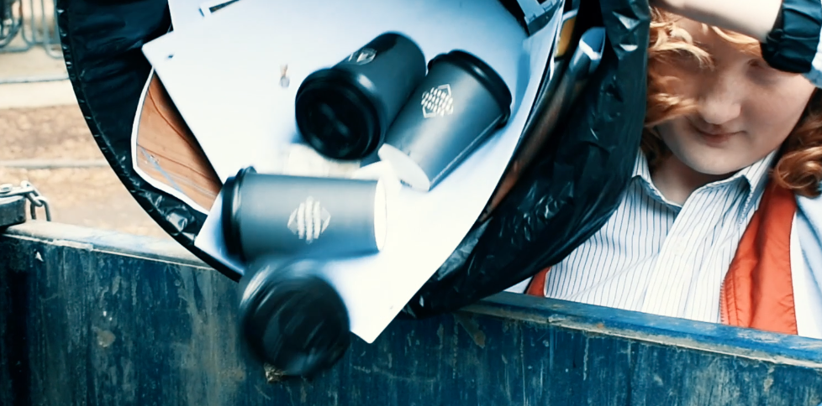





The RESOLVE Framework
R
elatable
E
motive
S
imple
O
riginal
L
asting impression
V
isual
E
mpowering
Notes:
Teaching and Learning Sequence
Ask the students to comment on how well the video met elements of the RESOLVE framework, for example
Relatable – it focuses on an everyday action that many people take to bring to life the larger scale, collective impact of coffee cup waste
Simple – the call to action, ‘use a keep cup’, is simple and reinforced throughout the video
Original – the use of humour to tackle a serious issue

Slide 4



Roles
Camera person
Cast
Director
Responsible for shooting the raw material for the video
Responsible for acting in the video or creating the images and text
Responsible for making sure that the idea for the video works
Notes:
Teaching and Learning Sequence
Explain that there are several different roles that each team will need to make sure are covered when they are creating their video, pointing out that in some cases team members will need to take on more than one area of responsibility.
Introduce the first set of roles that people in the team will need to take up when creating their video:
The camera person, or people, who are responsible for shooting the raw footage for the video, reiterate that the camera does not need to be high-tech and that a mobile phone or a stills camera could also be used.
(Click to reveal) The cast, the people who are responsible for acting in the film and/or creating the images and text (e.g. drawing the pictures, sourcing copyright-free images from the internet, creating PowerPoint slides).
(Click to reveal) The director, the person who has overall responsibility for making sure that the overall message for the video gets across.

Slide 5



Roles
Editor
Producer
Sound Person
Responsible for creating the final version of the video
Responsible for making sure that the team gets everything done
Responsible for getting all the audio needed for the video
Notes:
Teaching and Learning Sequence
Introduce the second set of roles, starting with:
The Editor who will have overall responsibility for creating the final version of the video by matching up the audio and video, adding music, etc. Reassure students that this person does not need to have be an expert on using different editing software.
The Producer who will have responsibility for making sure that everything gets done on time.
The Sound Person who will have responsibility for making sure that all the sound needed for the video is collected and that the audio is clear.

Slide 6
Who is doing what?
Camera person
Cast
Director
Editor
Producer
Sound Person
Notes:
Teaching and Learning Sequence
Make sure each team is clear on who is responsible for each role.

Slide 7
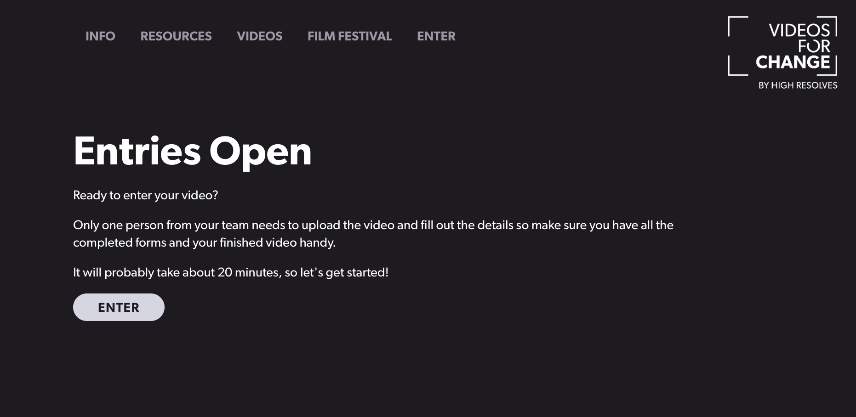
Entry Process
Notes:
Teaching and Learning Sequence
Explain that the official launch of Videos for Change 2018 will be in July and that all of the entry processes will become available online closer to the launch.
Strongly encourage that groups register their interest via the Videos Change webpage: http://www.highresolves.org/videosforchange so that they are the first to receive key updates, as well as further support resources to help them achieve their very best.
Let students know that the entry process will involve all actors in their video completing a talent release form and all participants under 18 years of age will require permission from a parent/guardian. All entry processes must be completed in order to claim the winning prize or People’s Choice Award.

Slide 8
Copyright
All the content, including images and sound, in your video must:
Be free from copyright restrictions
Show no branded products (e.g. a Coke bottle, a school logo)
You must also have permission to film at all your locations
Click for copyright-free Music and Image sites
Notes:
Teaching and Learning Sequence
Tell each team should only use music and images with are free from copyright restrictions and that they hyperlink will give them some more information on where they can source copyright free music and images.
Tell the students that they should also avoid having branded products in the video and should cover those up or use ‘blurring’ to make sure that the brands cannot be identified.
Tell the students that they also need to make sure that they have permission to film at all the different locations they are using.
Explain that if they do not follow these copyright rules they may be told to take their video down from any online platform they post it on and may not be eligible to enter their video into the ‘Videos for Change’ challenge.

Slide 9
Be careful
Make sure you have permission from a responsible adult before creating your video
Never give out personal details (e.g. phone number, email address)
Before meeting new people tell a responsible adult who you are meeting when and where and take a friend with you
Notes:
Teaching and Learning Sequence
Draw the students’ attention to some basic safety advice they should remember when creating their videos.

Slide 10

Create your video
Remember to save your work!
Notes:
Teaching and Learning Sequence
Tell the teams that it is now time for them to start creating their video, which may involve going out to film, creating the imagery that they will then shoot or coming up with a more detailed script.
Remind the students of the importance of regularly saving their work and ideally having some form of back-up storage.

