Slide 1
Videos for Change
6. Editing your Video
Notes:
This presentation and supporting materials are created as teacher resources for Videos for Change by High Resolves
Copyright © High Resolves 2018
Suggested timing: 15 minutes for teacher instruction, additional time needed for teams to edit, review and re-edit their videos
Resources: None
Teaching and Learning Sequence
Introduce this session as being about offering advice to students on editing their videos.
HRES-VFC-00001-A-AUS

Slide 2
Why edit your video?
Editing allows you to refine your video and make sure your message is as clear and powerful as possible
Use editing software such as Windows Movie Maker or Apple iMovie to rearrange your footage, add music and sound effects, add titles, transitions and special effects
Notes:
Teaching and Learning Sequence
Introduce video editing as the process that the teams should go through to make their video as powerful as possible.
Explain that this will allow them that video editing software will allow them to use the footage they have shot in different orders, add music and sound effects, add titles, add transitions and special effects.
Introduce the video on the next slide as a finalist in the 2017 Videos for Change challenge and ask the students to look out for how the team used the addition of sound, special effects, and stylistic methods to help their video have more of an impact.

Slide 3
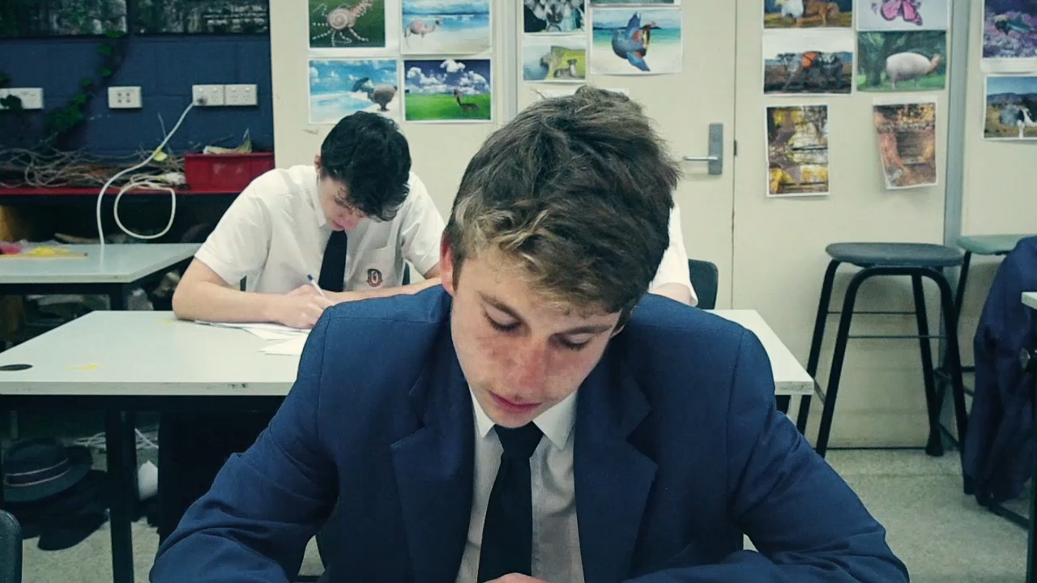
6.3
Notes:
Teaching and Learning Sequence
Cannon Hill Anglican College - Domestic Violence video will play here automatically (1 minute 8 seconds).
The video can also be viewed at: http://www.highresolves.org/videosforchange

Slide 4
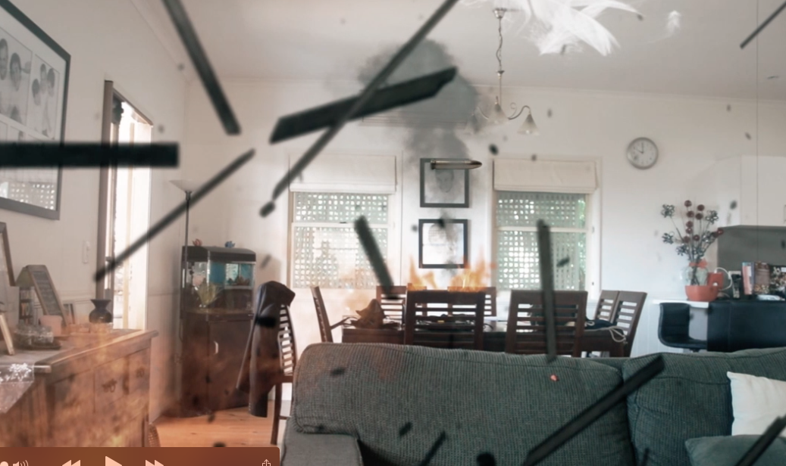
What did you notice?
Notes:
Teaching and Learning Sequence
Ask the students what they noticed about how the video was edited and then use the next three slides to cover those in a little more detail.

Slide 5
Editing
Sound
The sound quality is as important as the quality of the images in your video
Music can help set the mood
Effects (e.g. the clock ticking)
Voiceover can provide emotional insight
Notes:
Teaching and Learning Sequence
Point out that by editing their video the team were able to add voiceover and sound effects (e.g. the clock ticking ) to give their video a stronger impact.
Highlight the fact that the quality of the audio is incredibly important in creating a successful video and that people are far more tolerant of low-quality video than audio.

Slide 6

Editing
Special Effects
Symbolic images that provide powerful insights in to the story
Notes:
Teaching and Learning Sequence
Point out that by editing their video the team were able to add symbolic images that ‘show’ powerful insights in to the story rather than trying to ‘tell’ them

Slide 7
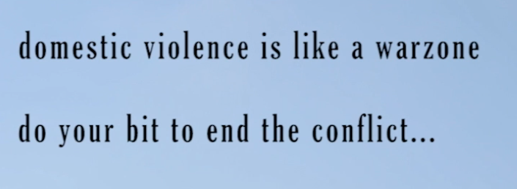
Editing
Captions
Can make a statement
Provide more information
Highlight a Call to Action
Notes:
Teaching and Learning Sequence
Point out that by editing their video the team were able to add a caption to amplify their key message about domestic violence.

Slide 8
Help and Advice
Plenty of help and advice available online, e.g.
Windows Movie Maker
Apple iMovie
https://www.youtube.com/watch?v=DSSdlP6OC-Y
https://www.youtube.com/watch?v=VF2mUJ0P3xU
Notes:
Teaching and Learning Sequence
Acknowledge that in the video about domestic violence the team obviously spent a lot of time in editing their video – this is a ‘high standard’ example of editing and not an expectation of all entries.
Point out that there is plenty of help and and advice available online to help them, including the websites on the slide covering video editing software available on most PCs and Macs to allow them to use the footage they have shot in a different order, add music, sound effects, titles, transitions and special effects.
These linked websites are not under the control of High Resolves, and we are not responsible for their content. Inclusion of any link should not be implied as endorsement of by High Resolves.

Slide 9

Create a back-up
Save the ‘project’ as well as the exported video in case you need to make any adjustments
Create a back-up on a USB or different computer
Notes:
Teaching and Learning Sequence
Tell students that as it is highly likely there will be some things that they want to change in their finished video they should save the project and not just the exported video.
Encourage them to also create a back-up version of the raw footage, audio, etc. on a separate device.

Slide 10
1. Team review
Does your video meet the brief you outlined?
Are the sound and images clear?
Are there any spelling mistakes?
Will the audience have enough time to read any captions?
Is the video no longer than one minute?
Notes:
Teaching and Learning Sequence
Explain that once the teams have finished editing their videos they should review what they have created using the checklist as a way of recording any points they want to improve upon.
Use the questions on the screen as an example of a checklist that teams should consider when they watch their video.

Slide 11

2. Test Screening
Notes:
Teaching and Learning Sequence
Suggest that once teams have reviewed and made any changes to their video that they get input from another team.
Suggest that the team reviewing the video for the first time use the RESOLVE framework as their term of reference.
Use the information on the next slide to offer some basic advice on giving and receiving feedback.

Slide 12
Giving & receiving feedback
Be considerate of people’s feelings and their work
Be open to receiving feedback
Be constructive, offer ideas for improvement
To fully understand the feedback ask clarifying questions
Notes:
Teaching and Learning Sequence
Suggest to the students some tips they should bear in mind when giving and receiving feedback:
The importance of being considerate especially of people’s feelings and the work they have already done.
(Click to reveal) The importance of being constructive, by offering feedback that includes ideas and strategies for improvement.
(Click to reveal) The importance of stopping and being prepared to listen to the feedback.
(Click to reveal) The need to ask clarifying questions to fully understand what is being said.

