Slide 1
Perch of Perception
Memory Game

Slide 2
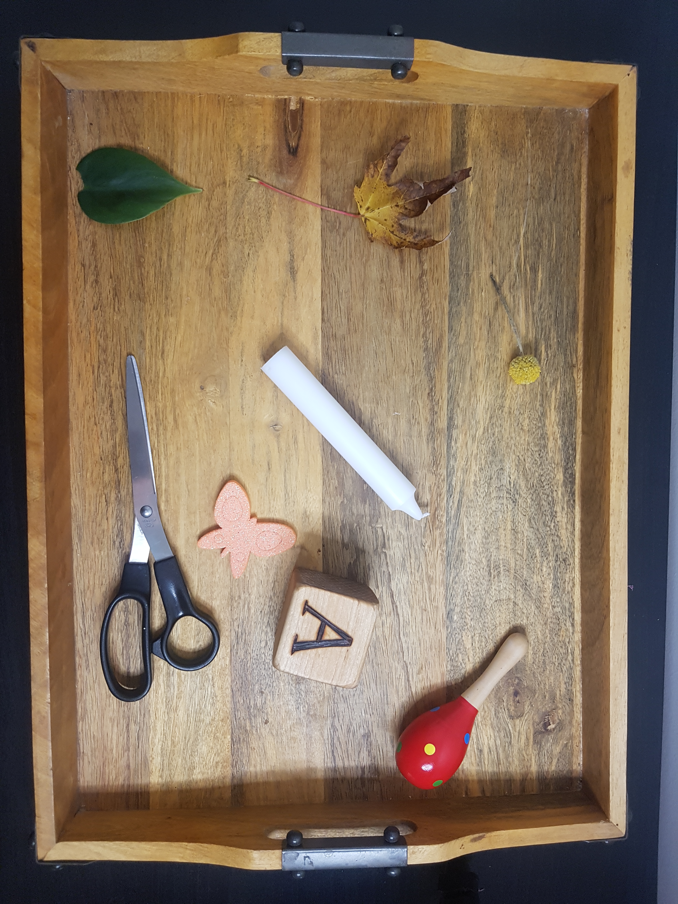

Slide 3
There were 8 items in the tray.
How many items can you remember?
Write a list.

Slide 4
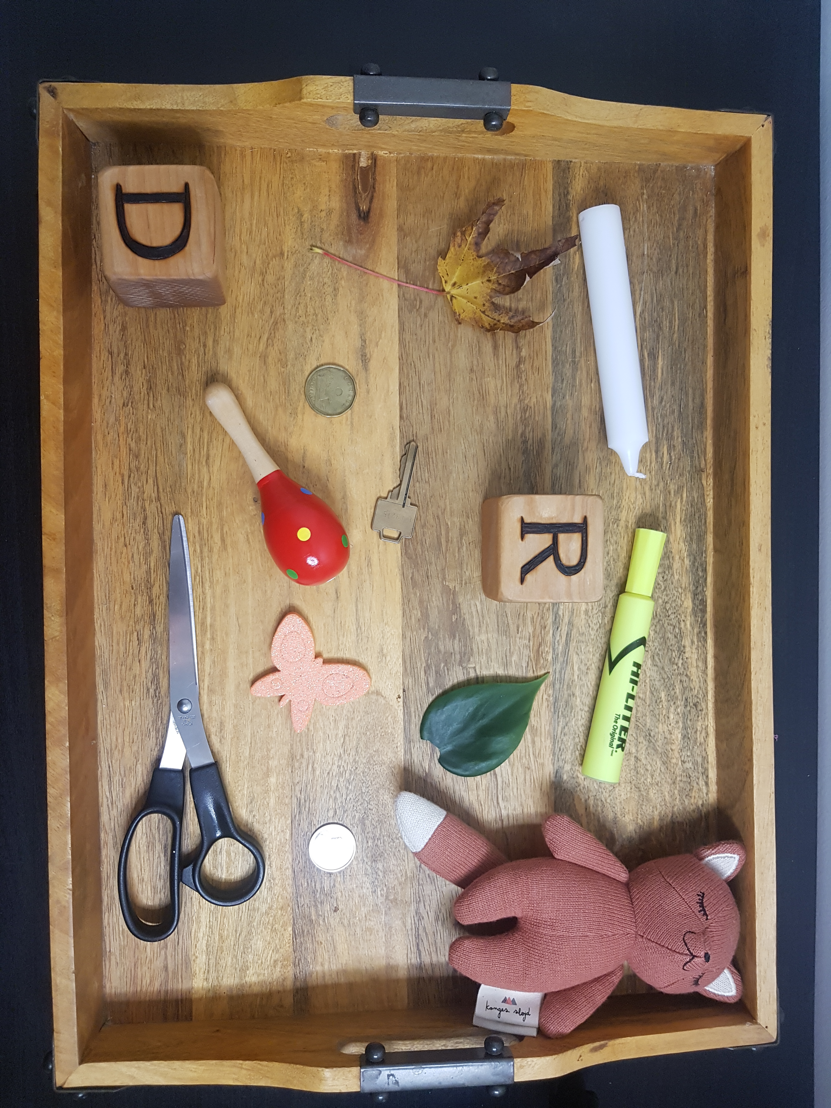

Slide 5
There were 13 items in the tray.
How many items can you remember?
Write a list.

Slide 6
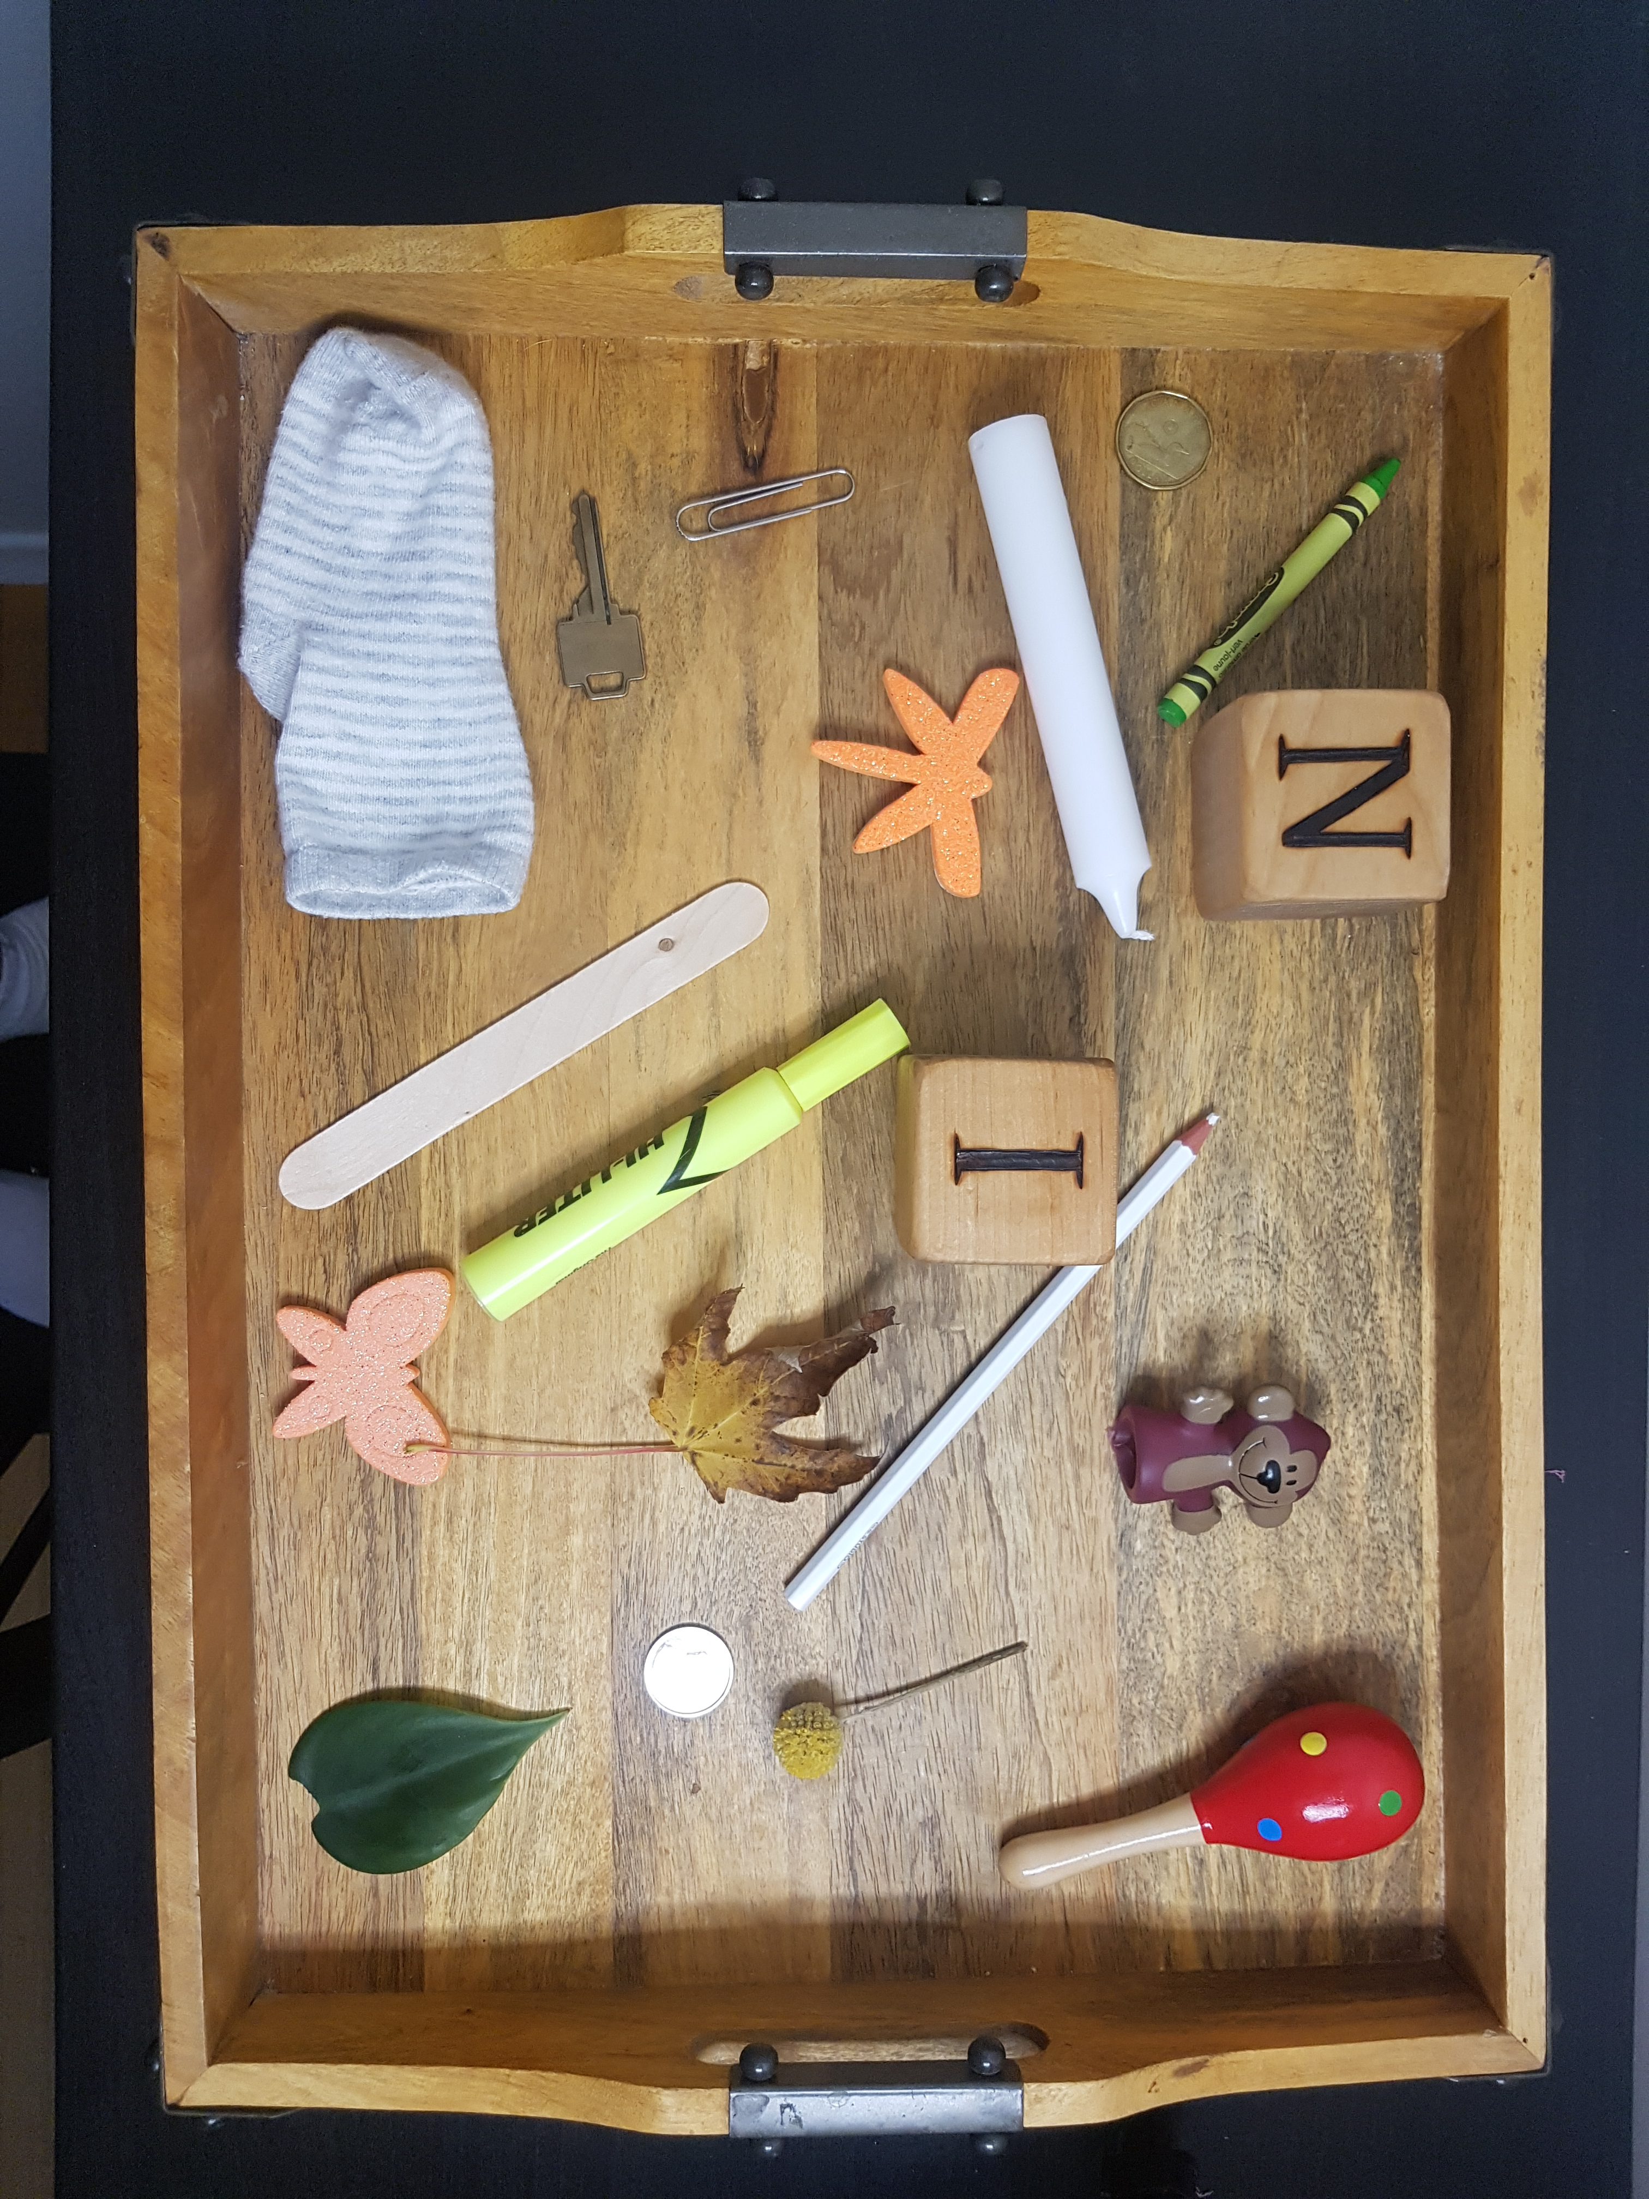

Slide 7
There were 19 items in the tray.
How many items can you remember?
Write a list.

