Slide 1
in space activity
b r a i l l e

Slide 2
Introduction to Braille and Resources shared by Karen from CNIB
What is braille and how does it work?
English: https://cnib-beyondprint.ca/braille/
French: https://cnib-beyondprint.ca/fr/braille/
Resources
To custom print sim braille phrases for participants to decode, there are free braille translation programs available online, such as https://www.brailletranslator.org/
VERY IMPORTANT: Select the ‘uncontracted, grade 1 or alphabetic braille’ option, otherwise it may translate into a more advanced (contracted) braille that kids won’t be able to decipher using just the alphabet.
Short free course for learning to read uncontracted braille
English: https://cnib-beyondprint.ca/reading-uncontracted-braille-course/
French: https://cnib-beyondprint.ca/fr/cours-de-lecture-en-braille-non-contractuel/

Slide 3
BRAILLE CELLS

Slide 4
Let’s look at three types of braille cell alphabets
Simulated braille alphabet with numbered dots
Tactile alphabet with metal bead stickers
Simulated braille alphabet with shaded dots

Slide 5
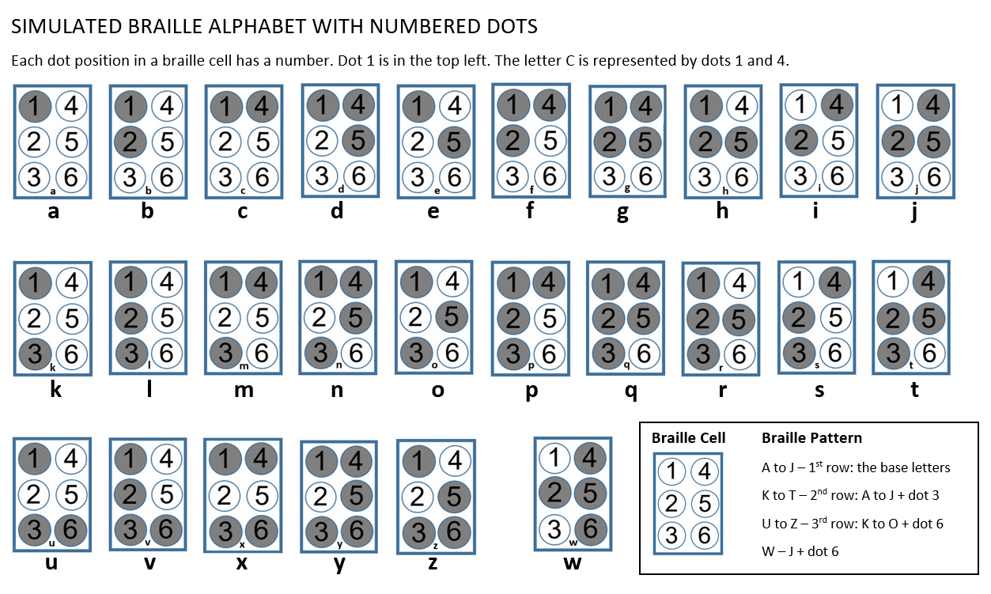

Slide 7
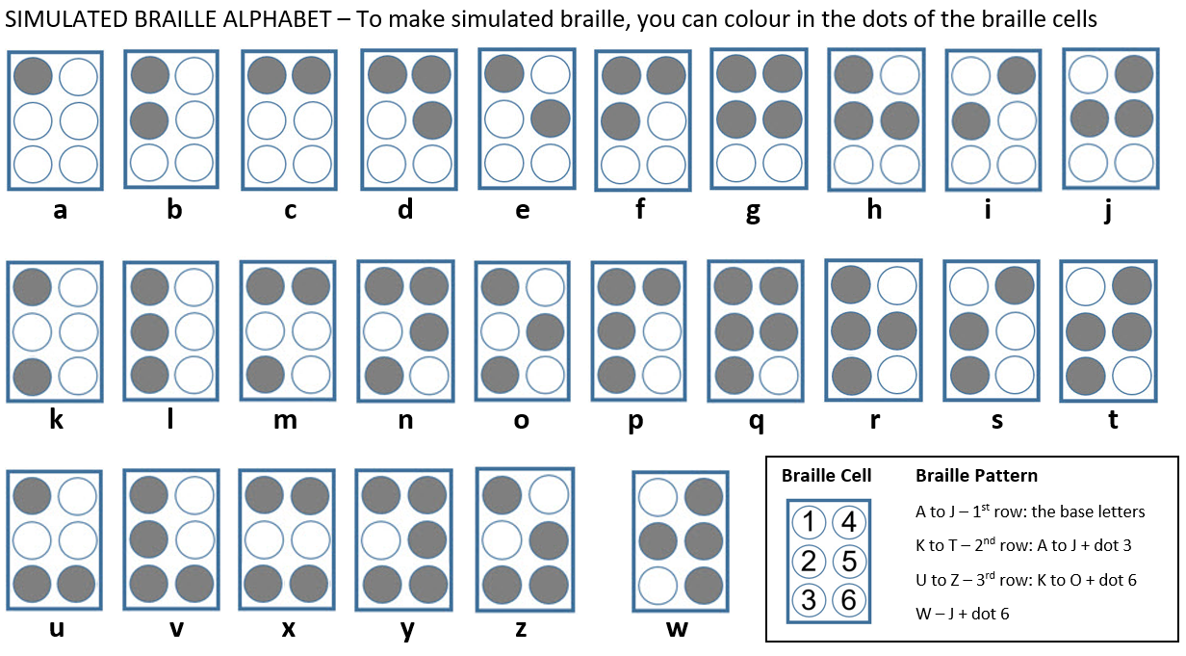

Slide 8
BRAILLE ACTIVITIES

Slide 9
We have created some braille-related activities. Feel free to do any or all of them.
Braille-related Activity Worksheets
(recommended order)
Create Your Own Braille Alphabet
To the Stars Braille Activity
Decoding Braille Riddles
Create a Braille Message

Slide 10
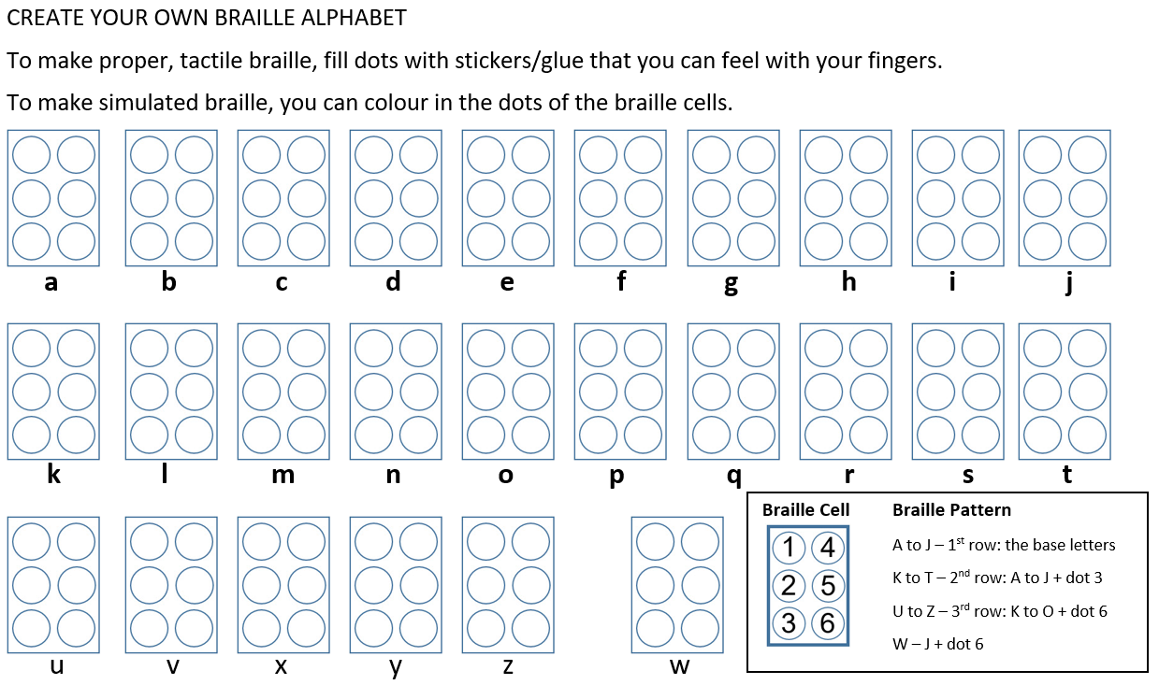

Slide 11
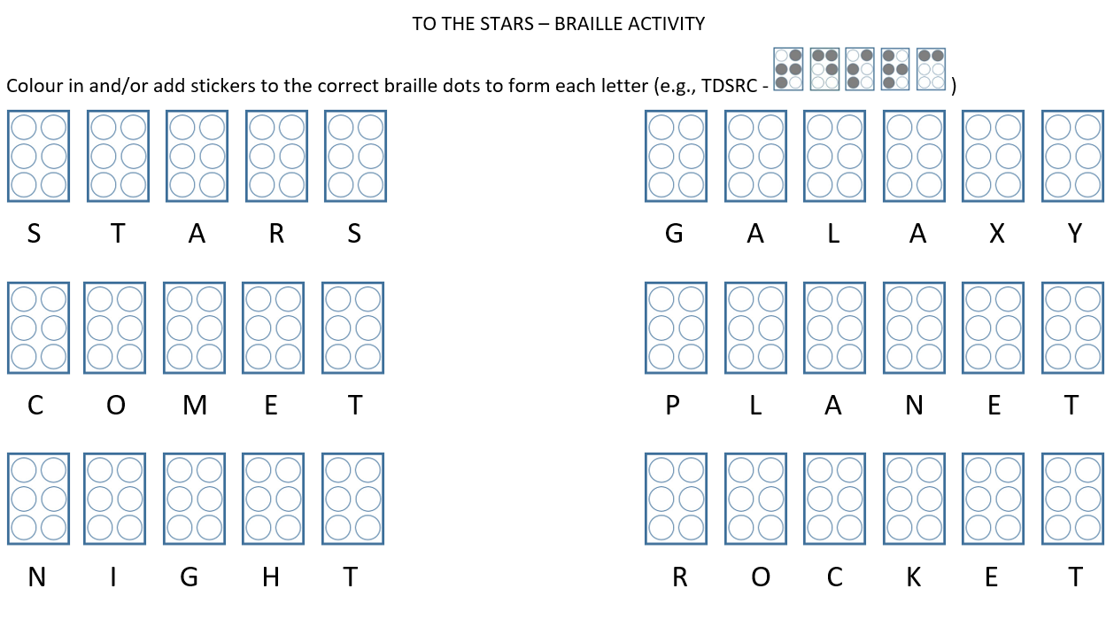

Slide 12
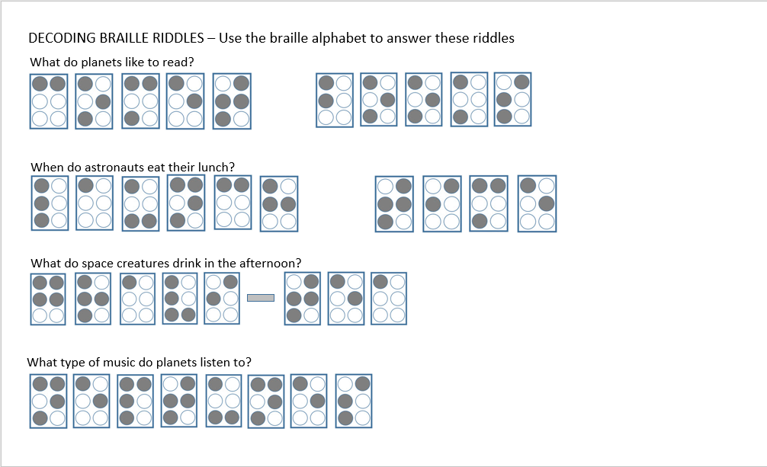

Slide 13
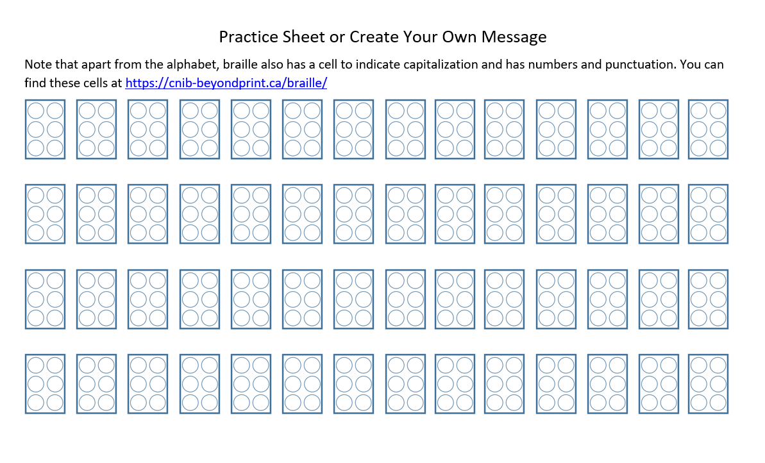

Slide 14
BRAILLE ACTIVITY SOLUTIONS

Slide 16
