Slide 1
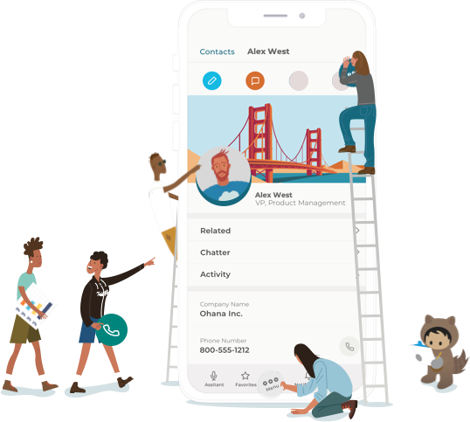
CITIZEN DEVELOPMENT

Slide 2
What we’ll cover:
1
2
3
4
5
What is Citizen Development?
Opportunity
Process & Government
Team & Resources
Vision & Goals
Notes:
Adjust this outline slide as needed accurately represent your presentation flow.

Slide 3
What Is Citizen Development?
1
Notes:
Citizen development is a low- or no-code approach to software development that allows users to create apps and solutions without needing to have technical development knowledge or how to write code.

Slide 4
| What Is Citizen Development?
Citizen development brings IT and the business together.
Citizen development:
Is low- or no-code development done by business users, but governed by IT
Enables business users to create the low-code apps they need
Helps the organization tackle backlog requests more efficiently
Provides an outlet for developing low-code solutions that fall outside the realm of funded IT priorities
Holds the business to a system of governance
A citizen developer:
Creates new business applications using development and environments sanctioned by IT
Notes:
Define citizen development in terms your audience will understand. You can give a definition that breaks down the outcome of the program: “Citizen development brings IT and the business together to tackle backlog requests more efficiently. These programs provide a viable outlet for developing low-code solutions that fall outside the realm of funded IT priorities while holding the business to a system of governance that allows technology leaders to sleep better at night.”

Slide 5
| What Is Citizen Development?
And gives IT more time to focus on work that pushes the needle.
46%
of time for IT teams is spent innovating for the business to keep legacy systems and applications operating properly.*
A properly run citizen developer program will:
Reduce the risk of unchecked shadow IT
Expand IT’s bandwidth to focus on mission-critical app priorities
Allow citizen developers to focus on department-specific efficiencies
Let IT concentrate on data integration, security, and innovation
* “State of IT.” Salesforce Research, 2017. c1.sfdcstatic.com/content/dam/web/en_us/www/images/form/pdf/pdf/2017-state-of-it-report-salesforce.pdf
Notes:
Communicate why this will be a big win for the IT department and what that means for the company as a whole. Think about the most critical priorities at your organization and include the points above that speak to it.
In you need some inspiration, pull from this description: A properly run citizen developer program will expand IT’s bandwidth to focus on mission-critical app priorities while building a stronger relationship with the business all while reducing the risk of unchecked Shadow IT. The citizen developers can focus on department-specific efficiencies, while IT concentrates on data integration, security, and innovation across the enterprise.

Slide 6
| What Is Citizen Development?
A typical CitDev workflow gives autonomy to the business and oversight to IT.
1
3
5
User identifies a
business problem
User identifies systems
and data to support app
User works with IT to secure and standardize app
2
4
6
User generates an app
idea to solve problem
User builds low- code app
IT publishes app to be used by others
Notes:
You can use this sample workflow from Salesforce or create your own.

Slide 7
Opportunity
2
Notes:
Outline the opportunities for citizen development in your organization. If you conducted surveys to reveal shadow IT activity, share the results here. Use larger surveys and interviews to showcase employee interest and potential engagement in citizen development.

Slide 8
| Opportunity
We’re facing risks with shadow IT.
[insert survey results]
Notes:
Use this slide to share any key results from your surveys around Shadow IT and/or interest in Citizen Development.

Slide 9
| Opportunity
Our backlog represents significant opportunity.
At [Organization name], IT receives [X] application build or upgrade requests per quarter.
The current IT backlog contains [X] requests.
IT estimates they can support [X%] of these requests per quarter.
BUT we estimate that [X%] would be good candidates for citizen development. These applications are typically simple apps and updates that only require low-code or minimal changes and don’t require much data integration. They are easy to pick out as prime candidates for citizen development.
Fore example: [list requested apps that are candidates for citizen development here]
This amounts to [X] citizen development-led apps developed each year.
Notes:
Use the backlog analysis tool to communicate to your audience what types of requests IT is getting, how many requests, how many are typically supported and which ones are suitable for citizen development. You can find the backlog analysis tool at https://backlog-analyzer.herokuapp.com/
Look at the backlog analysis you completed to indicate demand, while highlighting requests and applications that could be a good fit for citizen development. Then reinforce this idea by estimating the organizational impact of building these apps with CitDevs. Show your organization’s one-year and five-year ROI for using citizen developers and a low-code platform. Include both hours and cost savings as well as revenue impact.

Slide 10
| Opportunity
Across industries, others are moving to citizen development.
67%
76%
88%
74%
of IT teams say improving their collaboration with other lines of business is a high priority.*
of IT leaders say speed of application/project delivery is a critically or very important KPI.*
of IT leaders currently use or plan to use low-code development in the next 12–18 months.*
of IT leaders plan to increasingly shift some application building responsibilities to business users over the next 12–18 months.*
* “State of IT.” Salesforce Research, 2017. c1.sfdcstatic.com/content/dam/web/en_us/www/images/form/pdf/pdf/2017-state-of-it-report-salesforce.pdf
Notes:
Remind stakeholders that the move to Cit Dev is already happening all around you. Encourage early adoption in order to stay ahead of competition. These industry stats show the need for Citizen Development.. You can choose to include one, or all of the stats above to help prove your point or find some more specific to your vertical. Compare them to internal metrics if possible.
Finally, if you have already identified internal supporters, use their testimony to show leadership the program’s momentum.

Slide 11
| Opportunity
With citizen development, BMC turned 15 devs into 100.
BMC did not have enough IT resources to meet internal demand
They recognized they had latent talent in their organization that could help solve this problem
They introduced citizen development on the Salesforce Platform with a lightweight governance model and comprehensive training plan
With IT guidance, they were able to empower business users to build low- and no-code apps to effectively turn their team of 15 developers into a team 100 strong
With the help of automation citizen developers take over maintenance of their own apps and IT spends more time innovating
They’ve also reduced the time it takes to clear the app request backlog from 2–3 years to 2 quarters
As IT leaders at BMC, David Riggan and Sudheer Sura were driven by a core focus of going beyond the everyday activities and doing something innovative in IT.
Notes:
You can provide your own researched case studies here, or you can link to videos of Trailblazers on salesforcecitizendevelopment.com. If possible, try to use an example which is from either a similar industry or a similar size company as yours.

Slide 12
Process & Governance
3
Notes:
Reassure leadership that you’ve thought about security and process. Include the benefit and feasibility of using a secure low-code platform that meets your industry’s compliance standards as well as a timeline for rolling out governance, training, purchasing (and cost).
If you have a governance process outlined already, share it here. Remember, it can be flexible (minimal vs. complete protocols), but you should cover the following steps:
1. Define a training process for citizen developers — training and certification.
2. Establish trigger points that call for IT involvement.
3. Set up standard workflow protocols for low-code development: sandboxes, testing, validation, audit, integration, and deployment.
4. Determine who the approvers are for each of the steps in the development cycle.
5. Create an evaluation process for admitting projects into either the IT backlog or the citizen developer backlog.
6. Create a standard set of requirements that apply to any project admitted into the citizen developer backlog to ensure each app aligns with compliance and security measures outlined in the governance policy.

Slide 13
| Process & Governance
The citizen development process should complement the way we already work.
How much autonomy do citizen developers get? What situations call for IT involvement?
[Answer]
What does are the workflow protocols for sandboxes, testing, validation, integration, deployment?
[Answer]
What is the process for auditing and maintenance? Can we automate any tasks?
[Answer]
Who is the approver for each step in the dev cycle?
[Answer]
What is the process for requesting an application? What criteria determines if app requests are added to citizen development or IT backlogs?
[Answer]
Based on processes above and security concerns, what requirements will we put in place for ANY citizen development application?
[Answer]
How long will each step in the process take?
[Answer]
Notes:
Use these questions to help frame your governance model and communicate it to stakeholders.
To help define approvers, use the RACI tool at salesforcecitizendevelopment.com/tools
When you present your process, communicate how long you expect each piece to take, as well as your expected timeline for rolling out the Pilot, how long you plan to run it for, and how much time you’ll then need to prepare the full program.

Slide 14
| Process & Governance
The citizen development process should complement the way we already work.
Which platform will you use for low- and no-code development?
[Answer]
What’s the expected budget for the pilot program?
[Answer]
When will the pilot program kick off? How long will the pilot program run?
[Answer]
What’s the expected quarterly budget for full rollout (if known)?
[Answer]
What are the resources required for training, platform licenses, promotional efforts, etc.?
[Answer]
How do we expect to train pilot team members? The rest of the organization?
[Answer]
Notes:
Communicate the tools you plan to use for the pilot program. Explain what you need in terms of budget, staff, and resources to roll out your pilot program, then an estimate of what you expect for the full rollout. If you don’t have a precise estimate at this point, do you best to provide some expectations to leadership — they’ll be more likely to sign on if they have an idea of the long term benefits as well as the potential cost.
Here are a few questions to get you started.
For training, Trailhead is a valuable resource that is free and is robust enough to scales with your program. A few suggested modules for CitDevs are:
Citizen Development Trailmix: https://trailhead.salesforce.com/users/dboras/trailmixes/salesforce-citizen-developer-trailmix
Learn Salesforce with Trailhead Lightning Platform Orientation Build a Battle Station App Quick Start: Process Builder Lightning App Builder Automate Your Business Processes with Lightning Flow Build Better with UX Gallery of Sample Applications Built on Lightning Platform
You can even create a custom trailmix for you team from the trails above and others: https://trailhead.salesforce.com/en/trailmixes

Slide 15
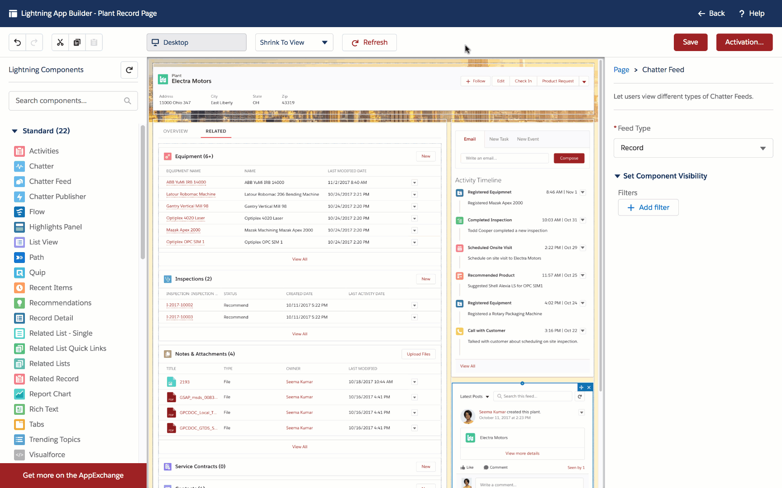
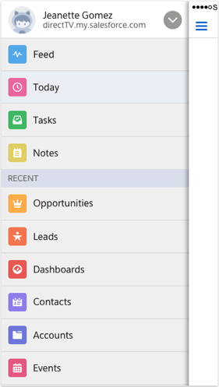
| Process & Governance
The Salesforce Platform
Code less. Ship more.
Deliver innovation.
Build apps together.
Empower both declarative and programmatic developers to create mobile-first apps with low-code and pro-code tools.
Deliver connected experiences.
Integrate data across multiple systems and orgs to achieve a complete view of your customer and business.
Future-proof your technology.
Unleash innovation with a solution that keeps getting better with intelligence, enterprise scale, and security baked in.
545%
78%
Five-year ROI
Shorter release cycles
Notes:
We’ve outlined some of the benefits and features of the Lightning Platform as a low code solution for you here and on the next slide. For whichever platform you choose, include the benefit and feasibility of using a secure low-code platform that meets your industry’s compliance standards.
The Salesforce Platform helps companies with their digital transformation
It’s fast because we empower both your declarative and programmatic developers with tools on the one platform. Low-coders can make use of our no-code builders, while pro devs are empowered with Salesforce DX and Heroku.
It’s easy because we have already built so much core functionality surfaced to app builders through managed services that come standard with any app.
It’s fun because every step of the way your app builders can learn through Trailhead – a hands-on way to learn everything about our products.

Slide 16
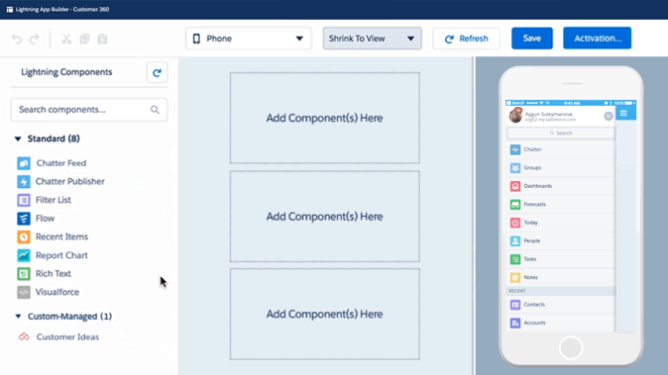
| Process & Governance
Lightning Platform
Empower the business and IT to work together with low-code.
Low-Code Builders
Anyone can solve business problems fast using drag-and-drop tools, without writing a line of code.
Pro-Code Tools
Focus programmatic developers on the highest-value initiatives like building Lightning Components.
Enterprise Services
Ensure governed and compliant app development that seamlessly connects disparate systems.
58%
Faster app dev*
* IDC Business Value Study Sponsored by Salesforce, Sep. 2018
Notes:
When talking about the Lightning Platform (or any other tools), specify how it can help you overcome some of the challenges you identified in your internal research.

Slide 17
Team & Resources
4
Notes:
Who’s involved? Identify the advocates you already have on board and any CitDev candidates you have in mind to show leadership that talent and support are available. Outline the size and roles required for your Pilot program and reassure leadership that the teams’ work in the citizen development program will NOT detract from their daily responsibilities.

Slide 18
| Team & Resources
No need to hire new talent as we can pull from existing, hidden talent.
Which of your peers will be involved in the pilot?
[Answer]
What role will each person perform?
[Answer]
Will you need any indirect support from other departments (announcements, recruitment, and so on)?
[Answer]
How many employees will be involved in the pilot? It’s recommended that no IT employees dedicate more that 10% to 20% of their time to citizen development unless it’s an explicit part of their role. Rather, they should work on citizen development apps in their own time.
[Answer]
Notes:
List all people for your pilot program, and if borrowing from other teams, list out the managers of those teams. If you need additional support (such as from HR or a communications person to broadcast the rollout), list those people as well. You may also want to include roles and responsibilities for each person who will be participating in the pilot program. To see a list of possible roles, visit salesforcecitizendevelopment.com/scale
Here are a few questions to get you started.

Slide 19
| Team & Resources
IT will be engaged to guide and support.
IT Leads:
[list who will lead the CitDev effort from the IT team]
IT participants will only commit 10–20% of their time to supporting citizen developers.
Additional IT support:
[List any other IT staff who will be involved]
IT will be responsible for things like:
Evaluating citizen development requests and work
Setting up sandboxes and testing protocols
Developing common components
Pushing apps live
1-to-1 coaching or consulting so that citizen developers have a go-to person throughout the entire process
Notes:
Describe in detail, how much and what type of IT support is needed to support Citizen Developers during the pilot and post-pilot roll-out. We’ve filled out some of the details for you, but you’ll need to customize the expectations to align with your governance model and provided questions for further guidance.
IT will be responsible for things like: conducting informational sessions, evaluating CitDev requests and work, attending and providing guidance during check-ins, review app documentation, set up sandboxes and aid in testing, develop common components, migrate application from sandbox into production, and review app usage and maintenance.
On a voluntary basis members of the IT team can be paired with a citizen developer.They can then set up weekly check-in calls, 1:1 coaching or consulting, and guidance so that citizen developers have a go-to person throughout the entire process.

Slide 20
Vision & Goals
5
Notes:
Explain how the program might look once it scales, and reiterate the five-year ROI of the program. The vision should align with the rest of your organization’s values and goals for the future.

Slide 21
| Vision & Goals
Citizen development ROI: productivity, employee satisfaction, and profit margins.
Where do you hope citizen development takes your organization?
[Answer]
What ROI do you anticipate?
[Answer]
How will citizen development make you innovators in your industry?
[Answer]
Notes:
Use this slide to enter your vision for this citizen development program. It should be inspiring, but grounded in the opportunities and benefits discussed earlier in the presentation. Here are some guiding questions to get you started. Think about ROi not just financially (i.e. payback time for your investment), but also the effect on your workplace productivity, employee happiness and retention, and all of the new potential projects IT can tackle with their new found time.

Slide 22
| Vision & Goals
Measure success against IT’s current metrics, while introducing new goals.
IT Metrics:
Backlog
Time to value
Idea to deployment
How many apps developed and usage
Dev cycle time
Developer productivity
Citizen Developer Metrics:
Time to deploy
Apps deployed to production
App users and usage
App progressions (versions)
Notes:
Review each of these metrics and discuss what each means and how it will bring value to the organization and ensure the Pilot is working toward common goals. If possible, add baseline numbers for each of the IT metrics, as well as goal numbers for IT and Citizen Developer metrics to measure the Pilot program against. For a more detailed look at citizen development metrics, visit salesforcecitizendevelopment.com/prepare

Slide 23
Q&A

