Slide 1
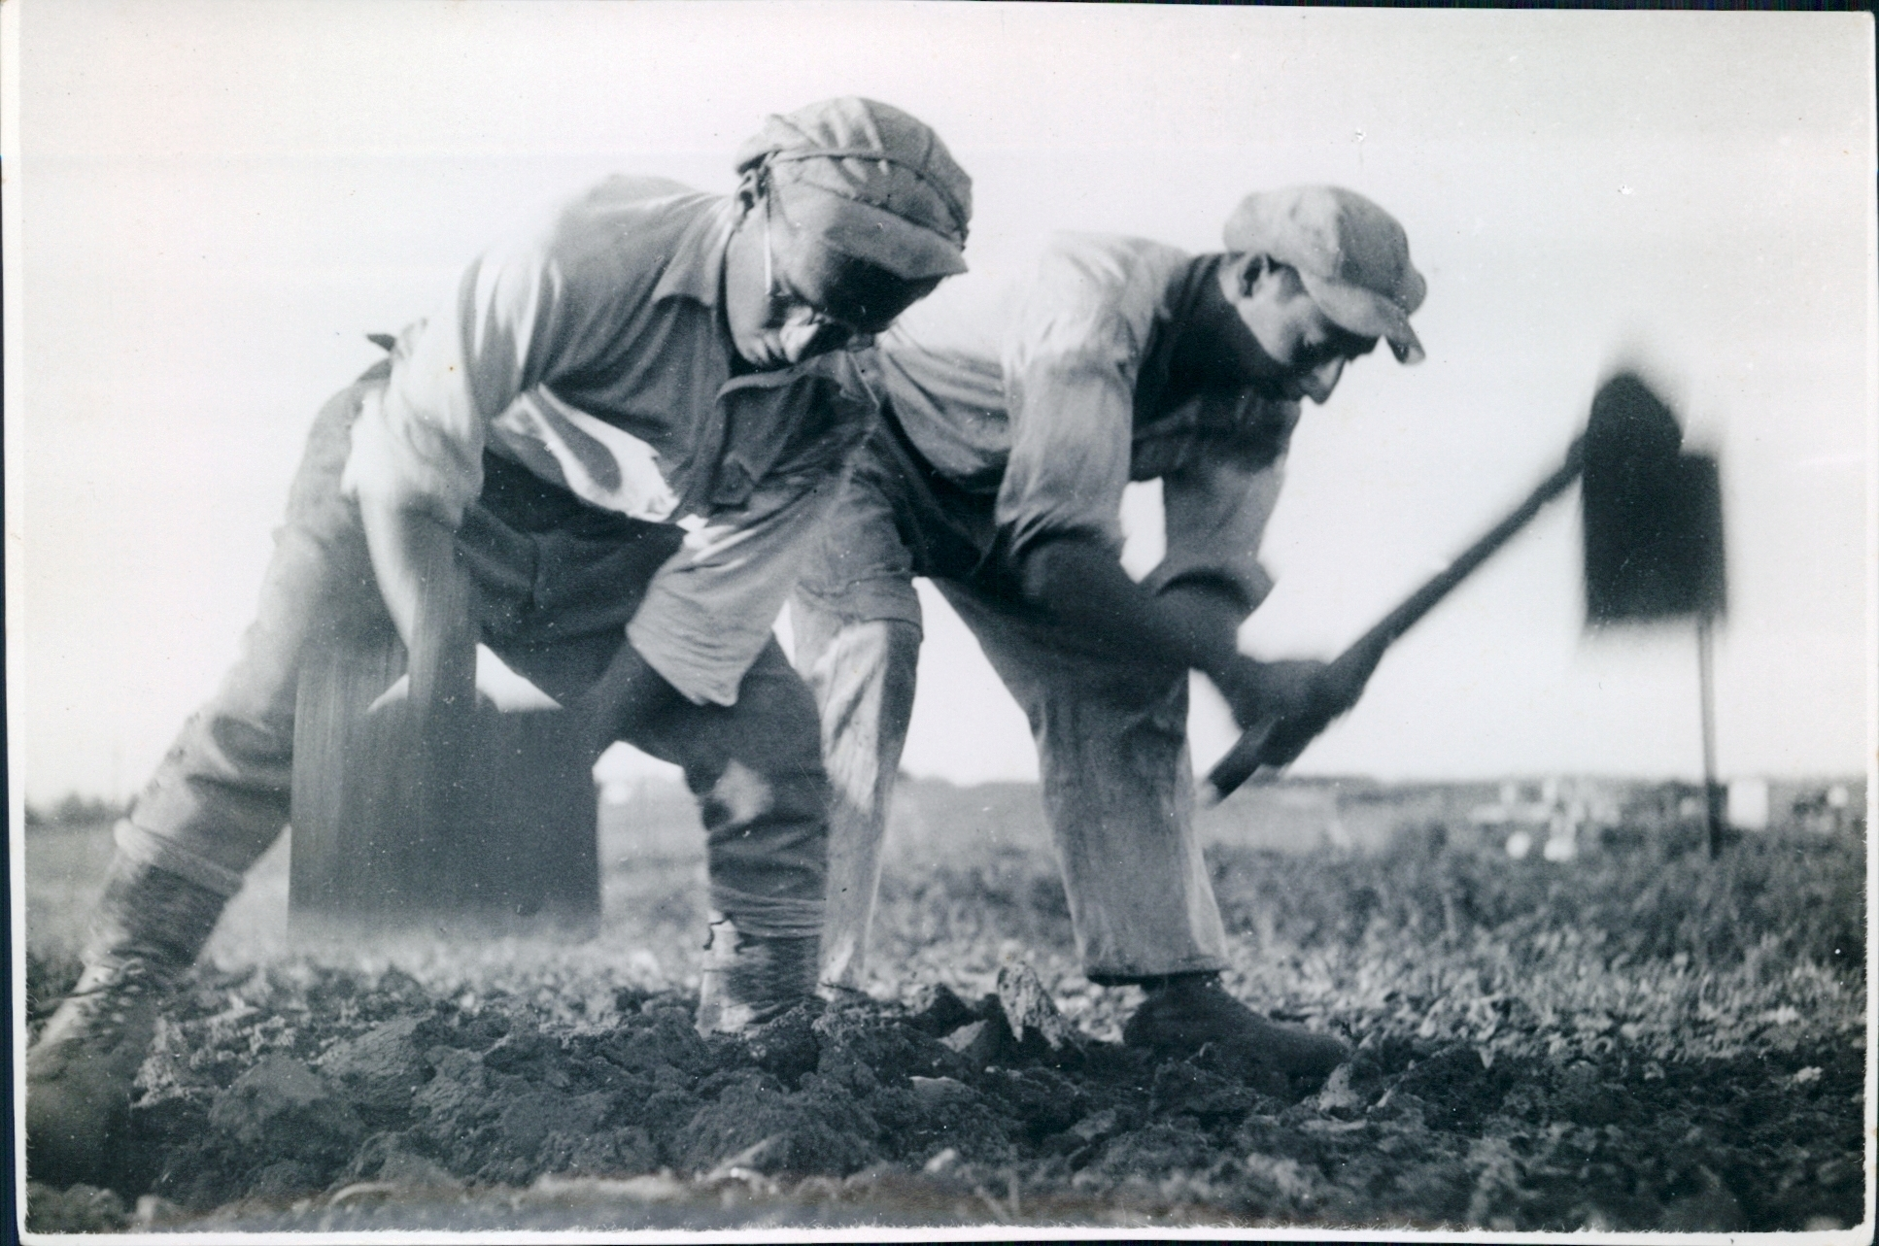
SHMITA &
ZIONISM
פולמוס השמיטה
בתולדות הציונות
Dr. Yizhar Hess
Vice Chairperson, World Zionist Organization

Slide 2
SHMITA שמיטה Sabbath of The Land
וְשֵׁשׁ שָׁנִים, תִּזְרַע אֶת-אַרְצֶךָ; וְאָסַפְתָּ, אֶת-תְּבוּאָתָהּ. וְהַשְּׁבִיעִת תִּשְׁמְטֶנָּה וּנְטַשְׁתָּהּ, וְאָכְלוּ אֶבְיֹנֵי עַמֶּךָ, וְיִתְרָם, תֹּאכַל חַיַּת הַשָּׂדֶה; כֵּן-תַּעֲשֶׂה לְכַרְמְךָ, לְזֵיתֶךָ.
Six years you shall sow your land and gather in its yield; But in the seventh you shall let it rest and lie fallow. Let the needy among your people eat of it, and what they leave let the wild beasts eat. You shall do the same with your vineyards and your olive groves.
שמות כ"ג פסוקים י-יב 10-12Exodus, chapter 23,

Slide 3
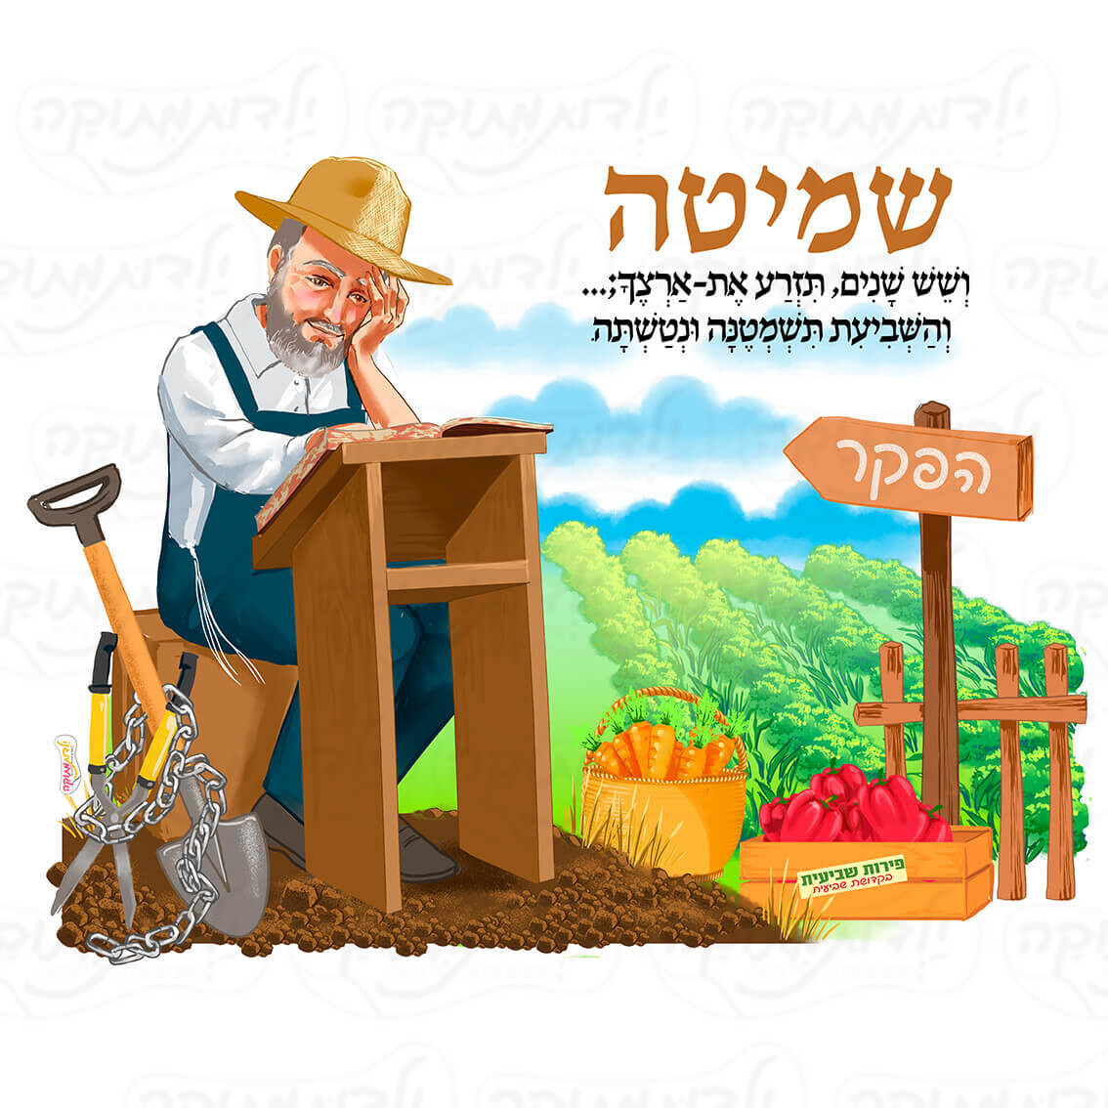
The sabbatical year "שְֹבִיעִית"
The seventh year of the seven-year agricultural cycle mandated by the Torah to be a sabbath to God
During shmita, the land is left to lie fallow and all agricultural activity, including plowing, planting, pruning and harvesting, is forbidden by halakha (Jewish law)

Slide 4
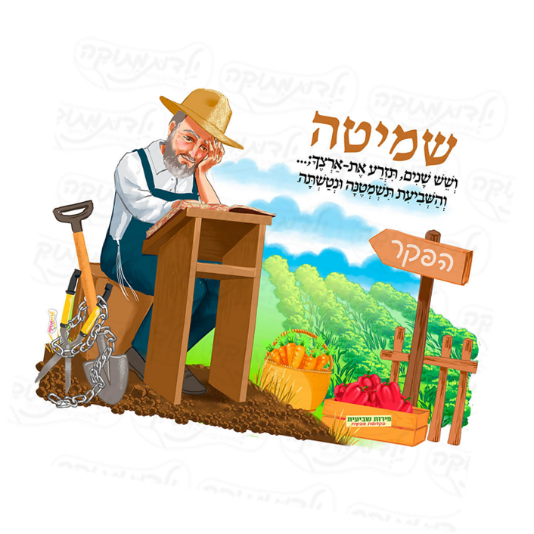

Slide 5
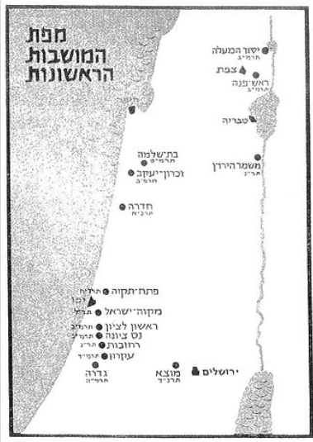
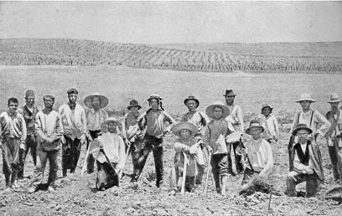
The First Zionist ALIYAH (1882-1904)
Rishon Lezion
Zichron Ya’akov
Rosh Pina
Nes Ziona
Gedera
Mazkeret Batya
Yesod HaMa’alah

Slide 6
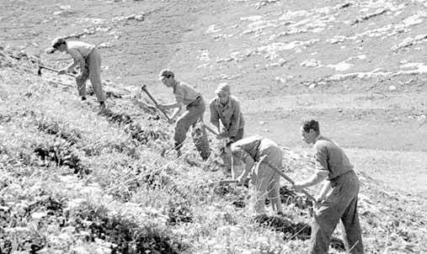
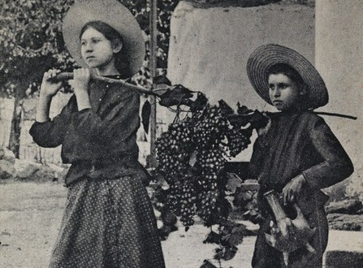
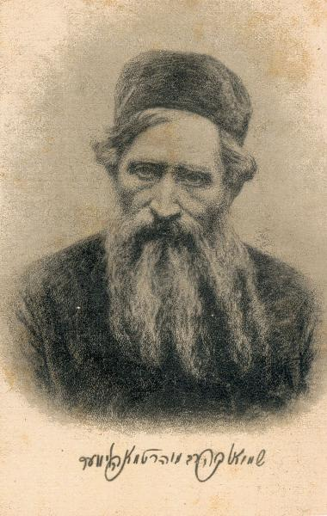
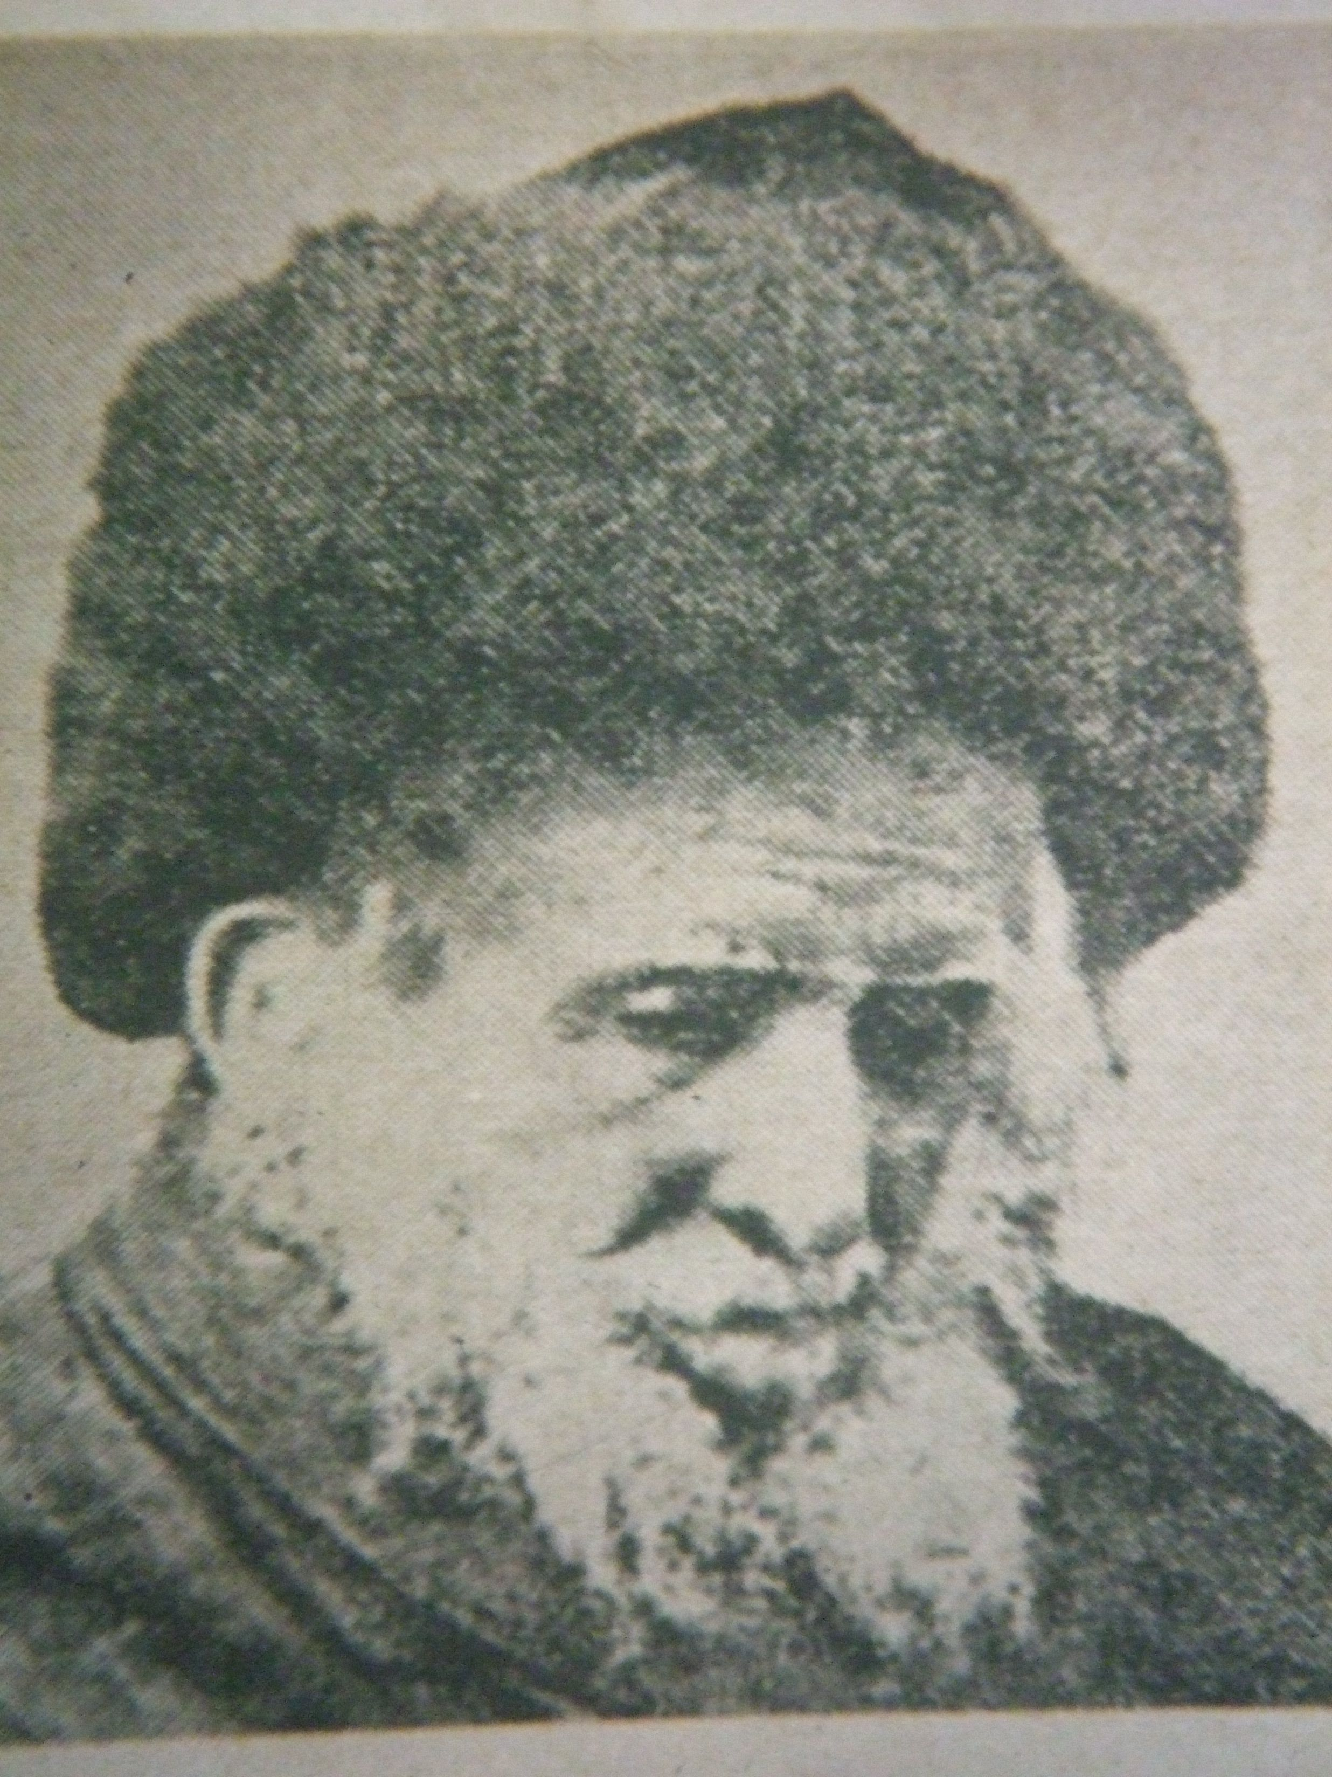
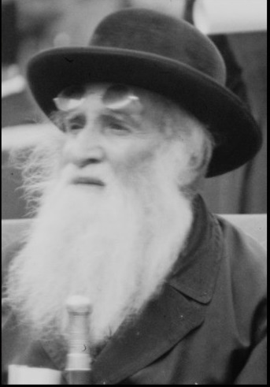
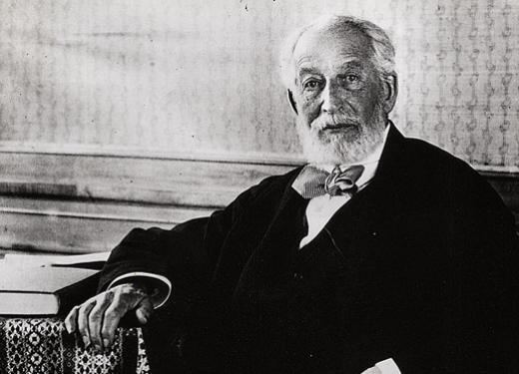
1889 תרמ"ט
Fear of hunger No one will make Aliyah Bad PR for Zionism Moshavot will be left | This Is Halakha!
הרב שמואל סלנט 1816-1909
הרב שמואל מוהליבר
1924-1898
הרב יהודה לייב דיסקין
1818-1898
Baron Edmond de Rothschild 1845-1934

Slide 7
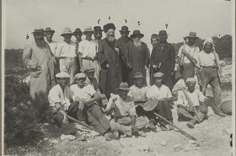
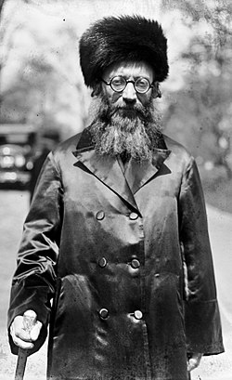
The solution: permitted sale היתר מכירה
A halachik mechanism by which the land could be sold to a non-Jew for the duration of that year under a trust agreement. Under this plan, the land would belong to the non-Jew temporarily, and revert to Jewish ownership when the year was over. When the land was sold under such an arrangement, Jews could continue to farm it.
Rabbi Abraham Isaac Kook
1865-1935
Chief rabbi of Palestine

Slide 8
And today?
The Haredi solution – doesn’t meet the requirements of a modern state
The Modern-Orthodox solution is questionable from a Zionist aspect
Rabbi Golinkin’s teshuva (1986)
שמיטה כ'מידת חסידות'
We should observe the laws of Shemitah today as an “act of piety”. In other words, it is laudable to observe it as much as possible. However, farmers who cannot observe it due to financial pressure or because of pressing circumstances can sow and do all other necessary activities during the Shemitah year.
Rabbi Prof. David Golinkin
https://schechter.edu/how-should-shemitah-the-sabbatical-year-be-observed-in-the-state-of-israel/

Slide 9
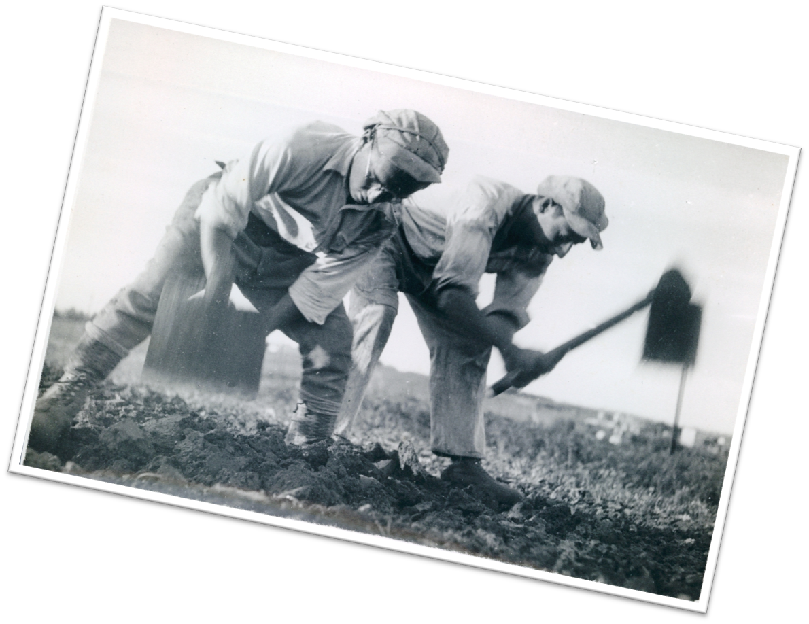
SHMITA & ZIONISM Dr. Yizhar Hess

