Slide 1
Go1 is coming
<< insert launch date here >>

Slide 2
The only digital learning subscription you need.​
One login
100,000+ courses
200+ providers
Notes:
Whether it’s e-learning or a blended learning experience, we know that the demand for digital learning has increased substantially.
If I was to explain what go1 does at a high level:
We provide L&D teams with access to the world's largest library of e-learning content, allowing them to curate content that’s delivered by the best learning providers, in the most engaging formats, to fulfil the needs and skill-gaps of every learner. Through one simple subscription. Delivered through your learning platform, or ours.

Slide 3
What is the Go1 Content Hub?
The Go1 Content Hub is the world’s largest digital learning library from the world’s top training providers.
You’ll soon have access to an epic range of topics, from general to industry-specific training, including:
Time management
Leadership
Team building
General personal development

Slide 4
Good for me
Good for the team
With over 100,000 resources to choose from, there's something for everyone.
All your eLearning in one place
Upskill anywhere, any time.
Increased and simplified accessibility for all teams
Great content recommendations just for you.
Easy to set, measure and report on learning goals

Slide 5
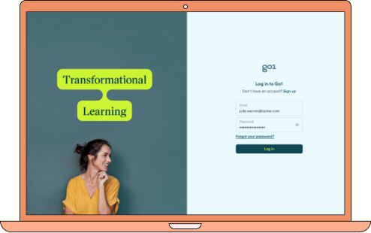
A world of eLearning awaits!
Got questions?
If you have any questions about Go1 or your learning, please contact our Learning and Development team for more information.
<<Insert internal HR/L&D leaders contact here>>

Slide 6
Our learning program
You can use this slide to provide more information on the specifics of your learning program, or promote a specific playlist, course, or topic.﻿
To have the greatest impact, keep your wording concise and list the business outcomes it will achieve for your team, along with the benefits for the individual.﻿
Bullet point
Bullet point
Bullet point
Bullet point
Bullet point

Slide 7
You can use this slide to provide more information on the specifics of your learning program, or promote a specific playlist, course, or topic.﻿
To have the greatest impact, keep your wording concise and list the business outcomes it will achieve for your team, along with the benefits for the individual.﻿
Our learning program
Bullet point
Bullet point
Bullet point
Bullet point
Bullet point

Slide 8
Discover more
go1.com
Your name
email ･ phone

Slide 9
Icon set:

Slide 10
Icon set:

