Slide 1

Royal London
Financial Capability Summary Report

Slide 2
Aims & Objectives
In 2016, Royal London commissioned YouGov to conduct a ‘financial capability’ experiment to explore how the use of planning tools (including pen and paper and 3 mobile apps) could impact on how people felt able to budget, plan and organise their financial situation
A qualitative and quantitative method was employed, inviting people to take part in a three month trial. 411 participants took part in the quantitative test, 278 actually used the budgeting tool we gave them and 43 were also engaged in a qualitative online forum at points throughout the experiment
The results of this experiment were used by Royal London as part of the ‘Looking after the pennies’ report in January 2017
In October 2017, Royal London asked YouGov to revisit the 52 people who had taken part in the experiment and had used either one of the apps or pen and paper for the full duration of the three-month trial. Of these people, 37 agreed to take part in a three day online forum to establish what impact the trial had made a year after they took part

Slide 3
Understanding the audience

Slide 4
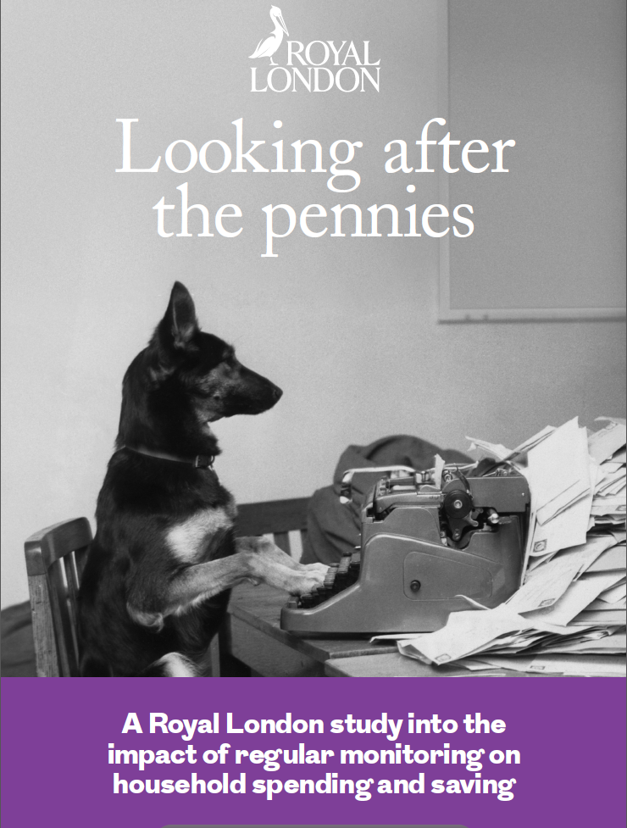
The research in 2016 gave positive indications that budgeting tools did help – particularly to shift attitudes and behaviour of the more vulnerable audience
From the 2016 report we found…
49% said the budgeting method was helpful in monitoring spend
This research will look to see if there are any indications that the changes have been sustained beyond the initial trial
37% said that they had a better understanding of their finances
There was a 7% shift towards feeling clear about how to create a monthly budget
26% said they were more motivated to save for unexpected expenses

Slide 5
Revisiting the audience a year later – only a small number were still using the same budgeting tool as in 2016
4 of our audience had continued to use the same budgeting tool over the last year since finishing the trial
Most people had reverted to their own/old system or had tried a different way to manage their budget going forwards
Some said that they were too “set in their ways” to change as a result of a 3 month trial
Some felt that once they had learnt the basic principles from the tool they did not need to continue using it on a frequent basis and that the budgeting tools were too time consuming long term
Some had stopped for technical reasons – for example a change of handset, or issues with the app itself preventing use
Others felt that the app-based technology was more complex and time consuming than they needed but the principles of budgeting were employed and had “served them well”
Participants were not opposed to using a tool, but they need to find a system that works for them, fits with their bank accounts and reflects their preferences for online/offline tools

Slide 6
Impact of the trial

Slide 7
Yes (14)
14/37 think that participating in the trial made an impact on how they plan, organise and manage their money
The trial reinforced the importance of budgeting on all levels, not just for bills and major expenses – people became aware of what they were spending on a micro-level, helping them to scrutinise their everyday expenses
Once they identified how much they really are spending and on what, they could see how to change their spending habits e.g. cut down on impulse buys
For some, the budgeting tool made it more manageable to monitor their finances than other systems they’ve tried
Not sure (9)
Those who are unsure are more mindful of what they are spending, but are less sure of the noticeable impact on the way they manage their money i.e. if their overall spending/saving habits haven’t changed
For some, the trial has raised their awareness of how to budget, resulting in them feeling more in control of their finances, regardless of its tangible impact
No (14)
The equivalent amount said it didn’t, whilst some were unsure
Largely, those for whom the trial made no impact were sufficiently confident at managing their money prior to the trial e.g. they already used a tried and tested budgeting system, which the app didn’t add anything to

Slide 8
Yes
Regardless of how long you used the budgeting tool for, do you think taking part in the trial last year made any impact on how you plan, organise and/or manage your money?
“I already keep control of my finances by way of a book, but the tool I used, once set up, made it easier as I always had it with me”
Female, 45-54, C2DE
“It confirmed that I earned as much as I needed, it also showed where I was spending more than I thought, which surprised me but since I always have money left at the end of the month I wasn't concerned” Male, 35-44, ABC1
“I am stuck in my ways in regard to my finances, and I know my incomings and outgoings”
Female, 55+, ABC1
No
“Having to record the amount and area of expenditure makes me evaluate how much I want things before purchasing them. It also acts as a good reflective tool - did we really need to spend so much on eating out each week!?” Female, 55+, ABC1
Not Sure
“I am not sure because I have for years developed my own system of budgeting and I did not think that the tool was much different to the way I have done things for years”
Male, 55+, C2DE
“I already had what I considered a well proven system over many years and the app really added nothing”
Male, 55+, ABC1
“I think it made me realise where I was wasting/overspending and gave the ability to control bad spending habits more effectively. I found that I could save a little more as a result”
Female, 55+, ABC1
“I don't think I've changed my attitude or the way I do my accounts because of the app, but maybe I check my account a bit more!”
Male, 45-54, C2DE
“I was already aware of how to budget and, as I said, the time taken to fill everything in was not a productive use of my time”
Female, 45-54, C2DE

Slide 9
Yes (16)
16/37 thought that taking part in the trial made a difference to how in control they feel about their financial situation
Being able to plan daily, weekly and monthly expenses in more detail enabled participants to feel more certain that they were on track with their finances, rather than hoping that was the case
By breaking down expenditure, people have a more accurate picture of how much they’re spending on what; it reinforced the importance of keeping a record of expenses, and allowed people to plan for upcoming months more accurately
Being able to budget and stick to it is a gratifying feeling for those who’ve mastered it; the more they are able to stick to their budget, the more confident and in control they feel
No (17)
Where the trial did not make a difference was amongst those who already feel in control, and are budgeting successfully using a trusted system
17 people said that it did not, and 4 people were unsure

Slide 10
Yes
And do you think that taking part in the study last year made any difference to how in control you feel about your financial situation?
“I understand my finances much better. I don't ignore things and hope. I plan if anyone in my family or myself really want something, I have learned to say no”
Female, 55+, ABC1
“Not sure whether we are in absolute control because we are on a fixed pension and that in itself is the controlling factor.”
Male, 55+, ABC1
“With my current system I have felt in control over both long term and daily planning and the app added nothing”
Male, 55+, ABC1
No
“Much more aware of where the money 'disappears to'”
Female, 55+, ABC1
Not Sure
“I suppose it has made me even more aware of the sense of budgeting, perhaps made me update my outgoing figures and income more times a year than I did before”
Male, 55+, C2DE
“I think that I all ready felt very in control of my financial situation, and the tool just made me think about it more and perhaps in greater detail than previously”
Male, 45-54, ABC1
“A daily check up became second nature to me and got rid of that nebulous feeling of ‘I think my finances are OK but I'm not really sure’. I had certainty”
Female, 55+, ABC1
“I'm either excellent in saving or spend like mad. I don't think it did have an impact on me”
Female, 35-44, C2DE
“I've always worked that out via my bank account anyway, I always felt the same degree of control. I might be a bit more aware now I don't think the level of control is different”
Female, 35-44, ABC1

Slide 11
Still using the tool
Few are still using the tool, although for others, it has had a lasting positive impact
Only a handful are still using the tool, although some are using ‘modified’ versions, particularly with pen & paper, where they are recording expenditure in a less rigid way
Some have taken elements they liked from the app to design their own system, or to tweak the system they were using previously
Not still using the tool
Many who stopped did so because they preferred their own system of budgeting
Some felt the tool lacked certain features which would be needed for it to be beneficial in the long-term e.g. more capability to view their finances retrospectively or project future outgoings, or breaking down expenditure more precisely
Others struggled with the practicality of the app, e.g. the amount of time spent recording expenditure, particularly for those using pen & paper, who desired a digital method
Most now do have some sort of budgeting system in place, whether new or pre-existing

Slide 12
Still using the app
Are you still using the budgeting app/ tool that you tried last year? Why / why not? If you are not, what would have helped you to continue?
“I am sort of using it... not as rigidly as I was... I still note spending, I closely watch outgoings. I would have liked an app I could have put on my phone being old and not very tech I am nervous about finding one”
Female, 55+, ABC1
“It was of no added benefit to me. For me it would need at least a month at a glance incomings/outgoings and a facility to include alongside diarised events and appointments for me and the family”
Male, 55+, ABC1
“I am not still using the tool because I prefer to use an Excel spreadsheet as I find it easier to clearly see the state of my finances ”
Male, 25-34, ABC1
“Still using it. Find it a really useful tool and feel 'out of control' re spending on the occasions we don't use it e.g. on holiday”
Female, 55+, ABC1
“I did try and follow it for a few days but in the end decided that it was not really making things better and that my system had worked perfectly well since 1970”
Male, 55+, C2DE
“I could not break down one item of expenditure (e.g. a supermarket shop) into different categories without doing multiple entries. I found this frustrating given how useful some other aspects of the budgeting tool were” Male, 55+, ABC1
No longer using the app
“We are still using the app (modified) we tried last year as it fitted our system of many years”
Male, 55+, ABC1
“I am not using the budgeting tool as I found it a bit cumbersome but have adapted my own method of monitoring my expenditure”
Female, 55+, ABC1
“I have moved back to using my old budgeting software, I found it hard running two systems side by side. It would have helped if I had not been using an electronic system before I started”
Male, 35-44, ABC1

Slide 13
Use of digital apps
Personally-designed Excel spreadsheets are most widely used to budget
Only a couple are using a different pre-designed budgeting app, e.g. Mint, Wisma; for most, the only financial app they actively use is their mobile banking app
Otherwise, budgeting is largely done on a computer (e.g. Excel, Microsoft Money) rather than ‘on-the-go’
Whilst some access their banking app daily, more complex budgeting systems are accessed less frequently
Use of bespoke tools
Rather than a pre-designed tool or programme, most who actively budget are using systems they have devised, often handwritten or on Excel
Self-designed systems are seen as more personal, tried and tested, and are able to personalise different aspects e.g. reminders of events such as renewing insurance etc.
Those who’ve spent the time devising their own system are reluctant to deviate away from it, and would prefer to stick to what they know; unless an app offers something different to what they’re currently using, they see it as over-complicating matters
Few are using a daily / on-the-go tool beyond their banking app

Slide 14
Are you using any other budgeting apps or tools? What prompted you to try this particular tool?
“I am now using a spreadsheet, I am happier using a keyboard and P.C. and I am comfortable with formulas and the flexibility that a spreadsheet offers”
Male, 35-44, ABC1
“I am using my own method based on a simple Excel spreadsheet but it does lack the ability to input information on the go, a phone app would probably be better in that respect”
Female, 55+, ABC1
“The only other tool I use is my bank app which gives you account details standing orders, direct debits, cheques and money taken out by card. This app made sense for checking my account from home” Male, 55+, ABC1
“I use my own system... Excel files of income and regular expenditure (council tax, power bills etc.) and a notebook where I keep a record of spending each month”
Female, 55+, ABC1
“It’s not an app or tool, I am using a spreadsheet to forecast ahead income and expenditure and make amendments to this at least a couple of times per week”
Female, 55+, ABC1
“No. I'm just trying to stick to my budget”
Male, 35-44, C2DE
Using alternative tools
Not using any budgeting tools
“I have used a self-designed paper-based system for many decades. It arose both as a result of needing to keep on top of day to day and longer term finances for both the household and business”
Male, 55+, ABC1
“I've tried several apps, before deciding that the app called Mint, is what I was looking for”
Male, 25-34, ABC1
“No I did try to find one for my phone but too complicated for my poor brain....I can barely cope with my phone which is a basic model. I tried to find one for my computer but again either not free or too complicated” Female, 55+, ABC1

Slide 15
Yes (18)
Overall, participants who felt the impact of the trial described themselves as more focused on budgeting, and more motivated to do so
Awareness of spend is higher, and impulse buying has fallen amongst some participants
In some cases, people are using their own version of a budgeting tool based on what they found helpful during the trial period, prompted by trialling the budgeting tool
Nearly half (18/37) felt that the trial had a lasting impact on them
Not sure (13)
Those who are unsure feel they are more aware of what they’re spending although struggle to indicate any tangible changes they have made to the way they spend, save and budget
For others, a lack of lasting impact might come from the fact that their financial circumstances have changed, making it difficult to get an accurate read on how the app would have benefitted them under ‘normal’ circumstances
Only six participants did not feel the trial had any lasting impact
No (6)
Those who were more confident at budgeting to begin with do recognise the value of the trial, but just were less in need of the budgeting exercise, so the trial didn’t make a lasting impact on them personally

Slide 16
Yes
Do you think that taking part in the trial has had a lasting impact on you? Please explain your answer.
“It had a lasting impact, it made me more focused towards budgeting and making sure my money is spent correctly”
Male, 35-44, ABC1
“Made me think more about how I spend my money but not doing much differently”
Female, 55+, ABC1
“The budgeting trial has not had a lasting impact on me as it offered nothing that I was not aware of or already doing”
Male, 55+, ABC1
No
“As a result of using the tool I have changed the way I manage my finances and now I have a much more accurate and timely way of monitoring expenditure. I will certainly continue to use this approach in the future”
Male, 55+, ABC1
Not Sure
“I struggle with saving as I don't have enough at the end of each month to save... I don't however document everything I need to just because I know when and how much doesn't mean I don't always stick to it” Female, 35-44, C2DE
“I already have a budget system but I think if I did not and I really wanted to bring my finances into a sustainable state then it would have made a big difference”
Male, 55+, C2DE
“I have continued to monitor where my spending has been in danger of overspend in distinct areas and take action to put the situation right and this has had an ongoing ability to save a bit more”
Female, 55+, ABC1
“It's difficult to say - if I'd have done it a few years ago my financial situation was very different and I had a lot more disposable income”
Female, 35-44, ABC1
“No I have not changed my philosophy”
Male, 45-54, C2DE

Slide 17
Case studies: these participants felt the trial made a long-term impact

Slide 18
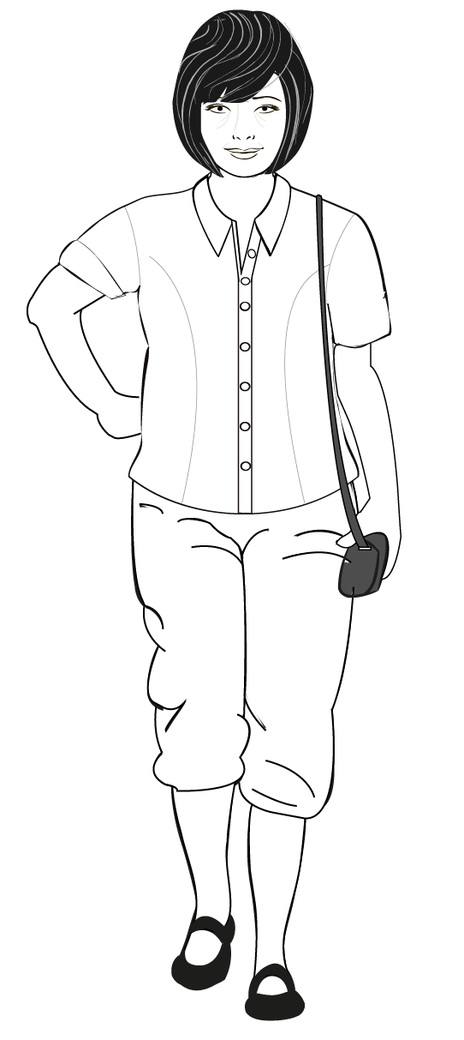
Case Study: Debbie
“I’m Debbie and I am a retired widow on a nurse’s pension living near Chester. My granddaughter has been living with me for a while.”
“I have taken control over managing my finances in the last year by cutting out impulse spending and I have also stopped smoking. I have not been able to save, but this is because I’ve chosen to help financially support my daughter.”
Managing money
Budgeting tools
    For Debbie it’s about cutting down on impulse spending and understanding her bad spending habits and changing them over the year.
    She makes lists and sticks to them, she has stopped impulsively buying food for dinner and making do.
    Debbie has also been cutting down on bills.
    She has found being on a fixed income (her pension) has helped her manage her money.
    Debbie now thinks about spending as a scale: ‘necessity’ first, ‘want’ second, ‘like’ third and ‘luxury’ fourth.
    “Instead of thinking of just popping out to buy something I fancy to eat I think twice and make do”
    Debbie kept a written diary of her spending but wishes that she could still use the app.
    The app and the diary allowed her to face what she was spending and not bury her head in the sand
    She can’t find an app that works with her older phone that she is confident in using
    She wishes writing the diary was easier but feels that it is worth the effort
“I really found it useful. It was time consuming but that really was the point. The act of writing things down makes them harder to ignore. Long term I would kill for an easier way but it has served me well.”
Impact vs Control
Changes over the year
    Feels that she now knows she cannot blame anyone else for her financial situation and it’s something she has to own and be responsible for.
    Although Debbie is spending less on herself, she isn’t saving as she is paying expensive vet bills and financially supporting her daughter.
    Debbie has cut out bills that she wasn’t allowing for, like hairdressing, charity donations.
    Cut down on various expenses (such as window cleaning) now uses relatives to help out on services like this.
    Feels that although she is not rich she has been able to achieve short-term saving and finance goals that have really helped.
    “Although I’m not exactly rich I am able to achieve short term goals and work towards longer term ones”
    Debbie feels more in control of her finances than before, has given up bad spending habits, stopped smoking and got a smart meter.
    She was overspending in supermarkets – so now she just makes a list and sticks to it
    Debbie’s granddaughter has been living with her which has increased the cost of her bills
    She says she has really changed her spending habits over the last year, and the study really was a catalyst for this change

Slide 19
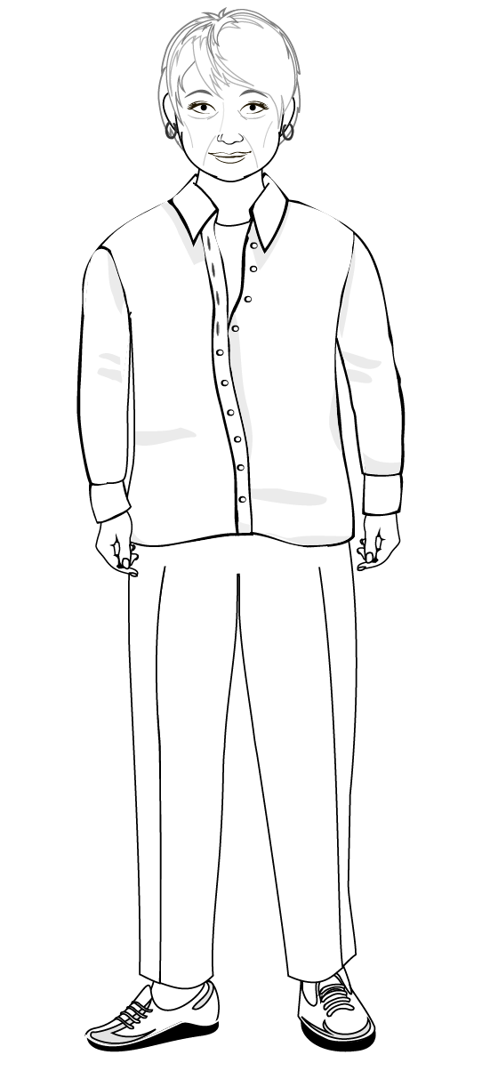
Case Study: Rosy
“I’m Rosy. I’ve been retired for about two years. I have two grandchildren who I like to be able to spoil. Since I’ve retired I’m enjoying the freedom to travel.”
“Over the last year I have used budgeting tools to curve overspending, especially at the supermarket, which allows me to save a little each month.”
Managing money
Budgeting tools
    “I feel that saving falls into three categories, long-term investment (or for a larger project), short-term savings for small projects and a savings pot for emergency expenses. ”
    Rosy used the app throughout the study so she was able to see not only what she was spending but on what
    The app helped her cut out bad spending habits and allowed her to save
    She added an allowance into her monthly budget for unplanned events and expenses
    Prefers to use an Excel spreadsheet but feels the app is better for when you are on the go
    Thinks that it’s easy to let the habit slip of using the app but that the benefits outweigh the effort.
    Rosy makes a conscious effort to track her outgoings which has helped prevent overspending, allowing her to save a little each month
    She has been spending too much on the food shop, buying too much and therefore over budgeting
    The money she’s been able to save now goes into a regular savings account that has a good introductory offer of 5% interest.
“I think that the budgeting tool I used last year is a useful method of monitoring expenditure when on the go. It helps to identify where my money goes and where there are areas for potential rationalisation to optimise savings and ensure freedom from financial stress and incurring debt.”
Impact vs Control
Changes over the year
    Rosy does manage to save a little each month but feels that costs have been steadily rising which will impact on her being able to save and not be able to do the things she enjoys
    She feels on the whole, in control of her finances but has some minor lapses into overspending.
    She feels uncertain about financial security in the future and worries this will impact on her ability to enjoy the things she wants to do
    The tools have allowed her to track her spending in specific groups (bills, car, entertainment) which has helped her set budgets for each.
“I learned that I needed to curb impulse spending more rigorously and instead built in a contingency figure into my monthly budget to allow for unplanned events and expenses without going into the red. ”
    There haven’t been any significant life changes over the last year
    But she is finding it more difficult to save compared to a year ago due to increased costs
    She has tried to cut out unnecessary food shopping
    She is managing to put away small amounts of savings

Slide 20
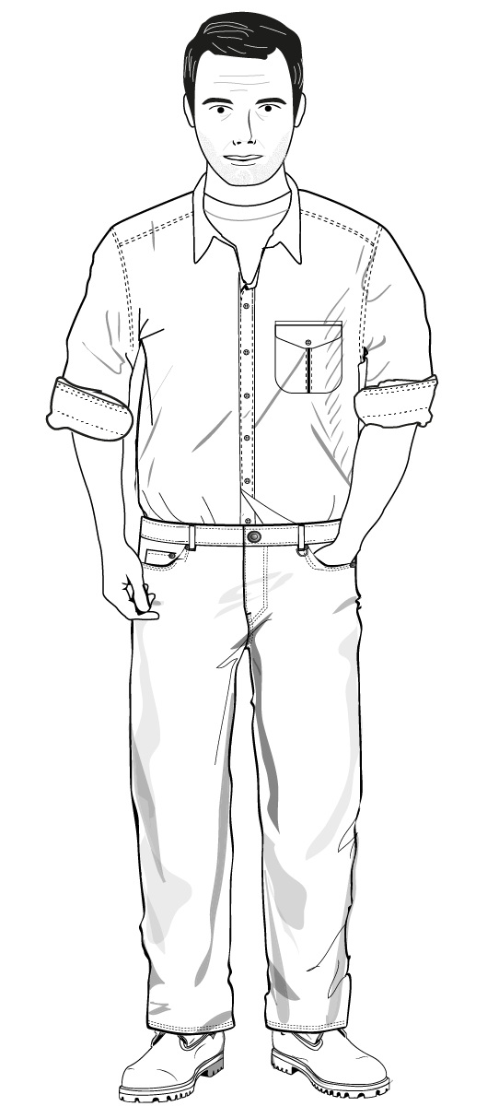
Case Study: Michael
“I’m Michael, I live in Rotherham with my wife and three children and work as an IT manager.”
“I use a variety of fixed accounts and ISAs and I feel fairly comfortable managing money as I’ve been doing it for some years now.”
Managing money
Budgeting tools
    “I feel very comfortable managing and budgeting my finances as I have been doing it for some years.”
    “The app made me feel more in control instantly of my money.”
    Michael used the app which synchronised his accounts and found that it was really helpful and made him feel more in control of his money.
    Using the app allowed him to see that there was more money for everyday spending
    The app helped him make all his payments on time, so it helped Michael get the most from all his different savings accounts.
    Michael uses internet banking to check all the accounts regularly
    On the whole, Michael is fairly tight with money, had set budgets for the family and uses various savings accounts to maximise savings
    With the tool Michael realised they could actually increase their day-to-day budget and also save an extra £100 a month.
“Yes, I think the budgeting app has had a lasting impact. Prior to having it we did not put enough thought into budgeting and how we can maximise the efficiency of our finances which we now do.”
Impact vs Control
Changes over the year
    “I used to forget to make certain payments or forget to fill up an account but the tool helped me organise which is crucial when many people have multiple online accounts.”
    “We make sure our money goes further when paying or saving.”
    Michael is fairly confident managing money and has a variety of accounts
    He has been managing these accounts for a few years now and does so for the family
    Although he is confident he feels that the interest’s rates are low and impact saving.
    Interest rates have decreased and therefore Michael is finding it more difficult to save money, he is thinking about investing the money into property instead
    Feels that using the app helped maximise savings and has had a lasting impact that showed him how to budget and organise his and his family’s finances more efficiently.

Slide 21
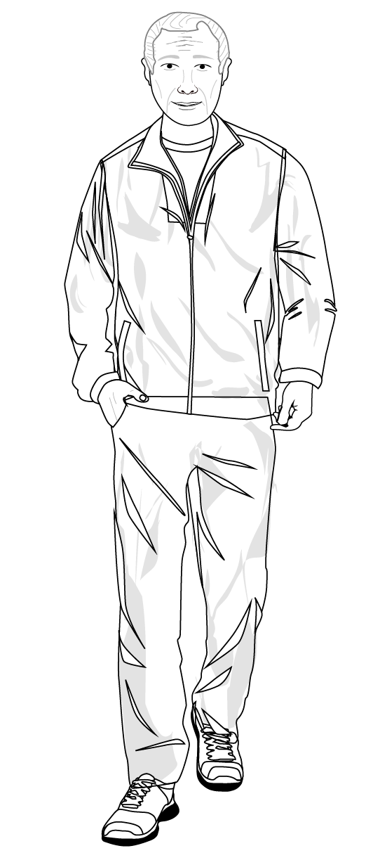
Case Study: Hugh
“I’m Hugh, I’m 63 and I retired from full-time work 3 years ago due to ill health. I used to work in management consultancy and I live with my wife in Wiltshire.”
“I mainly use a personalised spreadsheet for managing and budgeting money for the household.”
Managing money
Budgeting tools
    “The key thing is that the money is separated from the account used for day to day spending.”
    “Participating in the trial certainly helped me refine the way that I manage my finances.”
    For Hugh, saving is about putting aside money that you don’t need immediately for day-to-day living
    Hugh is usually able to save a bit of money at the end of each month, this hasn’t changed over the last year
    Hugh feels that he is living within his means so for him budgeting and monitoring is to make sure his household’s spending doesn’t go “awry”
    Monitoring the finances also means when he does need to “tighten the belt” to save for a big holiday for example, he knows how best to save.
    Hugh used the Spending Tracker app in the trial and found it easy to use
    He found that participating in the study helped him manage his finances better and it helped him think about the expenses he was grouping together and helped him refine this process
    He has since gone back to using the spreadsheet but the app really helped him think about how he grouped his finances.
“Yes, I think the budgeting trial has had a lasting impact on me. As a result of using the tool I have changed the way I manage my finances and now I have a much more accurate and timely way of monitoring expenditure.”
Impact vs Control
Changes over the year
    “With online statements I just feel that I do not have my finger on the pulse of my finances.”
    “I have adopted some of the ideas that it introduced me to; specifically this has meant that I am keeping a far closer watch on cash spending.”
    Feels fairly in control of his finances, manages the household finances and uses his own spreadsheet which he is constantly tweaking to fit their needs.
    The change to using online statements for credit cards and bank accounts makes Hugh feel less in control. He also feels they are less accessible and make his spending less trackable .
    The last 12 months have been fairly financially stable for Hugh and his wife
    Budgeting used to be retrospective for Hugh, due to the availability of statements, but now it can be approached quicker as he can access all the statements online so he can forecast his spending rather than having to look at the previous year to predict this year’s spending.

Slide 22
Conclusions
Further Information

Slide 23
YouGov’s concluding thoughts
Whilst participants mostly did not continue to use the planning tool they were given during the trial, there is evidence that in some cases the trial did help to shift behaviour.
Over 1/3 stated that the trial had a positive impact on the ability to manage finances, particularly those who did not have a system in place before the trial. Almost half felt that it made them feel more in control - this remains consistent with the post questionnaire showing that the changes could be lasting.
It is sometimes difficult for people to attribute how much of the changes they make to managing, planning and organising their finances was down to the tool, and how much came about due to other factors (macro and micro). It seems like it is easier for people to see a direct link between using a budgeting tool and feeling more ‘in control’ of their financial situation – as this is a more direct and tangible link.
Those who didn’t see the impact of the tool were often those with higher financial capability, who already had their own means of planning and managing their finances. Those who did see changes were likely to have made changes to their lifestyle which they have maintained since the trial.
Very few people had gone on to use another app in place of the ones we tried in the trial, and most had reverted to using a paper-based approach or an Excel document.
Whilst participants had taken learnings from the principles of budgeting tools, this trial shows that tools need to be simple and easy to manage over time to sustain engagement.
This research also suggests that tools that require on-going and regular input and observation may not be sustainable, longer term. Perhaps it is better to have something that can be used at less frequent intervals, when needed and when a change of circumstances arise.

Slide 24
Royal London’s concluding thoughts
Eighteen of the 37 participants felt the trial had a lasting impact on them. One told us it helped them curb their overspending, especially at the supermarket, allowing them to save a little each month. Another said they now thought more about budgeting and how to maximise the efficiency of their finances. While another said they now monitored their expenditure much more accurately. Thirteen participants were not sure if it had any impact on them and six said it had no lasting impact. So the results are mixed.
Fourteen of the 37 participants said the trial had an impact on how they plan, organise and manage their money. But the same amount of people said it hadn’t had an impact on them despite them having stuck with the tool we gave them for three months. So while some people changed their behaviour as a result of taking part, others did not.
Sixteen of the 37 participants thought taking part in the trial made a difference to how in control they feel about their financial situation. While almost the same number (17) disagreed with this. It’s worth noting that many of the latter had already felt in control of their financial situation and been using a trusted budgeting method before the trial began so we would not expect a change in them.
While it’s encouraging to see some long-term examples of participants changing their behaviour and feeling more in control of their finances as a result of using the tools, it’s important to remember that most people stopped using the tools we gave them when the three-month trial period came to an end. However, some of these people reverted back to their previous budgeting method so the lack of interest in using the budgeting tools we gave them does not mean these people were not interested in budgeting.
The people who took part in the final phase of our research were the most enthusiastic/conscientious of our original participants – these people used the tools we gave them for the full three months of the original trial and agreed to take part in this follow-up research. So they were not representative of our original sample or the UK population in general. Given the lack of engagement in the original trial, we have concluded that very few people would use a budgeting tool, be it an app or pen and paper, over a long period unless they were already doing so. However, in the short term there is clear evidence that the trial helped some people (albeit relatively few) to take control of their spending and make savings. Also, just because people did not stick with the budgeting tool we gave them does not mean that they won’t be budgeting in some other way.

