Slide 1
Panel Discussion: The Partnership of DataStream
Gila Somers, Government of the Northwest Territories
@WatersNWT

Slide 2
Notes:
Introduction– I primarily work with communities in the Northwest Territories -wide Community-based Water Quality Monitoring Program. I worked closely with Carolyn and Lindsay, and Teresa through the development and work with them on the continual improvements of Mackenzie DataStream. I also work with many great people who also work with communities and researchers, who are out in the field to collect water data, who analyze the data, who participate in the regulatory processes for water licenses and environmental assessments, and who work on water governance and implementing our territorial water strategy and transboundary agreements.
I am somewhat of a data geek – and I value the importance of data – and its importance for understanding our aquatic ecosystems, its importance for supporting decision making, and the importance of communicating the information to communities and the public.

Slide 3
Jurisdiction | Basin Area km² | % Total Basin
British Columbia | 274 500 | 15.3
Alberta | 444 700 | 24.9
Saskatchewan | 134 100 | 7.5
Yukon | 129 500 | 7.2
Northwest Territories | 804 200 | 45
Total | 1 787 000
Mackenzie River Basin = 20% of Canada
Notes:
I’d like to talk a bit about where I am from. I am from Yellowknife, and live within the Mackenzie River Basin. As shown here, the Basin equals about 20% of Canada’s land mass, covering almost 1.8 million square kilometres. It contributes 60% of the freshwater flowing to the Arctic Ocean from Canada. It has been stated that the Mackenzie River Basin’s natural water-ice-climate system helps stabilize the Earth’s climate and therefore has significant global importance. This global importance emphasizes the need to make decisions that benefit healthy northern lifestyles and sound environmental stewardship, and also contribute to Canadian and global advantage.
Unlike most river basins, the majority of development is in the upstream portion of the basin occupied by the three provinces while there is little development downstream in Northwest Territories and Yukon.
Sharply contrasting political, cultural and economic conditions, as well as water use patterns exist between the upstream and downstream portions of the basin. Looking within the Provincial / Territorial administrative jurisdictions, the NWT manages 45% of the land. Although the Basin covers a vast area and encompasses five political jurisdictions, the population is sparse. The majority of people (about 90%) reside in the Peace and Athabasca regions of British Columbia and Alberta.

Slide 4
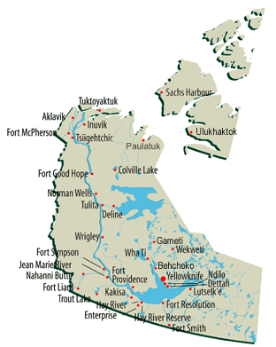
NWT Quick Facts
Capital city: Yellowknife
Territorial Population: 42,810
Total Area: 1,170,000 km²
Number of Communities: 33
Official Languages: 11 official languages, 9 of which are Indigenous

Slide 5
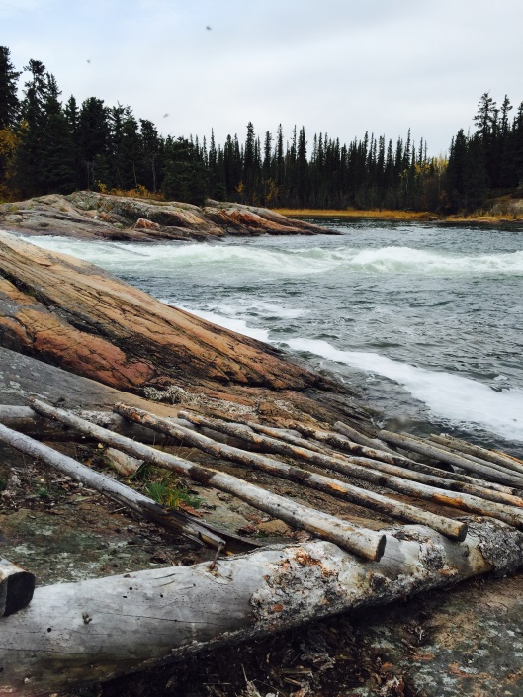
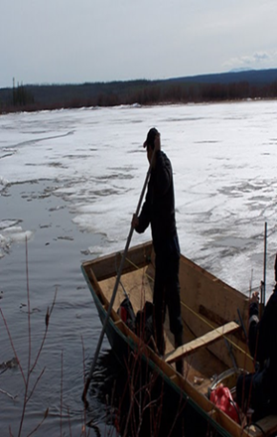
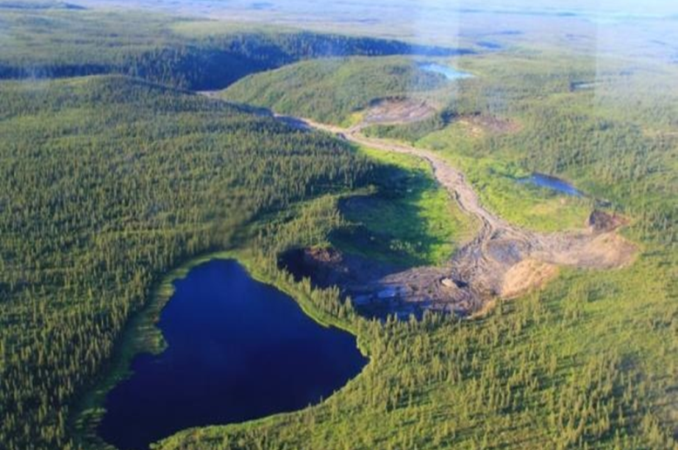
Notes:
Water is sacred. For the People of the North, Water is Life. Water and the land are spiritually and culturally and ecologically important for NWT’s Indigenous people and their way of life. For centuries, people have lived on the land, learning to adapt to its harsh climate. The Mackenzie River itself is of great economic importance to the North and is a main transportation route.
For less than a century, modern transportation and resource extraction and population growth have been changing the character of the Territory.
Although there are many influences on water quality and quantity, maintaining natural ecosystem health and diversity is critical and of prime interest to Northerners.
Aside from downstream development influencing the quantity and quality of water is Climate. Climate change affects NWT’s water through extreme weather events, increased variability in precipitation, increased wildfires, as well as thawing of permafrost.
Climate change experts are forecasting that the Mackenzie Valley will likely experience some of the greatest increases in temperature in the world over coming decades.

Slide 6
“The waters of the Northwest Territories will remain clean, abundant and productive for all time.”
Northwest Territories Water Stewardship Strategy
Notes:
As you may be aware, the Northwest Territories has a very unique political structure. We don’t have political parties; we are governed through consensus - a system adapted from traditional Indigenous systems of governing.
Land Claims, self government and co-management regimes have given Indigenous people a more active role in managing resources than in most Canadian jurisdictions. We work closely with Indigenous governments and other partners, including the Federal government and neighboring jurisdictions, to effectively manage our valuable and important resources.
We recognize that we need to work together to protect our aquatic ecosystems, traditional livelihoods and the life system of the north. The federal, territorial and Indigenous governments and organizations all have roles as legitimate and responsible managers of our water resources and in ensuring the value of water is maintained; all have contributed to the development of the Northern Voices, Northern waters, Water Stewardship Strategy and Action Plan. The vision of the strategy is that the waters of the Northwest Territories will remain clean, abundant and productive for all time.
Mackenzie Data Stream was developed in partnership with the Gordon Foundation, as an online data management system to support individual, community, regulator and decision makers to access water quality information. Often research and monitoring information was collected, rarely communicated and not accessible for communities to use. When there is a lack of timely communication of information, it can and has lead to mistrust and there is a potential for undue alarm.

Slide 7
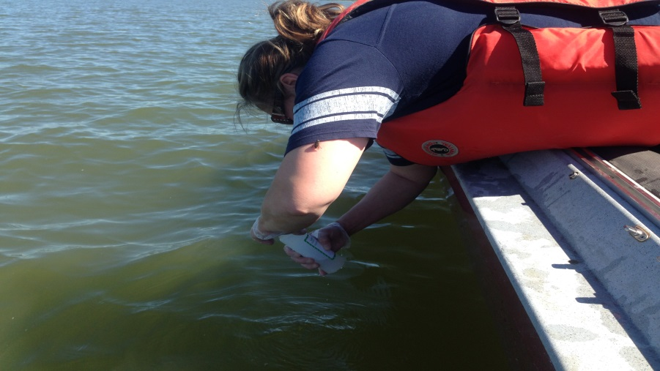
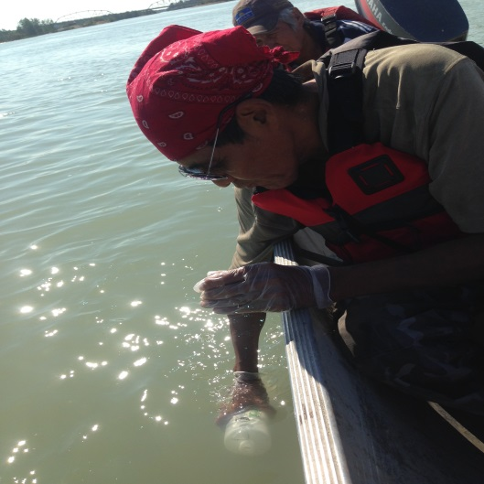
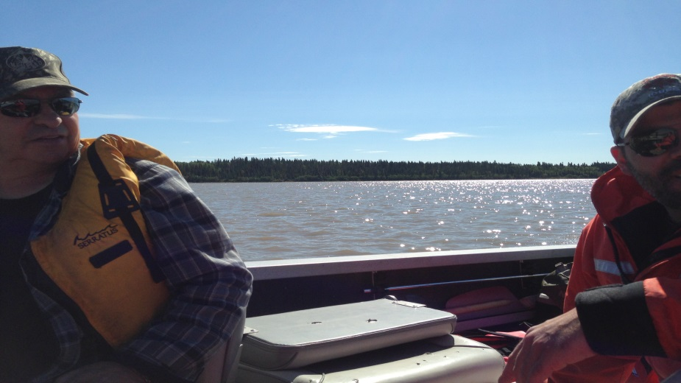
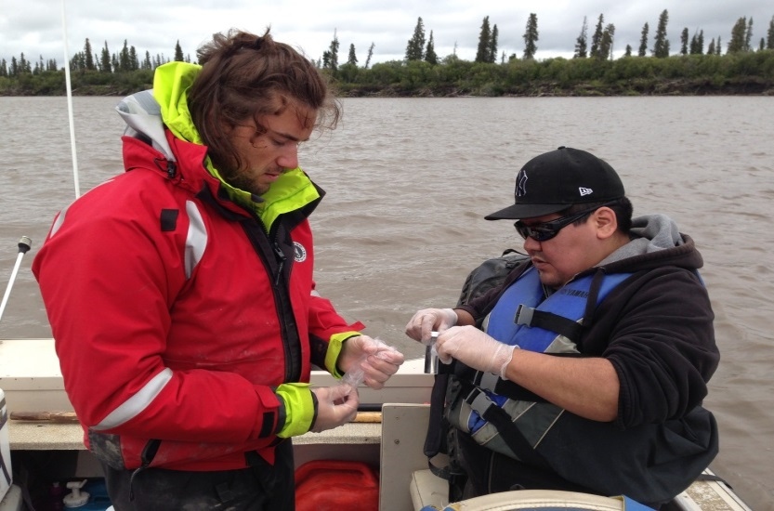
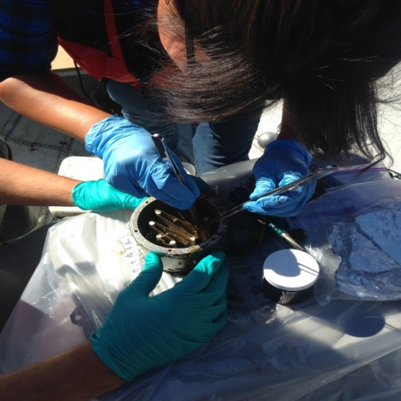
Community monitors are important!
Notes:
The community monitors are critical – they provide local knowledge and building their capacity for water monitoring and stewardship so very important. These monitors are filling data gaps – At a number of the sites, we’re collecting data in places it hasn’t been collected before. We’re using equipment that hasn’t been used before which gives new information.
We did a five 5-year review the data of the CBM program including an analytical focus on the community questions.
preliminary results indicated that the CBM program generated reliable data that are comparable to those collected by trained government staff.
The CBM program data analysis was able to answer a number of community questions, while others will require a longer data record or different sampling strategies.
Mackenzie DataStream has been effective in linking communities with other entities such as connecting researchers and to build research capacity.

Slide 8
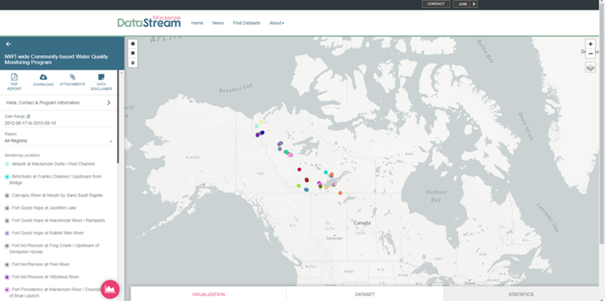
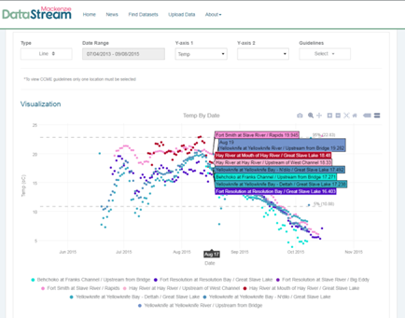
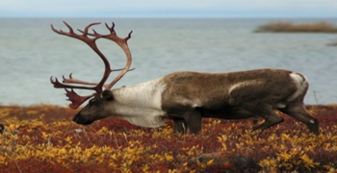
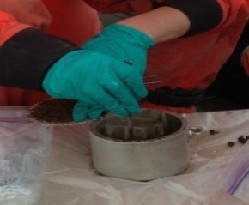
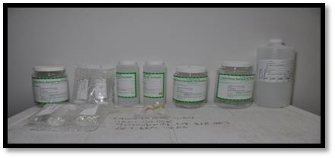
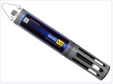
Integrated Decision Making
Photo credit: YSI.com
Notes:
We recognized that the best approach to effective water stewardship and management requires transparent research and knowledge – both scientific and traditional knowledge.
Mackenzie DataStream was the pilot project to lead the way for transparency and access to public water quality information. Northerners needed a place where we could come together and share, and learn about water quality in the Basin.
Mackenzie DataStream was developed to be a user friendly, ethically open access data portal to get this information out in a useable format. This is critical to being able to influence policy or decision making. And ultimately to have the information to make informed decisions at multiple levels – at the community level, at the regional government level, at the territorial government level, and at the interjurisdictional level through the Mackenzie River Basin Board and transboundary bilateral water agreements.
We do have the commitment and responsibility to provide data to communities first prior to the general public.
Getting information back to the communities in ways that meet the diverse needs of the public and communities is important and area requiring further exploration and continual revision and enhancement. Mackenzie Data Stream is a tool that allows community users to interpret the results in plain language ways, better enabling the community partner organizations to get the information out to their communities.

Slide 9
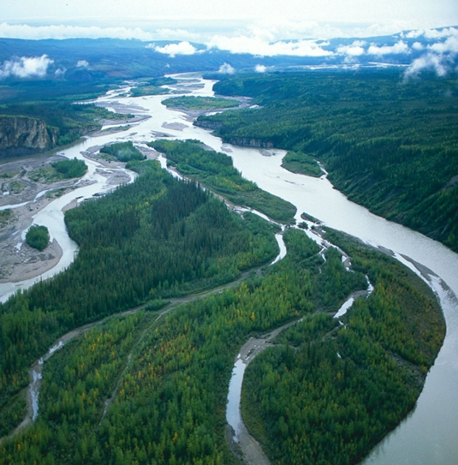
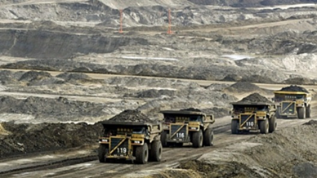
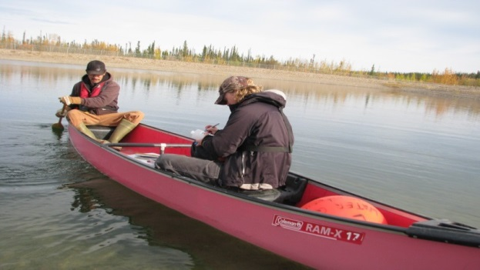
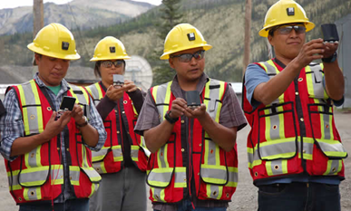
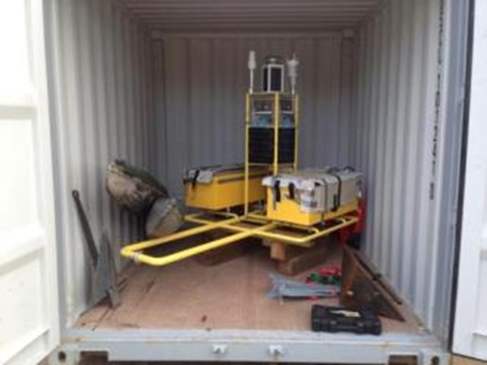
Linking to Industry, Academia and other jurisdictions
Photo credit: CBC
Photo credit: Miningandenergy.ca
Notes:
Our ethically open data has been accessed by communities, Indigenous governments, regulators, industry, not for profit organizations and academic researchers.
The data on the site has help support program planning for guardianship monitoring, the data been used to develop triggers in water licence hearings, to develop status and trends reports with NGOs and First nations, it is being used in cumulative effects modelling and climate change modelling, and as a spatial component of industry's monitoring programs and annual reports to land and water boards. It is seen as a much needed space to house data to address concerns regarding quality of water, and it is being accessed within the Territory, across the Basin, Canada and Internationally.
An example of the system supporting decision making can be highlighted are during a Oil and Gas Pipeline installation public hearing. There were public concerns were based on the water intake line being downstream from the proposed activity. The community was concerned about the potential increase of turbidity from frack outs during construction, and action levels were being discussed.
Regulators needed to know what the baseline range, and the CBM data was the closest proximity to the proposed activity. The company was using data from Environment and Climate Change Canada’s long term monitoring network. This data was below the construction site on the Liard River confluence which had a very high Turbidity level. The company was proposing the action levels to be based on ECC information.
The regulators decided to take a look at the CBM data, which was about 1 kilometer downstream from the construction site and upstream of the EEC station. It was found that it was much lower than the ECC Liard River information, as the turbidity settles out in the Mackenzie. The regulators were able to model information provided by Mackenzie DataStream to develop a spatially appropriate trigger level. There are other specific examples that I can draw on, but I think even this one example illustrates the power of DataStream.

