Slide 1
Panel Discussion: The Partnership of DataStream
Elizabeth Hendriks, WWF-Canada
@WWFCanada

Slide 2
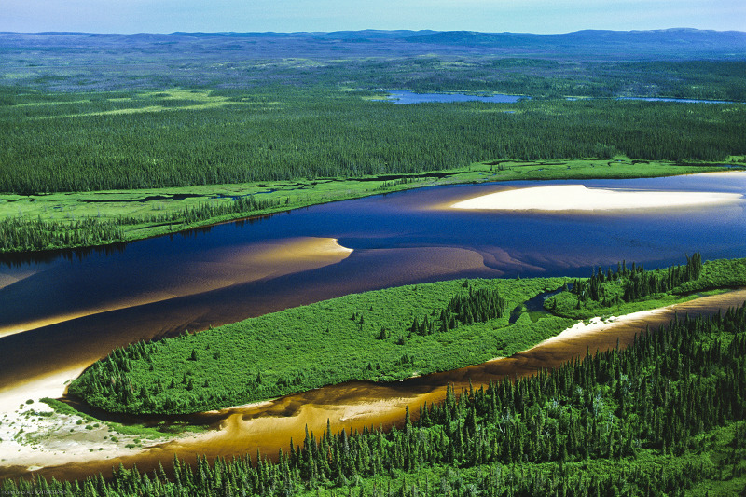
Elizabeth Hendriks, VP Freshwater
Notes:
Good Morning everyone and thank you for joining today. Thank you to the Gordon Foundation for having me speak.
Since 2013, WWF-Canada has been working toward releasing this groundbreaking research to build a clear picture of the state of all Canada’s watersheds.
In the first 2 years we created a scientifically-peer reviewed methodology, coded the assessment and created the online platform to communicate results.
Over 5 years, We hosted 30 or more webinars nationally to review results with local watershed groups and partners including scientific experts
We Worked with 171 data contributors
And invested well over a million dollars to understand the health and impact to Canada’s 25 major watersheds and 167 subwatersheds.
One, might ask, why all the effort?

Slide 3
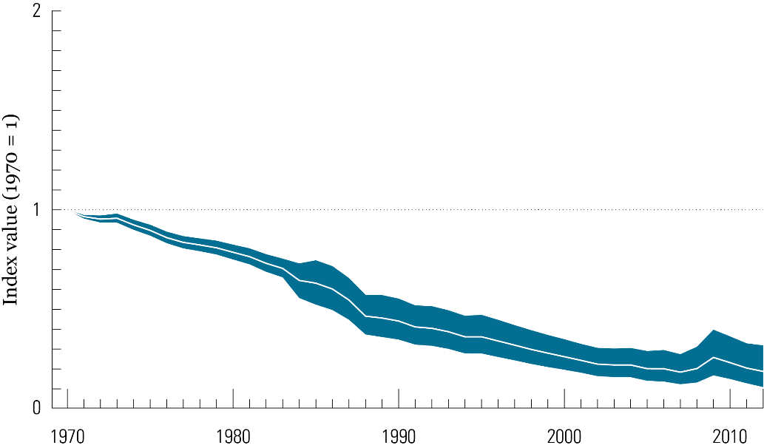
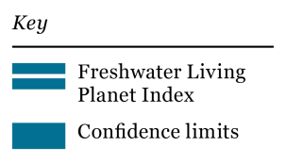
The Living Planet Report
The freshwater LPI shows a decline of 81 per cent between 1970 and 2012
Notes:
WWF-International produced a Living Planet Report which includes a Living Planet Index that measures changes in abundance of the world’s wildlife populations. The freshwater LPI measures the trend in aggregated abundance. Of 881 species living in lakes, rivers and wetlands measured there was an 81 percent decline in freshwater species between 1970 and 2012. The decline of freshwater is worse than terrestrial and marine. 81 percent decline in freshwater species !
the International Union for Conservation of Nature’s recent report estimates that global water requirements will increase by 40 per cent by 2030, only 13 years away.
The global water crisis is real and data in the latest Living Planet Report reaffirms this.

Slide 4
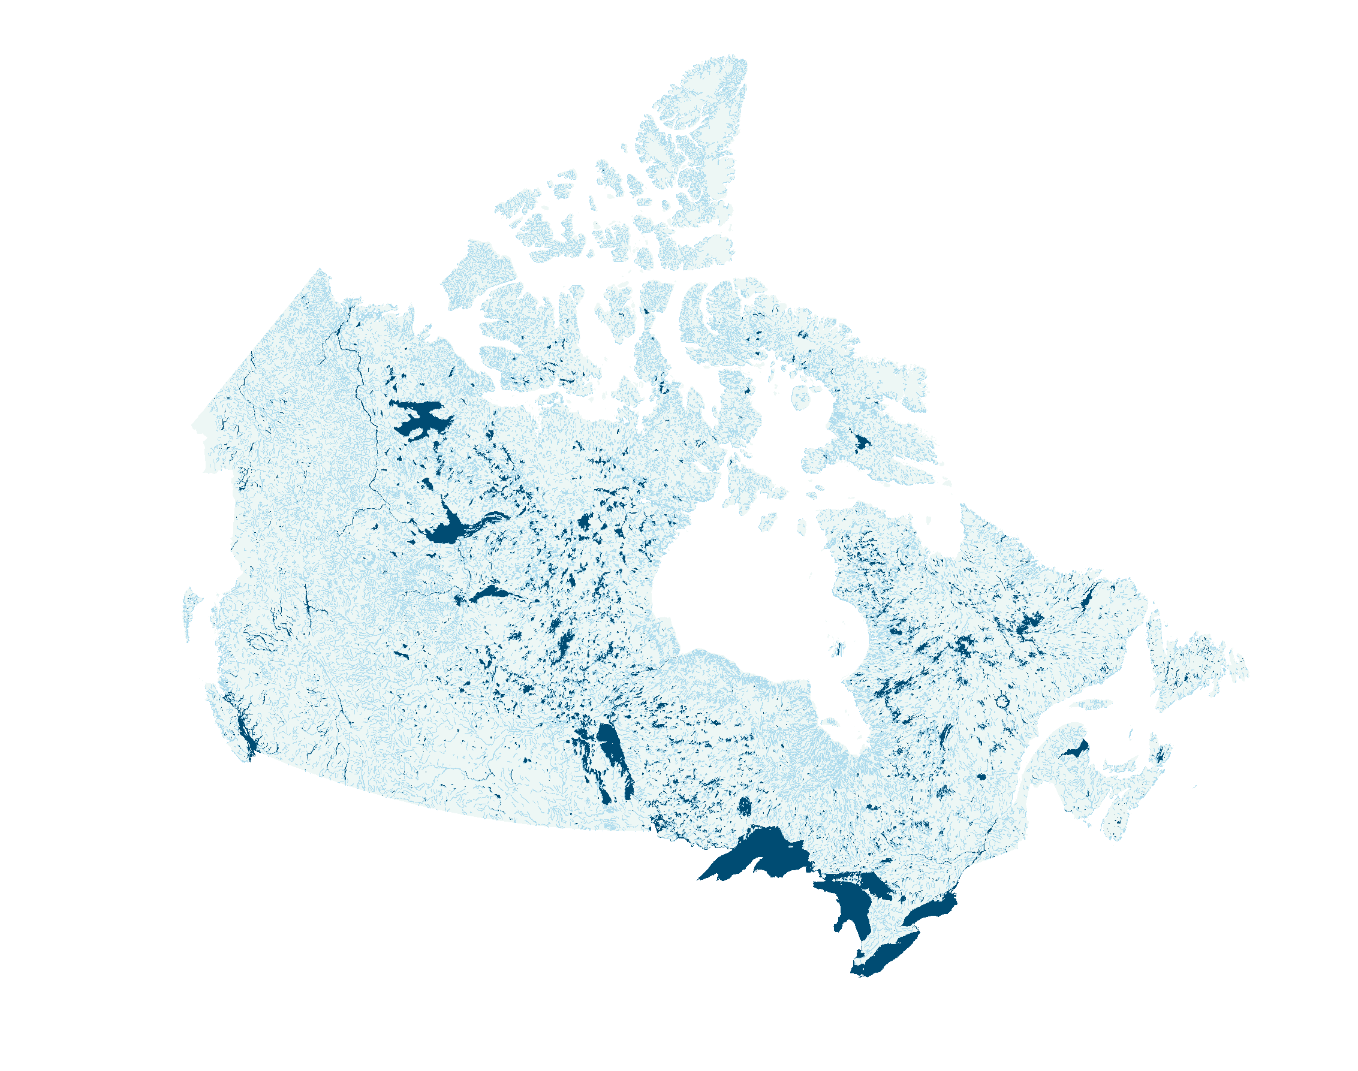
Canada mapped by rivers, lakes and streams
Most
important
resource
85%
60%
20%
Notes:
Closer to home, Canada has a global endowment of water with 20 per cent of the world’s freshwater supply.
60 percent of that water flows north
85% of the Canadian population live along the country's southern border.
And according to RBC’s 2016 water attitudes survey, Canadians rank water as the most important natural resource, ahead of oil and gas
So, it’s tempting to think of the global water crisis as “someone else’s problem.” Canadians have always been told that we live in a water wealthy country. But the fact is: Canada has a water problem, and not understanding our water resource is the first part of this problem.
For decades, Canada has failed to collect, or as many of you in the room really understand, manage the real information on a national scale about the health of our freshwater ecosystems.
.

Slide 5
Watershed Reports
The Freshwater Threats Assessment (FTA) works with the Freshwater Health Assessment (FHA) to provide a full picture of the health and threats of our freshwater nationally
FHA provides the current state and FTA illustrates the influence of human impact on aquatic habitat.
We can then determine “how” to fix it through the appropriate course of action – policy, legislation, restoration, etc.
Notes:
The watershed reports are split into two different assessments: a health assessment and a threat assessment.
The Freshwater Threats Assessment (FTA) works with the Freshwater Health Assessment (FHA) to provide a full picture of the health and threats of our freshwater nationally

Slide 6
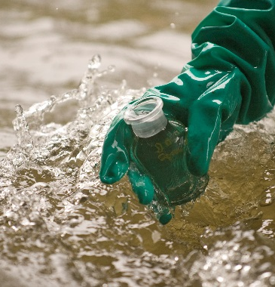
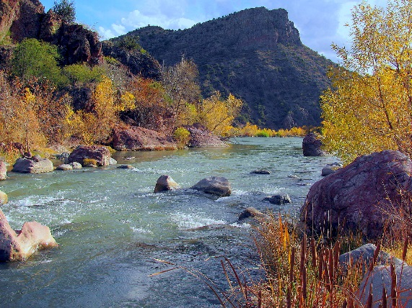
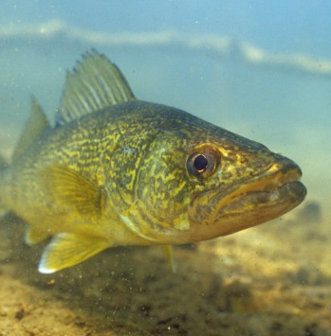
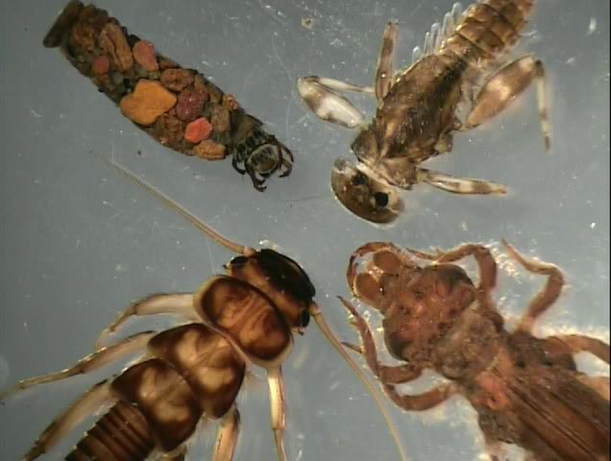
Indicators of freshwater health
Water quality
Hydrology
Fish
Benthic invertebrates
Data sources: All levels of gov., ENGOs, CAs, CBM, etc.
Notes:
The health assessment was based on short and long term trend data from on-the-ground organizations, as well as a range of data sources.
We focused on four indicators ( presented in this slide) that represent key elements of aquatic systems — water quality, hydrology (water flow), fish populations and benthic invertebrates (bugs)
We evaluated each indicator individually and assign a score ranging from very good to very poor. We calculated the overall health score by averaging the scores for the four indicators. If we didn’t have enough information to confidently determine a score, we note the indicator as data deficient
I’ll just review the national overall heath results and the water quality results.

Slide 7
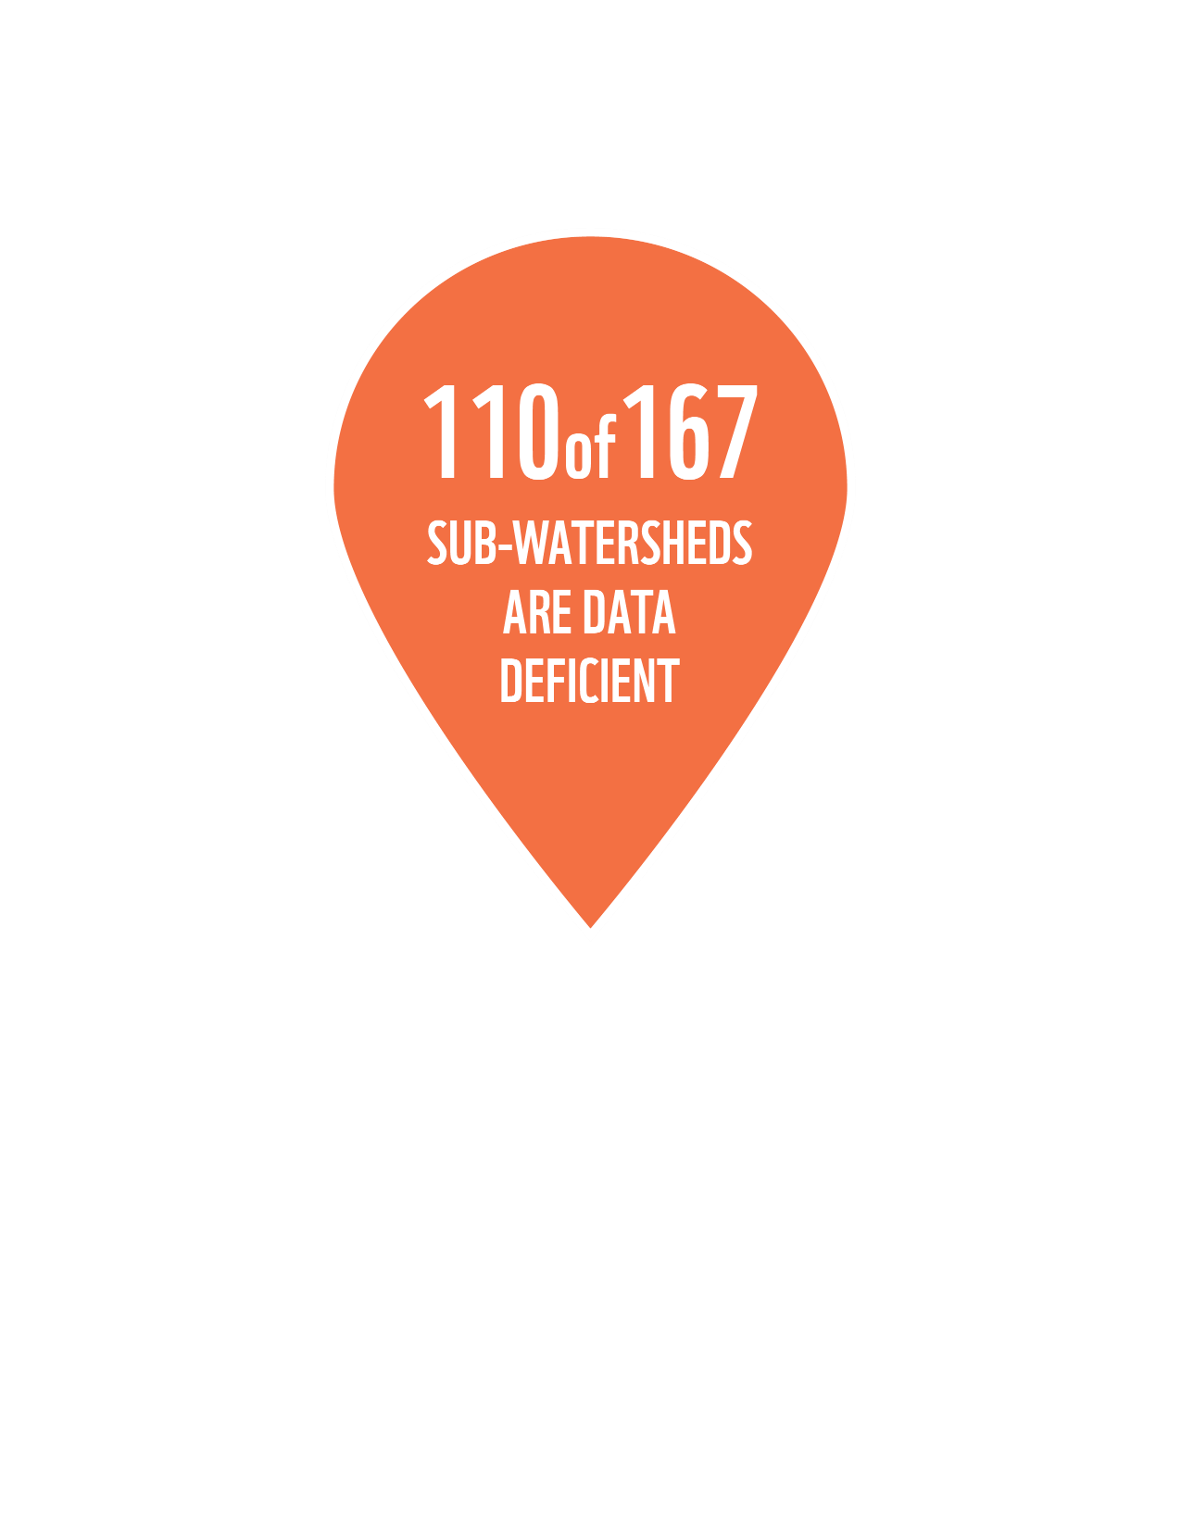
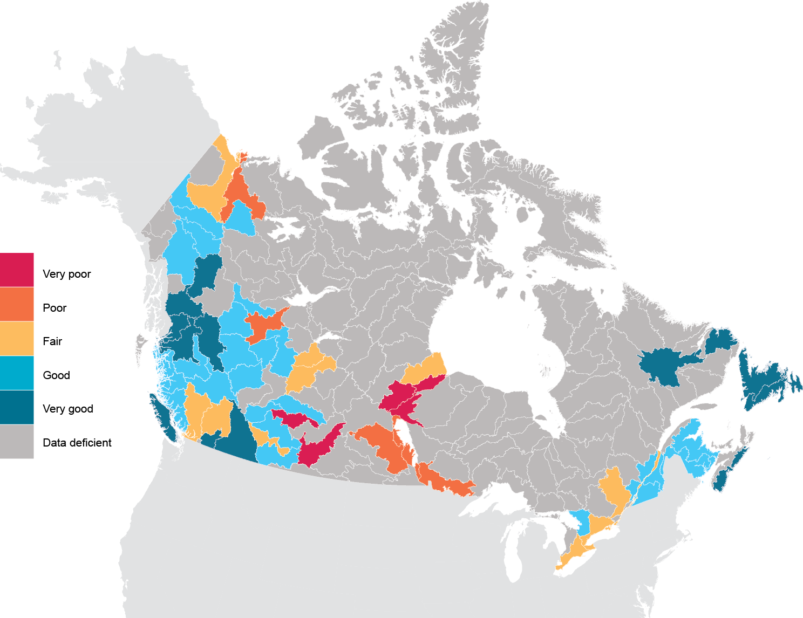
Overall health
Notes:
A large story coming out of our health results, is the lack of available or accessible data that would allow us to report on over half of all sub-watersheds in Canada. It is the accessibility issue that brings us to this event.
Of the 167 sub-watersheds in this country, fully 110 are lacking the data necessary to paint a baseline picture of watershed health. In those sub-watersheds, we were unable to assign a score for at least two of the four health metrics. For the most part, the deficiencies involve benthic invertebrates and fish.
Certain areas stand out as being of particular concern: The North and South Saskatchewan prairie watersheds, as well as the Peace-Athabasca, have many sub-watersheds with worrisome scores for multiple indicators. And data is inaccessible or unavailable to make firm conclusions about the health of the Great Lakes, Ottawa and St. Lawrence watersheds – surprising considering these watersheds are home to a significant portion of the country’s population, industry, agriculture and well over 100 at-risk species .

Slide 8
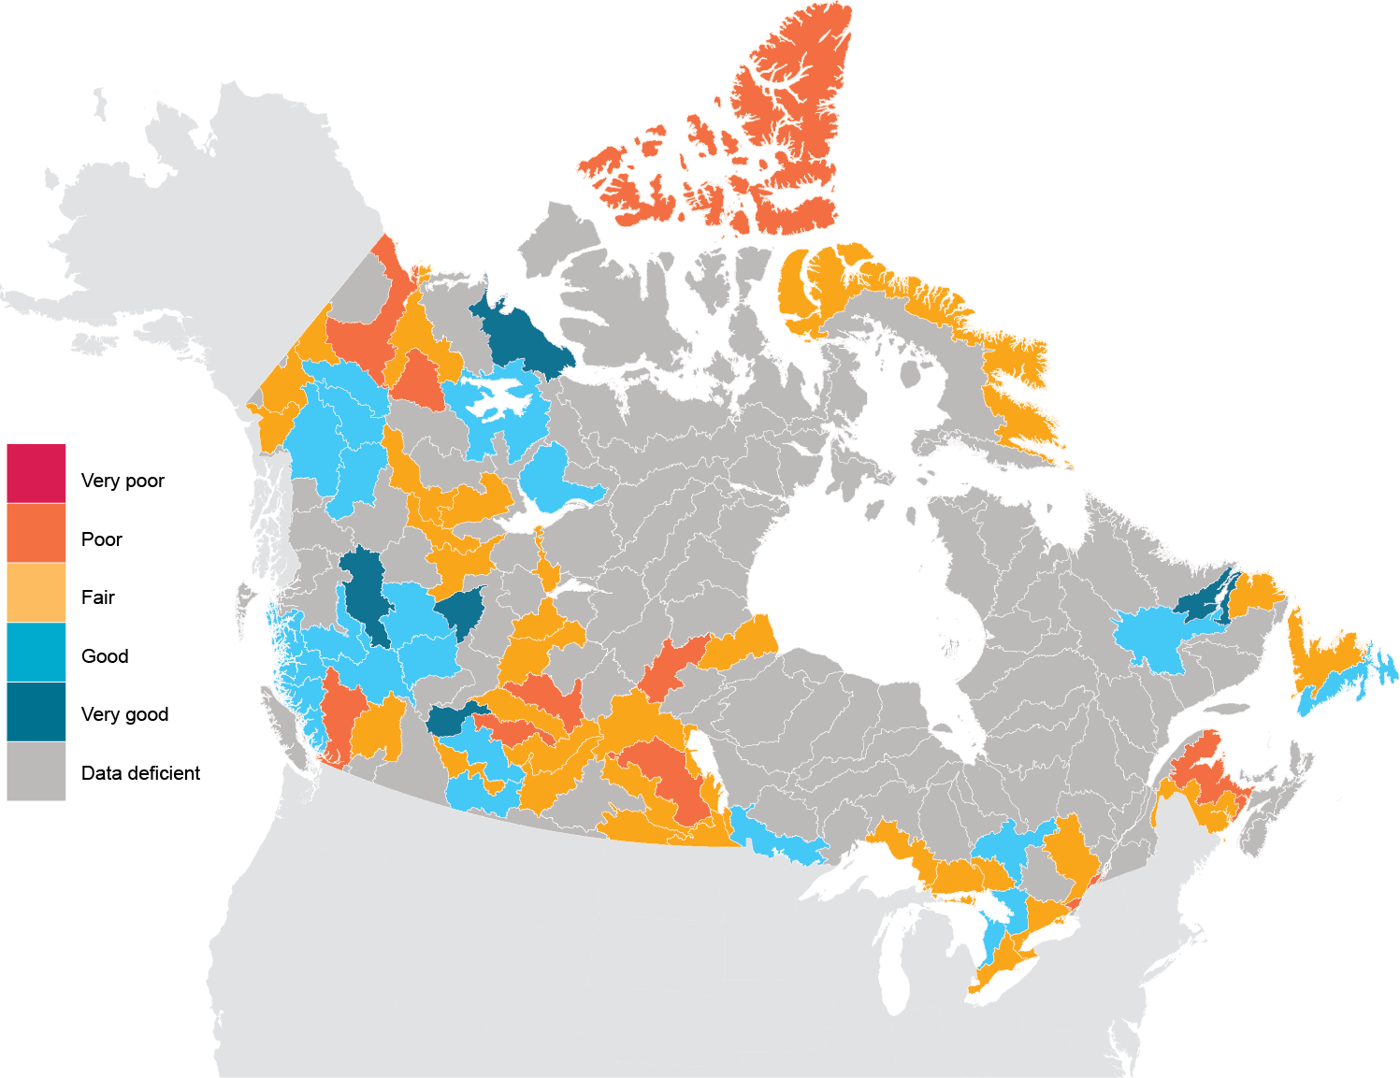
Water quality
Notes:
Data deficiency (root cause being availability or access ability) is a major hurdle to attributing water quality scores all across Canada. Only 67 sub-watersheds have available water quality indicator data, and of those 42 were found to have either poor or fair water quality. In some areas, water quality is undermined by agriculture-related contaminants such as phosphorous and nitrogen; elsewhere quality is affected by metals like aluminum or iron, either naturally present or introduced due to mining and industry.
In the 100 sub-watersheds without data, deficiency was mainly driven by lack of spatial diversity (not enough sites) or temporal diversity (not enough recent sample dates). However, low numbers of assessed parameters also played an important role.
To prevent attributing a score based on only a small number of parameters, the Watershed Reports requires at least 10 parameters measured for at least 10 per cent of the samples of the most recent five years – where this minimum criterion was not met, a score of data deficient was attributed.
I want to note, that because of our work with many of the communities here in Atlantic Canada we know, it’s less about availability of data and more about accessibility. It’s because of the networked approach to monitoring in eastern Canada that we heard from the Moncton workshop last year the opportunity to quickly leverage up what is already happening in Atlantic Canada.
And better inform action on the ground.

Slide 9
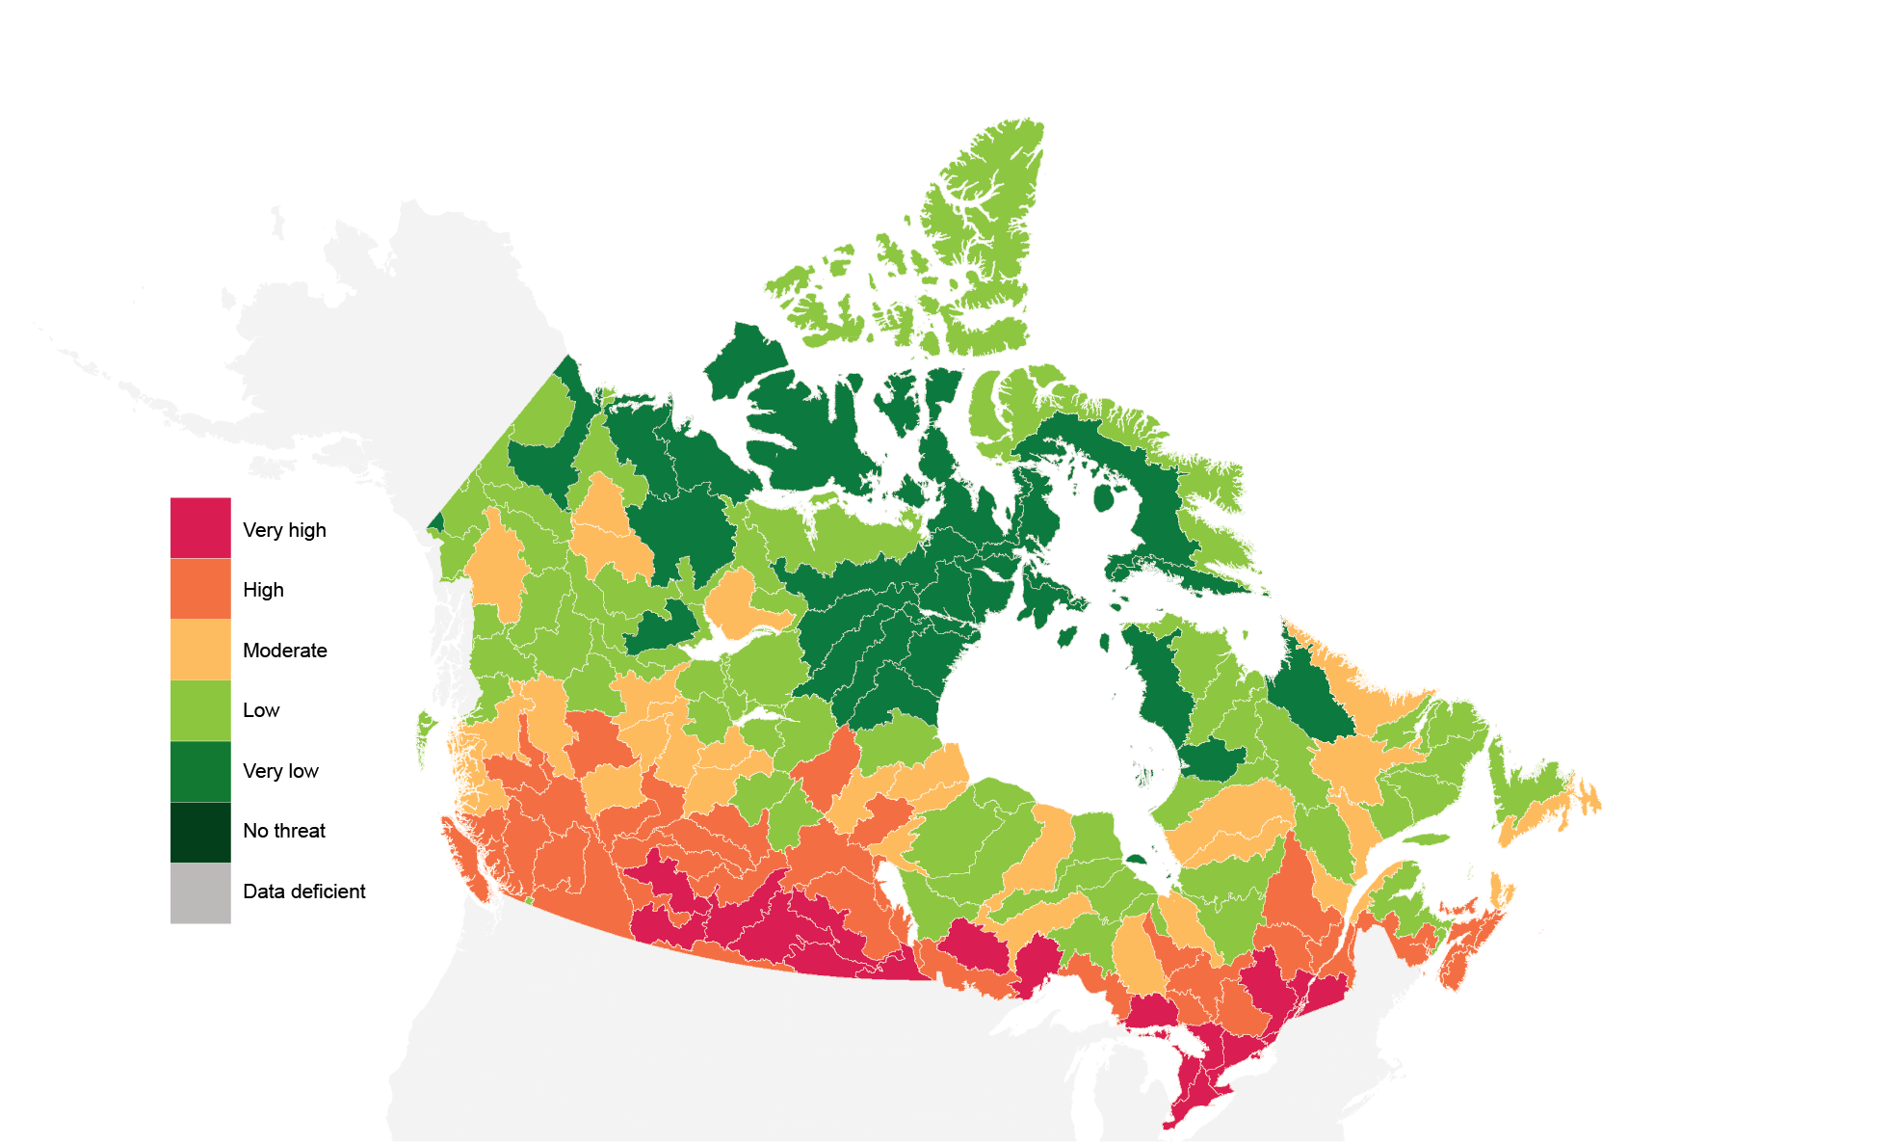
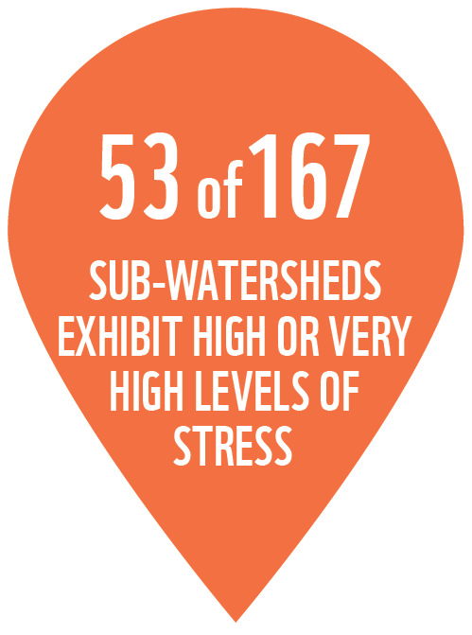
Overall threat
Notes:
While datastream and the next two days are about water quality and access to data, I just want to quickly mention the threats results because it’s starting and for WWF reminds us daily why we need to work locally and regionally to create new ways and systems of freshwater management.
We found significant evidence of disruption to watersheds that are crucial for our health, our economy and the wellbeing of wildlife, as a result of urbanization, forest loss, municipal and industrial pollution, agricultural runoff, climate change, pipeline incidents, oil and gas development, hydropower dams and other activities.
None of Canada’s 167 sub-watersheds are immune to all of the seven threats to watershed health.
Overall, 53 sub-watersheds exhibit high or very high levels of disturbance; only 84 were experiencing low or very low disturbance. Considering that most of the population lives along the souther border the highest road densities, and much of Canada’s agriculture, farming and industry are found further south, it isn’t surprising that watersheds in southern latitudes are more heavily impacted than those in Canada’s North.

Slide 10
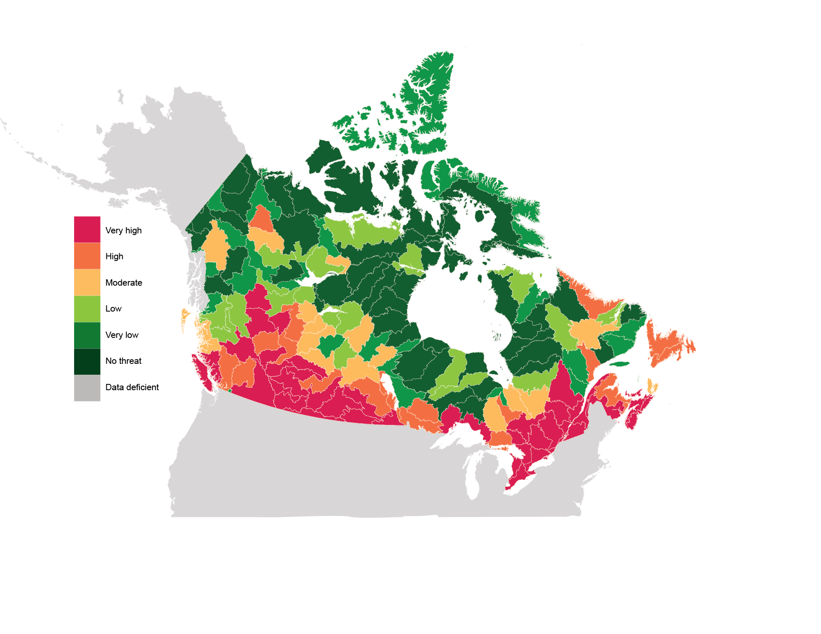
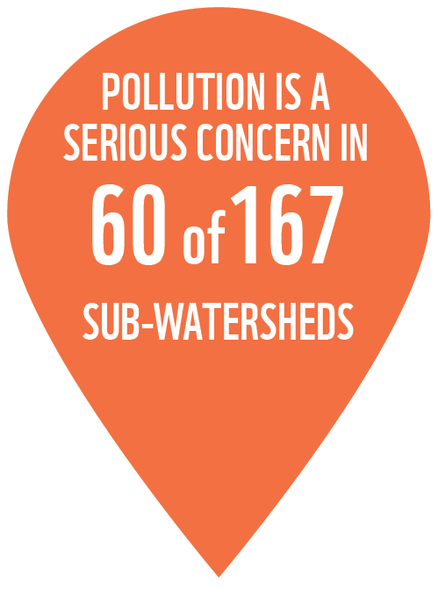
Pollution
Notes:
Pollution is a serious concern in 60 of Canada’s sub-watersheds.
In urban areas, point source pollution from municipalities and industry, for example, were strong determinants of the findings.
In rural and agricultural regions, agricultural contamination from phosphorous, nitrogen and pesticides drive the findings. Pipeline incidents, and pollution from the transportation of dangerous goods, are also affecting freshwater ecosystems.
Pollution can change the ecology and chemistry of rivers, sometimes in immediate and obvious ways (by killing large numbers of fish or making the water unfit to drink) and in other cases through the buildup of toxic substances in an ecosystem over a long period of time.

Slide 11
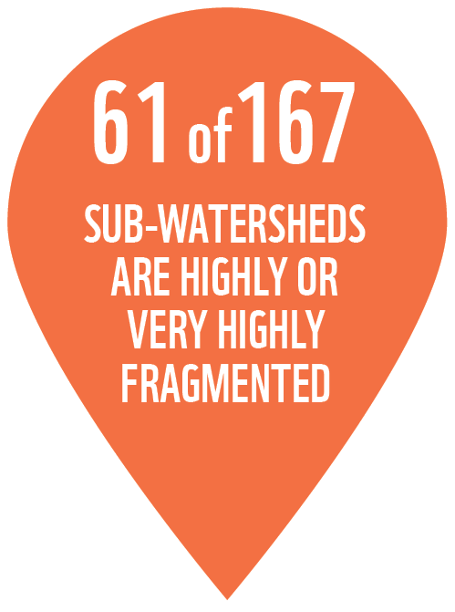
Fragmentation
Notes:
Roads and rail crossings as well as the presence of dams create a loss of connectedness between freshwater habitats. This can create small populations with limited genetic diversity and can also prevent migrating species from reaching upstreams regions to spawn.
61 of 167 sub-watersheds in Canada are either highly or highly fragmented. These are found along the southern border, where most of the roads, rails and dams exist.

Slide 12
RECOMMENDATIONS
Notes:
Many of you were at the workshop we cohosted with CBEMN which really helped inform our recommendations and what would come from our Watershed Reports we launched in June. To modernize freshwater management for the challenges of the 21st century, Canada needs to, and WWF is working with partners across the country do the following:
1. Invest in a standardized national monitoring system to track the state of freshwater as climate change and increased population put more pressure on freshwater ecosystems and wildlife.
A national monitoring system for Canada must account for local conditions like higher naturally occurring concentrations of metals; include real-time, monthly and annual standardized reporting; and be made available through newly created nationally linked regional hubs.
This national monitoring system should include mobilizing citizens to do things like collect data through citizen science. With proper training, tools and coordination this is potentially one of the most effective ways of getting large amounts of local data throughout the country
c. Priority should be on areas where significant resource development is proposed and where existing data shows negative trends.
2. The assessment methodology needs to account for regional differences, require consistent protocols on analysis to guarantee reliability, and be developed to integrate diverse datasets.
3. Because freshwater is a public resource, data should be open, available and accessible – whether collected by government, academia or industry.
4. And if we hope to understand trends over time, all levels of government must commit to conducting standardized freshwater assessments every three to five years.
For WWF, we see most of the capacity and pieces of these recommendations already at play in Atlantic Canada making it the ideal place to help invest in and build capacity in existing structures that would allow us to demonstrate the opportunity and ability to leap to the national scale.

Slide 13
Elizabeth Hendriks, VP Freshwater, WWF-Canada
watershedreports@wwfcanada.org

