Slide 1
Building the open metaverse
Openness and Open source
Royal O’Brien
GM, Digital Media and Games
The Linux Foundation
@OBWANDO

Slide 2
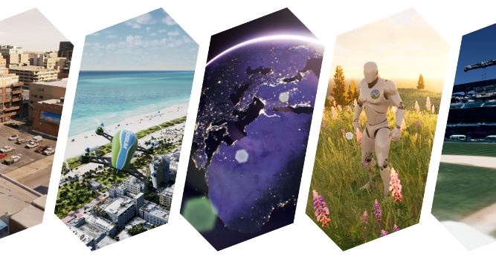
Metaverse: What we know and what we think it is now
Unlimited number of varying experiences
Entertainment, Business, Social, Limitless areas
Known / unknown experinces into Metaverse
Web, Mobile Apps, VR / AR, Projection rooms
Holodecks, Virtual Smell, Neural Implants!
Decentralized Technology Hubs
Proven by video, news, and social networks
Unlimited Scalability

Slide 3
Metaverse growth and scaling
Open sharing has the greatest speed of growth and innovation through evolution.
Organizational restrictions on sharing can slow the speed of growth
Open source can have unlimited resources unlike single companies
Open standards are needed as a common model to build upon

Slide 4
Open Source vs Open Standards
Not the same thing even though
they share the word ‘Open’

Slide 5
Open Source – The Implementation
Freely sharing code by anyone, anywhere with attribution
Licensing terms to ensure contributions become free and open to the community.
Built upon a decentralized community collaborating on a project to benefit from the result.
Tend to use Open Standards

Slide 6
Open Standards – The Specification
Creating a standard freely available to adopt, and implement.
Focus is on portability and interoperability.
Managed by a foundation of stakeholders to maintain quality and ensure focus kept
May discover new needs and features from open source implementations

Slide 7
Open Standards and Open Source
Starting point for openness
Prevent vendor lock-in
Create sustainable ecosystems

Slide 8
Balance: Metaverse is business and sustainable ecosystems matter
Flywheel of community and commercial
Sustainable projects have an ecosystem that enable and support openly developed technology into commercial products and solutions.
Commercial profits benefit businesses, who in turn are able to participate and reinvest back into the project and technical community.
PROJECTS
TECHNICAL
COMMUNITY
PARTICIPATION
TECHNOLOGY
PRODUCTS
MARKETS
PROFITS
PRODUCTS

Slide 9
Modular Metaverse experiences are key
3D Engines and synthetic graphics:
Unreal, Unity, Open 3D Engine (O3DE), Omniverse
Distributed cloud computing services:
AWS, Azure, GCP
Ad and social networks
Applovin, Adcolony, Facebook, Snapchat
Innovative Gameplay and simulations
Game studios, digital twins, scientific research

Slide 10
What role will openness play in the Metaverse?
Openness benefits both corporate and community interests
Each organization improves Metaverse experience through focused disciplines
Openness allows the implementation to speak for itself
Uncontested “Blue Ocean” projects can thrive and appear from anywhere
Openness benefits the Metaverse through an open & decentralized community
Metaverse projects can grow and stabilize with an open and sustainable ecosystem

