Slide 1
BUILDING THE OPEN METAVERSE
Dr. Nadine Alameh
Open Geospatial Consortium (OGC)
nalameh@ogc.org
Twitter: @nadinesa

Slide 2
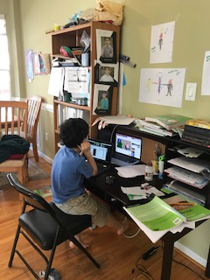
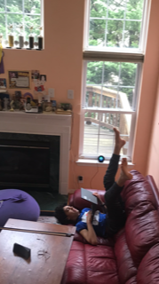
Why am I here?

Slide 3
Location (Geospatial) is everywhere
A
A
I
R
R
E

Slide 4
We have a responsibility
F
C
Open
A
A
I
R
R
E
Findable | Accessible | Interoperable | Reusable
Collective benefit | Authority to control | Responsibility | Ethics

Slide 5
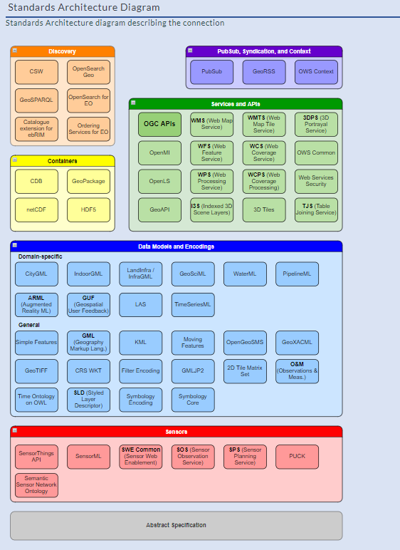
Metaverse-Relevant OGC Standards
https://ogcapi.ogc.org/
https://www.ogc.org/roadmap
https://www.ogc.org/docs/is

Slide 6
What’s the point?
For us to build a truly open sustainable equitable useful #metaverse that is bigger than each one of us!
Let’s not each reinvent the wheel
hence standards & interoperability
Let’s work to combine our strengths
hence standards & interoperability
Let’s ensure that our pieces integrate smoothly and at scale
hence standards & interoperability

Slide 7
What’s the point?
This is definitely NOT a one-time-thing!
It’s an evolving beast
so our standards and how we develop our standards are also evolving (at the pace of today’s innovation too!)
It’s not going to be done ”by magic” or “on its own”
so we need to be deliberate and genuine about our collaborations (and our standards!)
It’s only the beginning and we need to be ready for the unknown use cases (brought to you by my kids and yours!)
so we need to be agile
Get involved ☺

