Slide 1
The Platform for 3D Geospatial
2020 SIGGRAPH Carto BOF
Lisa Bos
Product Manager, Cesium
lisabos

Slide 2
Smart cities
Analytics
Tourism
Autonomous vehicles
Notes:
Brief:
Intersection of 3D graphics and geospatial
Load, host, tile, fuse with our data in position on the globe
Stream using 3D Tiles
Visualize with our engine
Then it’s up to you!
We’re true believers
Also believe that community and standards are essential to realizing the potential of 3D geospatial
Will share how we’re making it easier for you to build immersive, impactful 3D geospatial experiences

Slide 3
Cesium OSM Buildings
Notes:
Brief
Great 3D geospatial interactions need great 3D data
We’ve rounded out our global base layers with Cesium OSM Buildings
Based on OpenStreetMaps
True 3D buildings, clamped on Cesium World Terrain
More than 350 million buildings
Bring in the data and metadata for you to leverage
Excited to make OSM available through Cesium to our community
Already feeding new buildings and corrections back to OSM

Slide 4
Underground visualization
Switzerland’s Federal Office of Topography’s beta site.
Built by Camptocamp.
Notes:
Brief
Born in aerospace
3D from space to ground
Now full 3D visualization under surface too
Look what our friends at Camptocamp have done for Swiss Federal government
Through effective use of transparency at different layers, their developers reveal geological resources below the ground
Other use cases – water pipes, mining

Slide 5
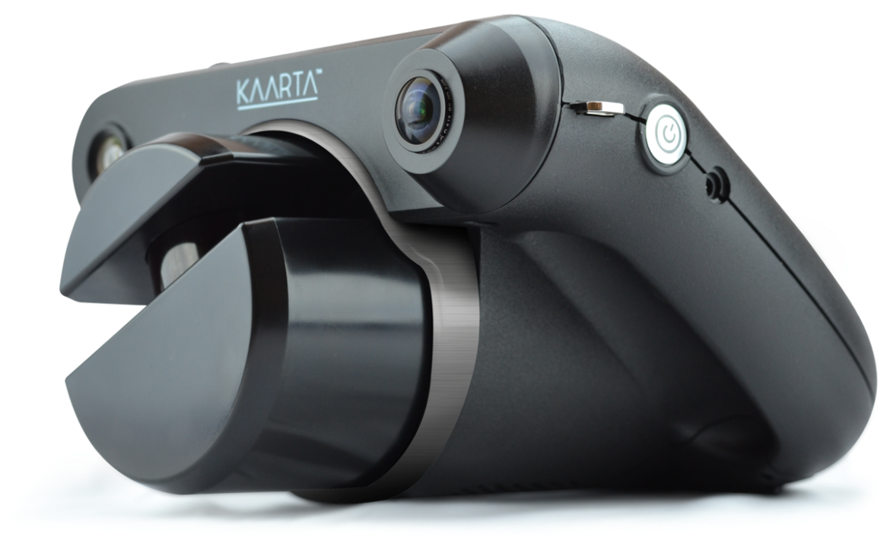
Teaming with Kaarta for rapid visualization of underground and interiors
Notes:
Brief
Cesium can also show interiors
Partnered with Kaarta to gather point clouds
See picture of hand-held device
Goal = provide first responders and military operators with tools for improved situational awareness in dense urban environments.
Very different use case – speed and key data points as opposed to detailed analytics
Data fusion (buildings and point clouds)
Less than 20 minutes per location - gathered point clouds, loaded, made available.
This space is Cesium’s office. The roof deck is a great space to gather.
We’re hiring if you’re located in Philly and looking.

Slide 6
Undersea
Coming Soon
Notes:
Brief
Still missing 75% of Earth’s surface
Anything can do above ground will be able to do underwater - 3d tiles, bathymetric data (terrain undersea)
So many use cases
Example: Maintenance of undersea cables
99% of all data on undersea fiber optic cable
More than 400 submarine cables
More than 1 km around the world
Others: mining, mapping the whale movement, the deterioration of marine life
No more restricted areas of the earth
Can’t wait to see what you will do with it
Those are some updates we’ve made for you
Here is some inspiration

Slide 7
Visualize
Compare target surface design to terrain
See where terrain is above and below the design
See changes over time
Notes:
Brief
Smart Construction = tools for digital transformation in construction
Partnering with Komatsu
Shout out to Renee at Komatsu
Visualize and analyze with Cesium to create a true 3D solution that is available on-site
Better management of progress over time
Showing combo drone surveys and designs
Illustrates how true 3d brings deeper understanding and on a timely basis

Slide 8
Human surveys of stockpiles are laborious and time-consuming
3D analysis of drone survey data is faster and much more accurate
Dependent on accurate positioning
Analytics
Accurately measure volumes of complicated shapes
Notes:
Analytics – in a web browser, real-time, GPU accelerated
Measuring stockpiles
Human surveyers slower, less accurate
Volume calculations are deeply dependent on accurate data – positionally accurately at the construction site
SmartConstruction takes advantage of quickly available drone surveys and Komatsu intelligent machine data
We’re fortunate to work with industry leaders on digital transformation, but the people that make it happen are you

Slide 9
SOCOM Hackathon
Cesium and 3D Tiles running offline on an Android phone
Notes:
Brief
Another project for your inspiration
SOCOM hackathon from end of last year
3D Tiles and Cesium running on mobile devices
Offline environment
Processed imagery, terrain and 3D buildings,
Loaded it on SD Cards
Ran it on an Android phone with GPU acceleration
No server side connection required

Slide 10
Cesium for Unreal Engine
Coming Soon
Massive real-world 3D data into a game engine
High precision globe with same accuracy as Cesium
Notes:
What has us especially energized
Cesium for Unreal Engine
Awarded an Epic MegaGrant
Working in collaboration with Epic Games
Natural place for us - intersection of computer graphics and geospatial technology.
Is personally exciting for our engineering team members and our founder and CEO Patrick Cozzi
Also exciting because it opens up VR/AR use cases
Realize the value of truly immersive 3D geospatial experiences.
Demo 1 – combo of Epic physics with real 3d buildings in position on the globe
Demo 2 – imagine flight simulators, architecture, autonomous driving simulations
We’re bringing the real world into Unreal, for you to build!

Slide 11
Sign up to try for free at cesium.com
Lisa Bos
Product Manager, Cesium
@lisabos

