Slide 1
Building the open metaverse
Rev Lebaredian, VP Omniverse & Simulation | SIGGRAPH 2021

Slide 2
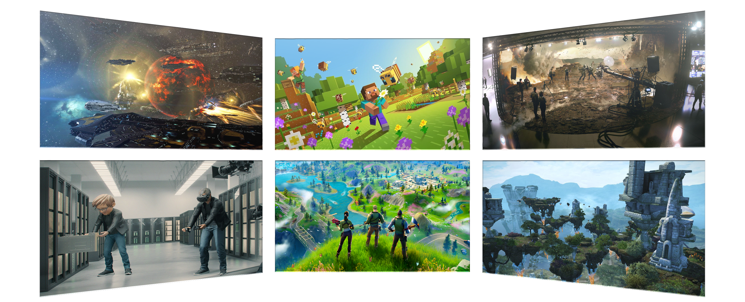
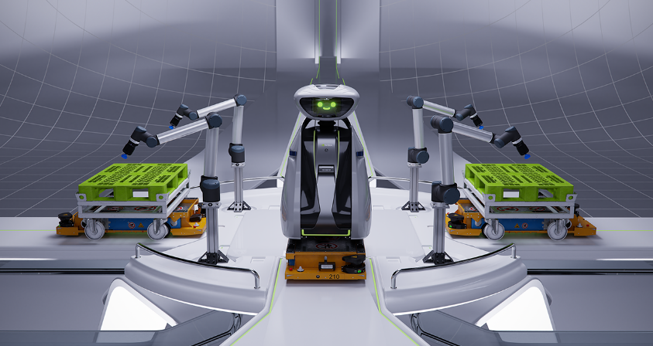
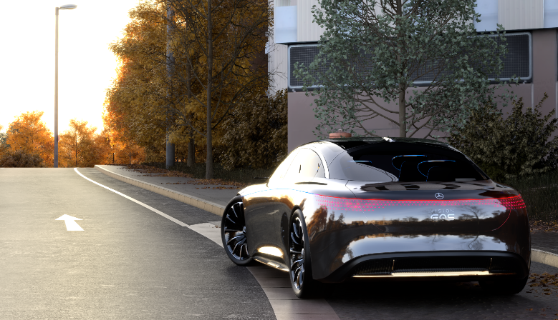
THE METAVERSE IS COMING

Slide 3
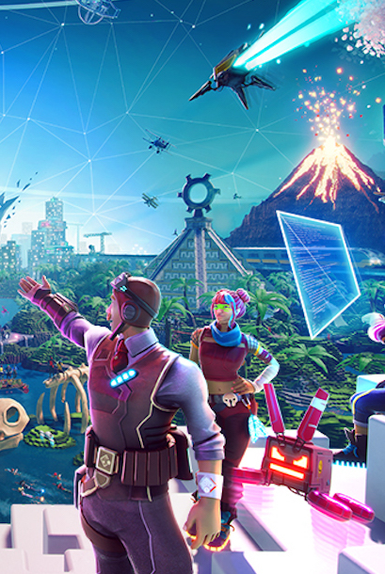
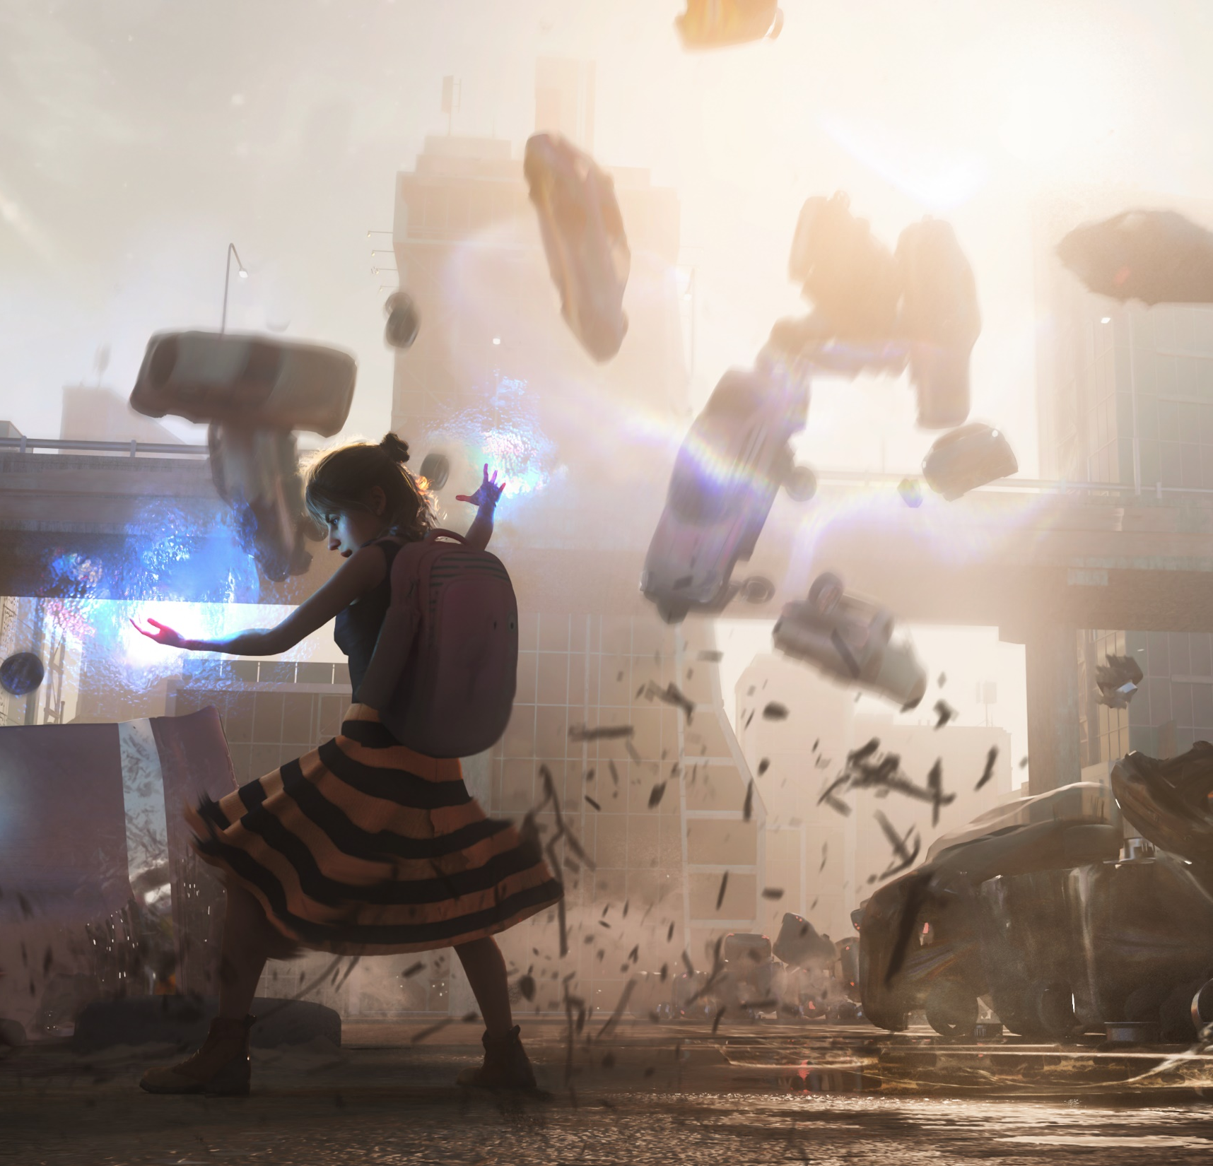

ACHIEVING OUR VISION
Identify problem statement
How can we build a truly open Metaverse?
Need better image
Evolve to a true 3D web
Swarm and adopt an open, powerful, extensible 3D scene description
Encourage connections between closed 3D ecosystems to bring users together
Accelerate adoption of open standard, open-source technologies to build trust
Made in NVIDIA Omniverse

Slide 4


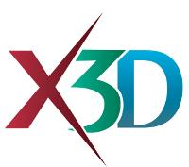

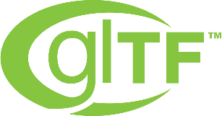
A HISTORY OF 3D-WEB INTEGRATIONS
FPO
FPO
FPO
FPO
FPO
Web3D Consortium 1994
VRML
ISO/IEC 2001
X3D
2015
glTF
W3C 2019
WebXR
2020
WebGPU
Notes:
For decades, the computer graphics community has tried to integrate 3D into the World Wide Web. Early attempts included VRML [Web3D Consortium 1994] and X3D [ISO/IEC 2001]. Today we have stan-dards like WebGL [Khronos Group 2017], WebXR [W3C 2019], glTF [Khronos Group 2017] and the coming WebGPU [W3C 2020]. But after so many years, 3D web technologies still suffer from min-imal adoption. The performance is limited, the visual quality is unimpressive, the representations are primitive, and the tools are almost non-existent. Why is this, and what will it take to for 3D to move from a web curiosity to something we all experience on a daily basis?

Slide 5
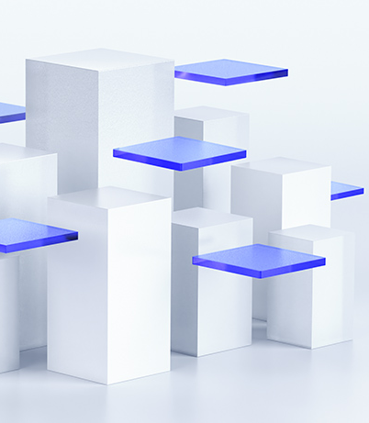
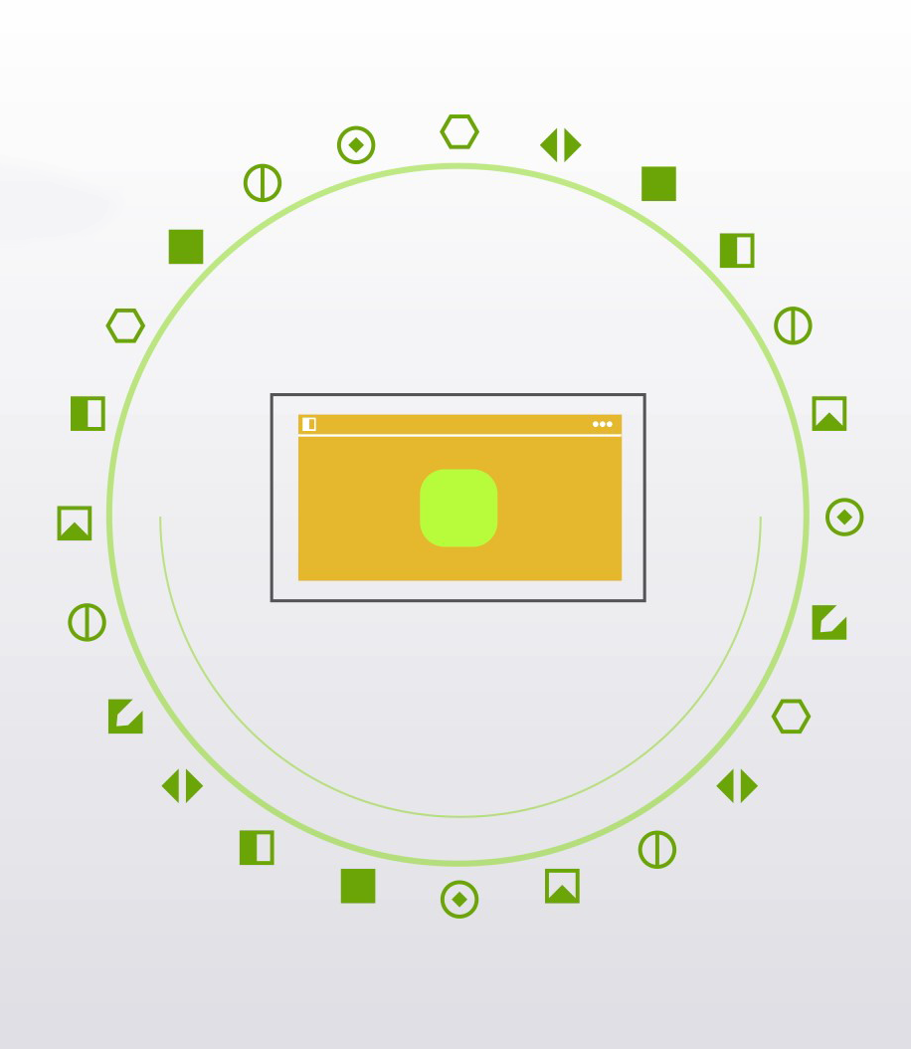
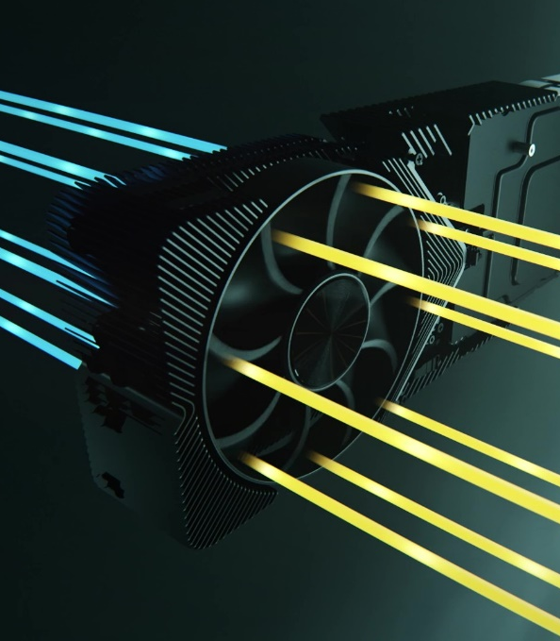
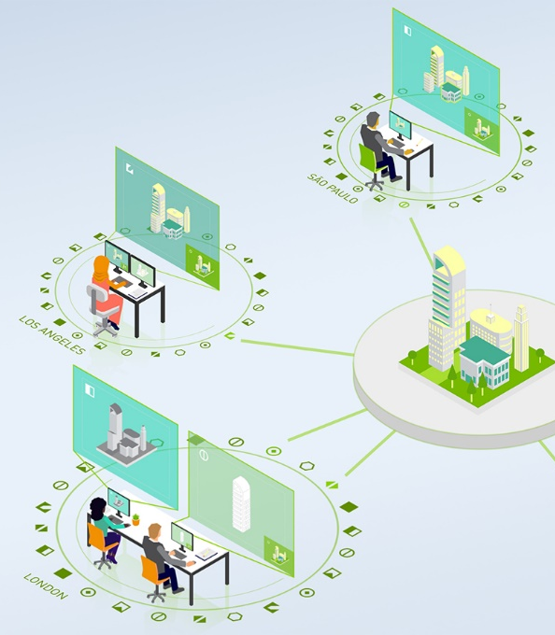
A NEW APPROACH
How NVIDIA is Solving for the 3D-Web and Enabling the Metaverse
Embed the 2D web into a powerful, extensible 3D framework
Incremental core, accelerate creation by sending only what changes
Favor powerful hardware over least common denominator
Support authoring at all times to create experiences

Slide 6
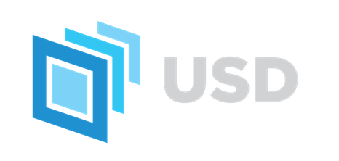
USD FOR THE VIRTUAL WORLD
A Powerful, Open, Extensible 3D Scene Description
Developed by Pixar to meet the needs of their complicated film production pipelines
Open-sourced API and file framework for complex scene graphs
Specifies a set of properties and respective values with higher level abstractions called “schemas” that attribute meaning to values
Enables simultaneous collaboration for large teams in different department working on the same scenes

Slide 7
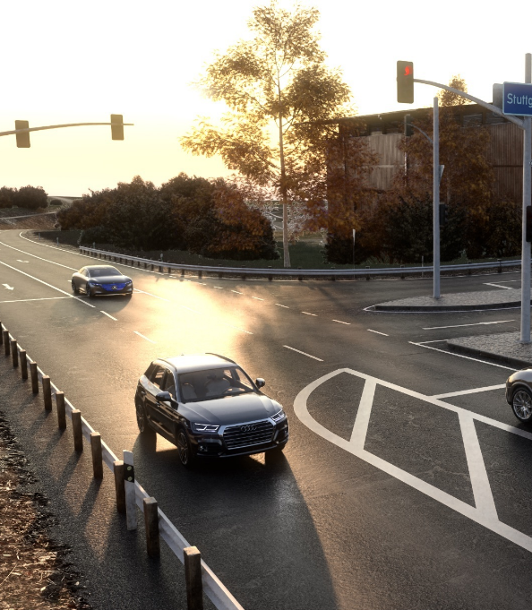

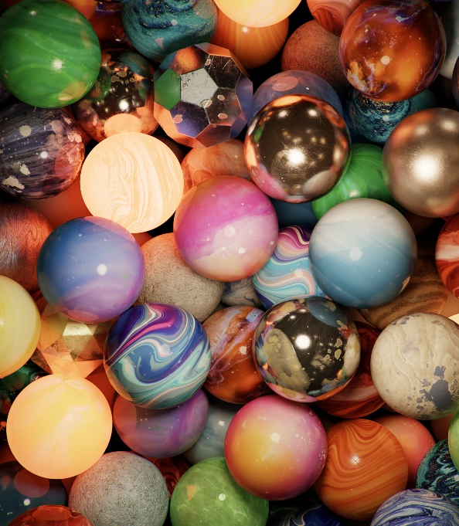
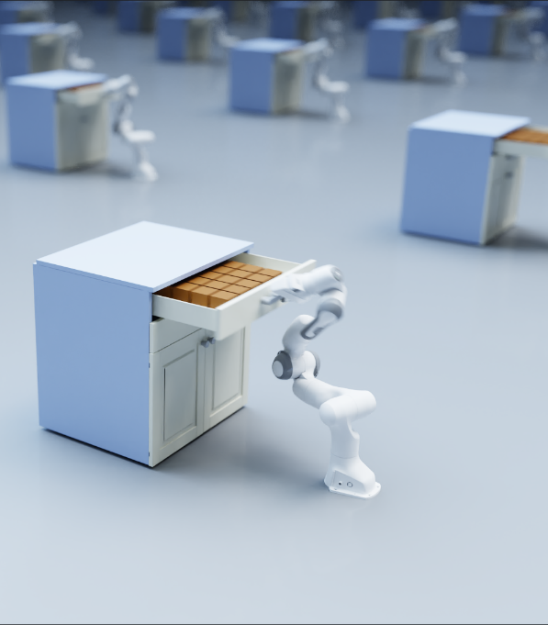
FILLING THE GAPS IN USD
Leveraging USD’s Extensibility to Add New Capabilities and Functionalities
Fast Updates
Creating code paths to enable maximum performance of dynamic updates.
Materials
Leveraging Material Definition Language (MDL) to let artists achieve maximum quality at ultra-high speed.
Procedural Elements
Using GPU-acceleration to achieve dynamic and secure proceduralism.
Physics
Integrating PhysX to ensure 3D worlds obey the laws of physics.

Slide 8
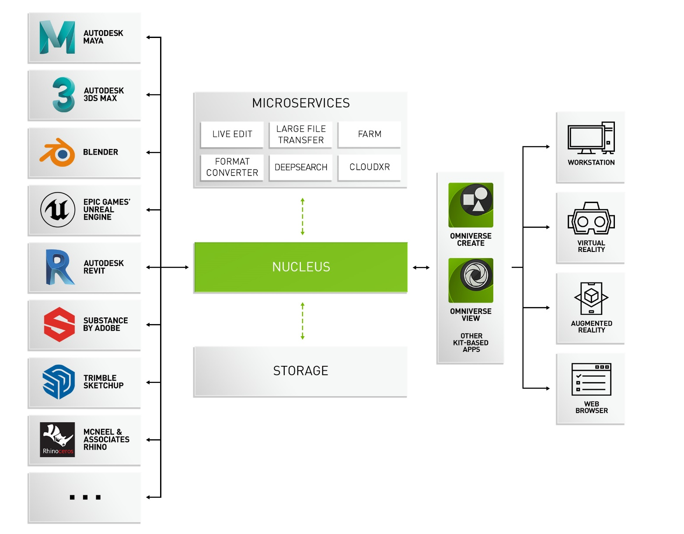
OMNIVERSE AS AN EXAMPLE OF A NEW APPROACH
Platform for Creating, Editing, and Animating 3D Virtual Worlds and Experiences

