Slide 1
BUILDING THE
OPEN METAVERSE
Vladimir Vukicevic
Director, Lightweight XR, Unity
@vvuk

Slide 2


Slide 3
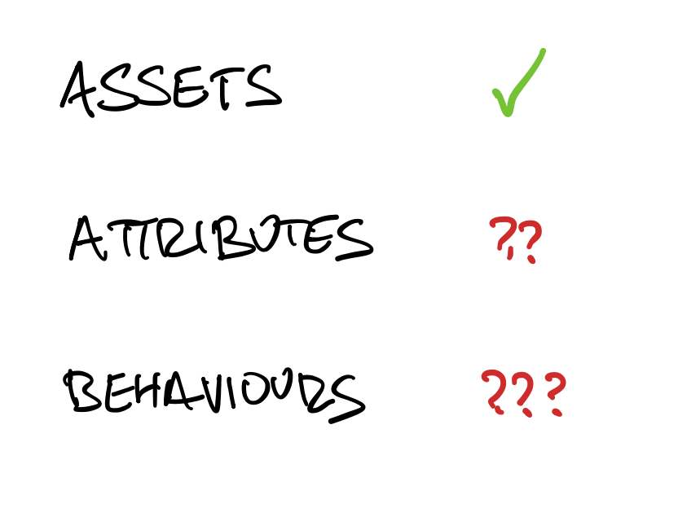

Slide 5
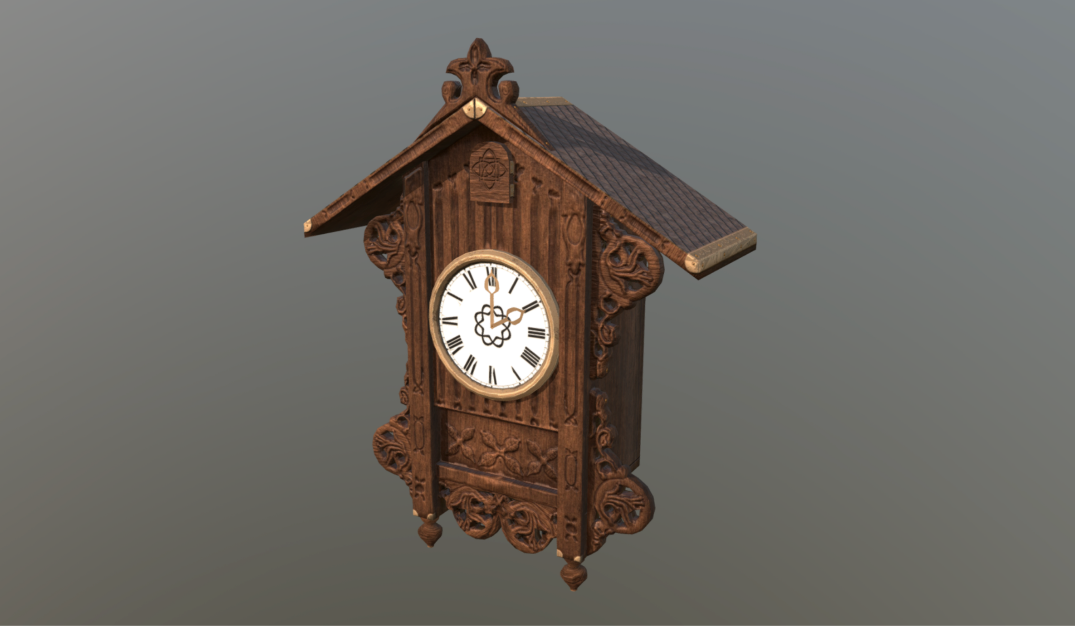
Model by FFeller on Sketchfab

Slide 6
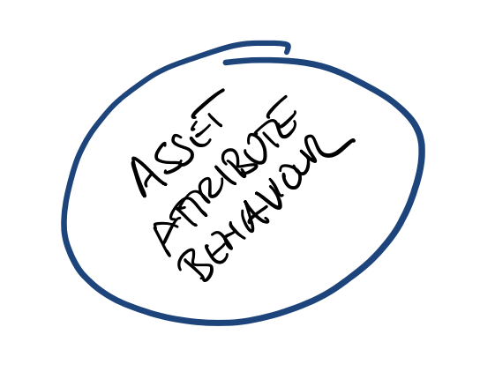

Slide 7
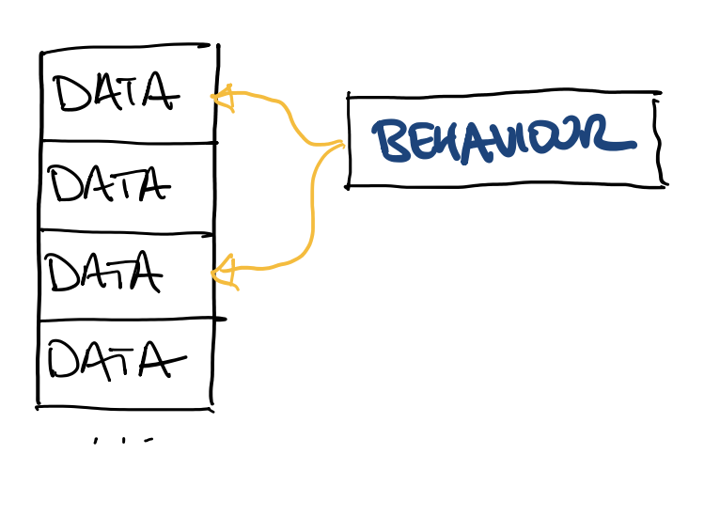

Slide 8
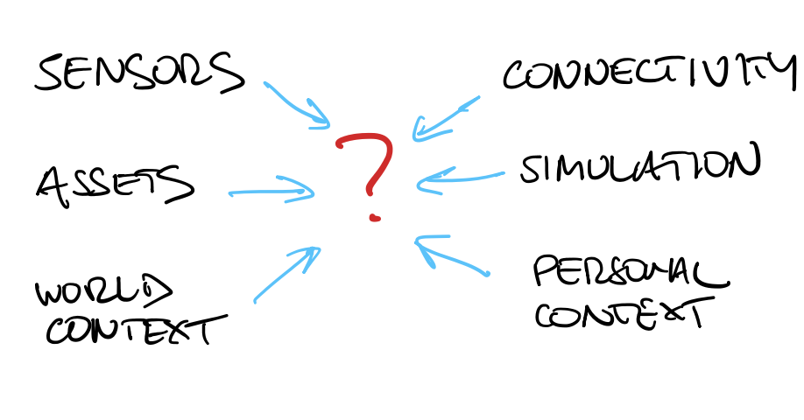

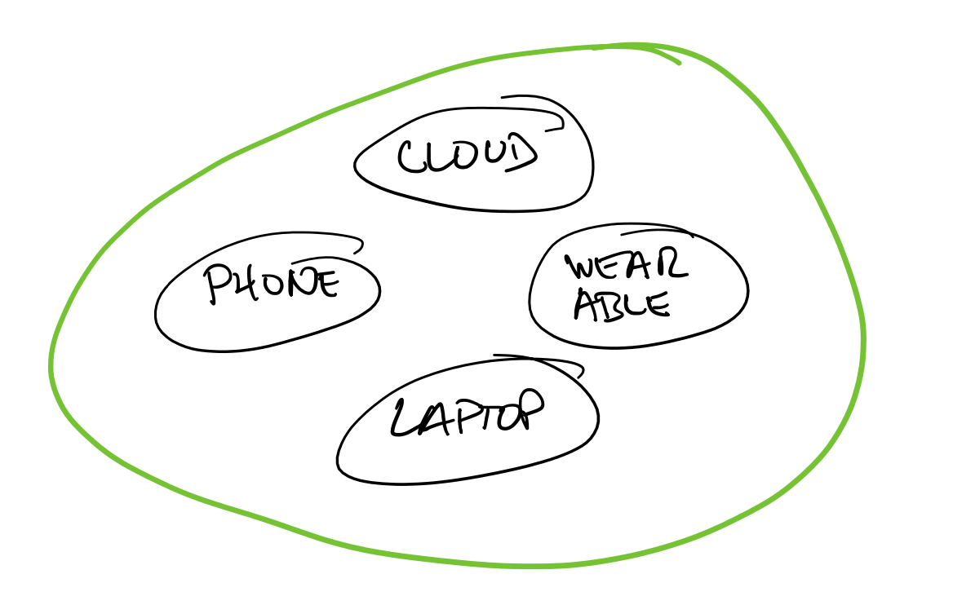

Slide 9
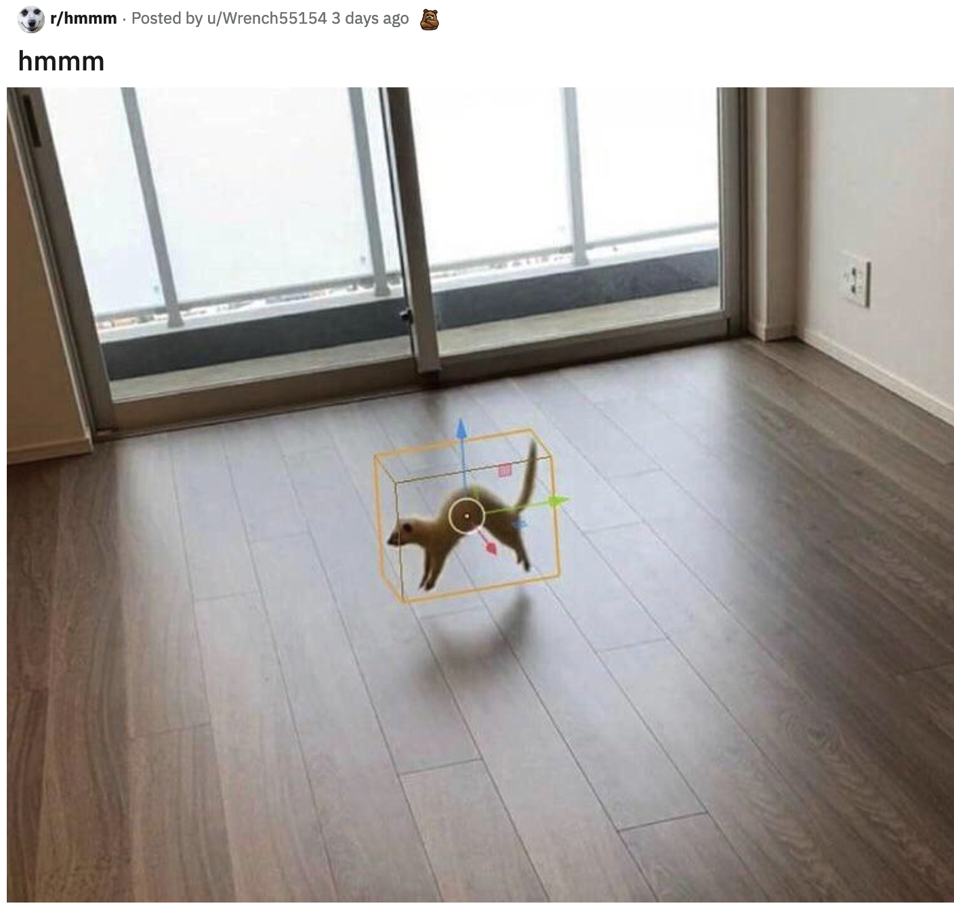

Slide 10
Thank You
Twitter: @vvuk
Email: vladv@unity3d.com

